Slide 1
CEC Student Chapter Trivia

Slide 2
Membership

Slide 3
Which Membership Category is for students getting undergraduate or graduate degrees, but have not started teaching?
Pre-Service Student
Graduate Student
Early Career
Professional
Late Career
Paraeducator
Family/Parent Affiliate

Slide 4
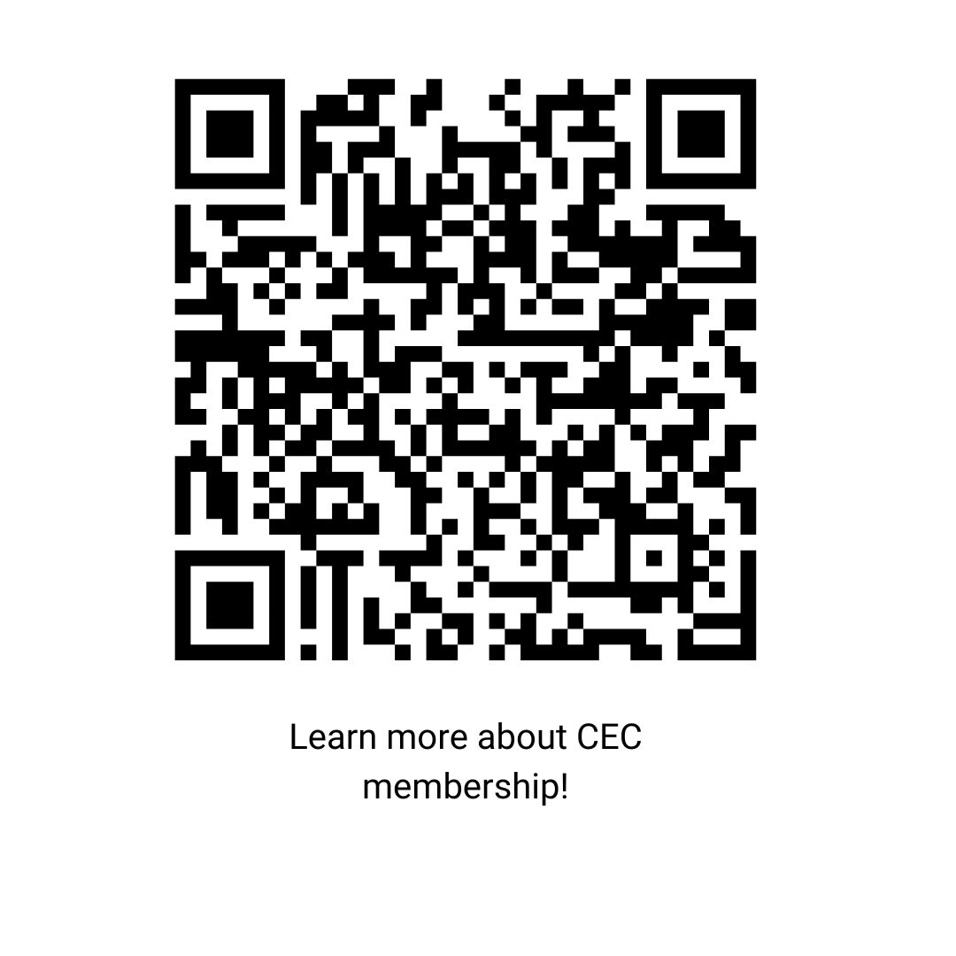
Which Membership Category is for students getting undergraduate or graduate degrees, but have not started teaching?
Pre-Service Student
Graduate Student
Early Career
Professional
Late Career
Paraeducator
Family/Parent Affiliate

Slide 5
What is the cost of membership in CEC for pre-service teachers in their final year of school?
$15
$25
$40
$0

Slide 6
What is the cost of membership in CEC for pre-service teachers in their final year of school?
FREE
$15
$25
$40
$0
Year-Long Support & Resources
Community & Connection
Professional Growth & Recognition
Notes:
The Teacher Candidate Support Network offers
Students will have access to 32 digital resources annually—including webinars, handouts, and blogs from CEC, IRIS, and CEEDAR Center—designed to support teacher candidates throughout their final year of preparation.
There are monthly “sip and chat” sessions, office hours, and networking opportunities, the network fosters a sense of community and connects teacher candidates with peers, mentors, and educators across the country.
The program helps candidates expand their professional network, apply new strategies in real classrooms, and earn a certificate of completion—which may offer future membership discounts and career development benefits.
Learn more and join here: https://exceptionalchildren.org/membership/student-membership/pre-service-student-membership/teacher-candidate-support

Slide 7
CEC membership comes with a plethora of benefits, but which one of these is NOT a member benefit for Pre-Service Students?
Professional Liability Insurance
Local and Regional Networking
Free School Supplies
Access to Professional Journals

Slide 8
CEC membership comes with a plethora of benefits, but which one of these is NOT a member benefit for Pre-Service Students?
Professional Liability Insurance
Local and Regional Networking
Free School Supplies
Access to Professional Journals

Slide 9
CEC has an online platform that allows members to communicate, share ideas, and network with each other. What is it called?
CECommunity
CEC Hub
CEC Connect
CEC Corner

Slide 10
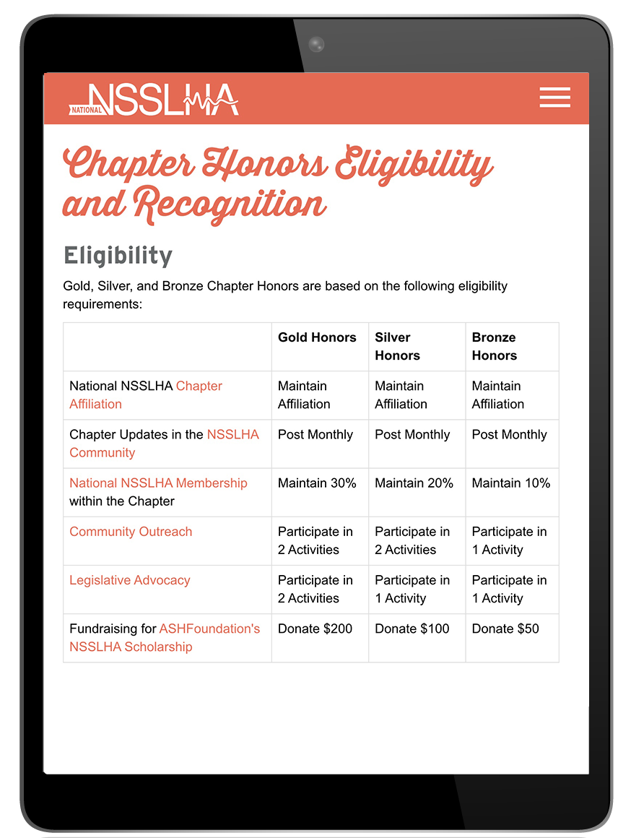
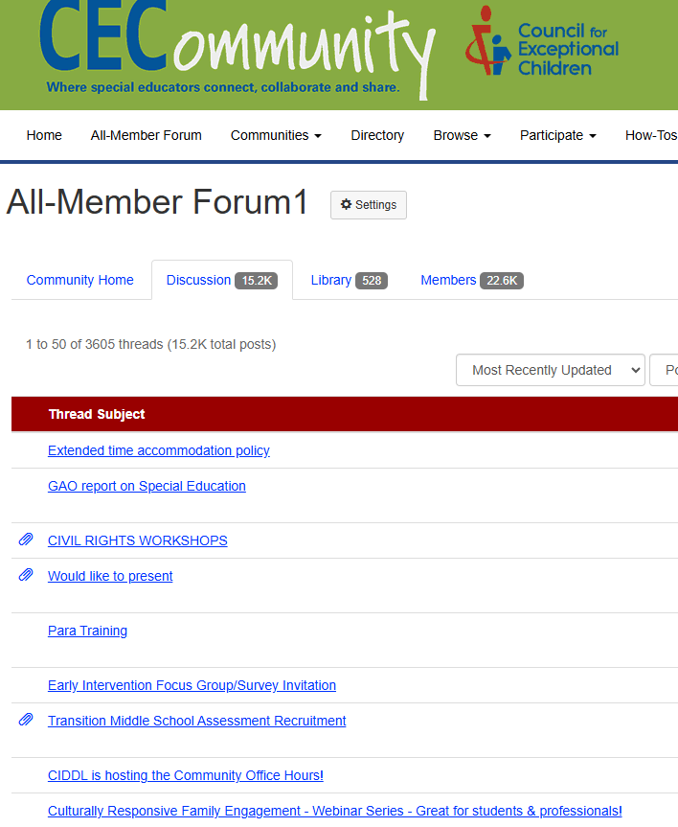
CEC has an online platform that allows members to communicate, share ideas, and network with each other. What is it called?
CECommunity
CEC Hub
CEC Connect
CEC Corner
Notes:
The CECommunity is the best way to Stay Informed & Engaged with other CEC members: You can see what hot topics there are in the All Member Forum, connect with others in your state or region, and learn from other students or early career members in the role specific communities.

Slide 11
Who governs CEC Student Chapters?
CEC National
CEC State and Provincial Units
CEC Divisions
The CEC President

Slide 12
Who governs CEC Student Chapters?
CEC National
CEC State and Provincial Units
CEC Divisions
The CEC President

Slide 13
CEC Pre-Service Student membership comes with liability insurance
True or False

Slide 14
CEC Pre-Service Student membership comes with liability insurance
True or False

Slide 15
CEC In-Dues Professional Liability Program (Pre-Service Student)
As a pre-service student educator, you face many of the same professional liability exposures as a licensed instructor. The CEC In-Dues Professional Liability Insurance benefit helps protect the personal finances and career prospects of Pre-Service Student members if named in a professional liability lawsuit.
Coverage dedicated to your protection while engaged in student teaching, an internship, or practicum.
Provides up to $1 million in protection against fines or judgments arising from a professional liability lawsuit.
Defense costs paid in addition to the limit of liability.
Satisfies the professional liability insurance requirements of education programs in many leading colleges and universities.

Slide 16
Publications & Resources

Slide 17
What CEC publication is designed to help novice teachers bridge the gap between training and classroom practice?
High Leverage Practices for Students with Disabilities
The Survival Guide for New Special Education Teachers
Practice-Based Standards for the Preparation of Special Educators
What Really Works with Exceptional Learners

Slide 18
What CEC publication is designed to help novice teachers bridge the gap between training and classroom practice?
High Leverage Practices for Students with Disabilities
The Survival Guide for New Special Education Teachers
Practice-Based Standards for the Preparation of Special Educators
What Really Works with Exceptional Learners

Slide 19
What is the name of CEC’s weekly eNewsletter?
CEC Live
CEC Journal World
Special Education Today
Special Education Yesterday

Slide 20
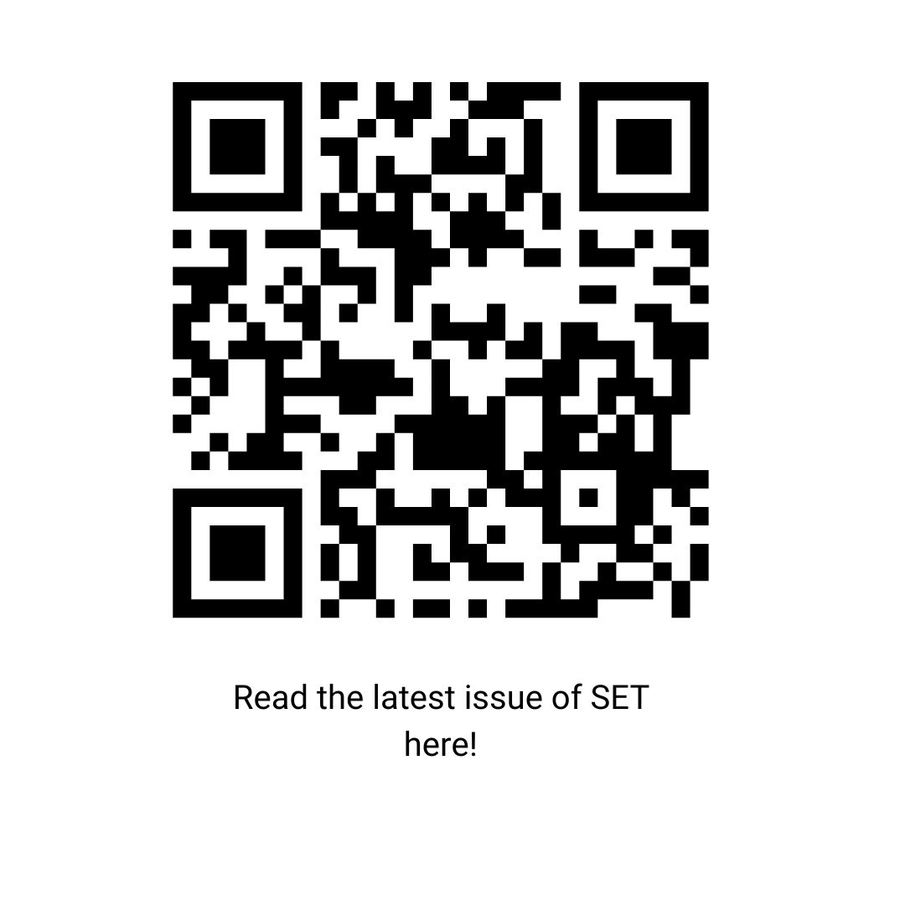
What is the name of CEC’s weekly eNewsletter?
CEC Live
CEC Journal World
Special Education Today
Special Education Yesterday

Slide 21
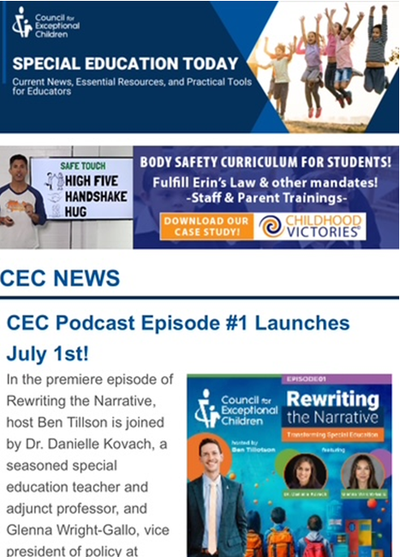
Special Education Today
In your inbox every Monday
Share impactful articles or blog posts with members to:
Highlight the article in its entirety
Share why it was helpful or how to use it
Connect members with relatable and relevant content
Notes:
The Special Education Today is CEC’s weekly publication that shares information and the best way to learn about the latest news. For example, you’ll see here in one of our recent messages we announced the launch of CEC’s first podcast episode that aired earlier this month! You can utilize content from the Special Education Today to build up your newsletters and share information with your Division & Unit members.

Slide 22
Which of the following is NOT one of CEC’s 22 High Leverage Practices?
Collaborate with Parents/Families
Provide Scaffolding
Use Flexible Grouping
Use Implicit Instruction

Slide 23

Which of the following is NOT one of CEC’s 22 High Leverage Practices?
Collaborate with Parents/Families
Provide Scaffolding
Use Flexible Grouping
Use Implicit Instruction
Notes:
High-Leverage Practices | High-Leverage Practices
•Share resources directly from the HLP Website
•Feature an “HLP of the Month” on social media or in a newsletter
•Share resources and/or modeling videos to show teachers actively modeling how to use your selected HLP
•Offer tips to building leaders so they can leverage these resources for your staff
•Support your para-members by sharing resources from the HLPs for Paraeducators resources

Slide 24
Professional Development

Slide 25
How much does it cost to attend a CEC Webinar as a member?
$0
$19
$29
$49

Slide 26
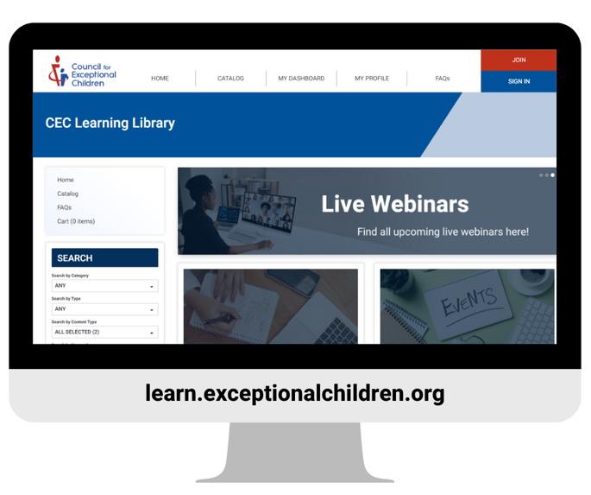
How much does it cost to attend a CEC Webinar as a member?
$0
$19
$29
$49
FREE

Slide 27
CEC has almost 300 on-demand trainings available in various formats. What is the name of the Learning Management System these are accessible in?
CEC Learning Depot
CEC Learning Library
CEC Training Library
Sharepoint

Slide 28
CEC has almost 300 on-demand trainings available in various formats. What is the name of the Learning Management System these are accessible in?
CEC Learning Depot
CEC Learning Library
CEC Training Library
Sharepoint

Slide 29
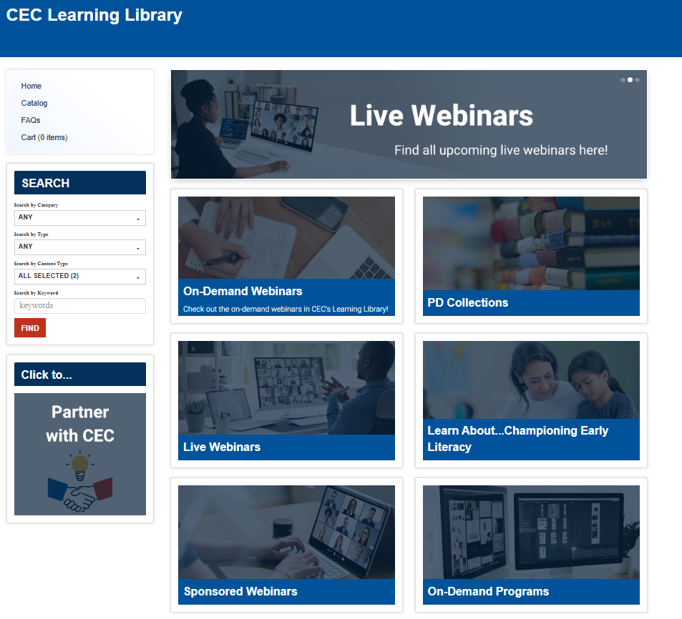

Slide 30
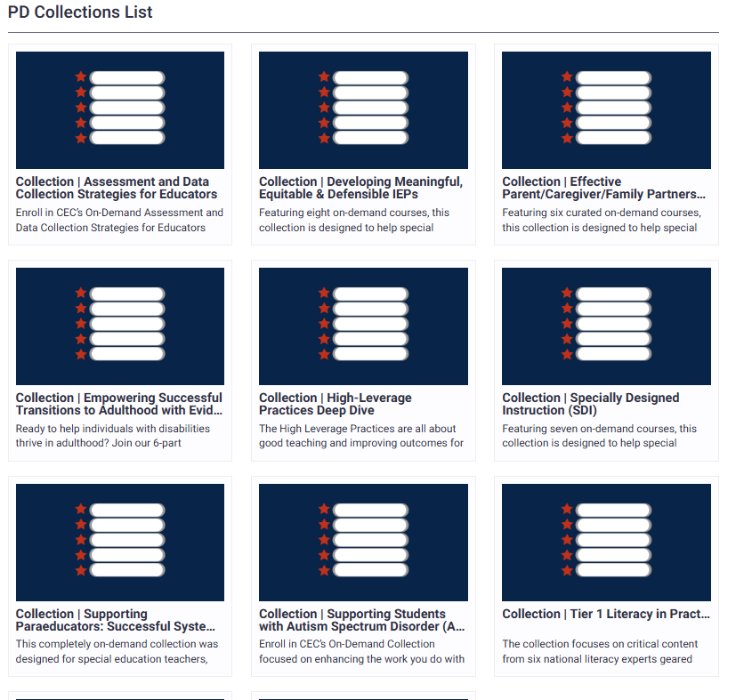

Slide 31
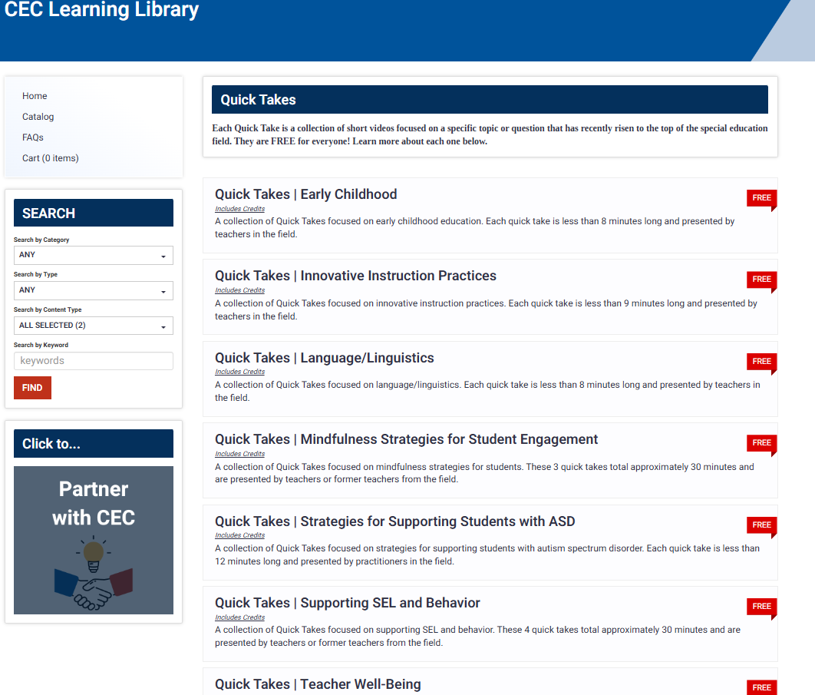

Slide 32
CEC Maintains a repository of ready-to-go resources for teachers, called the Exceptional Teachers Resource Repository—similar to Teacher Pay Teacher. Which of these is NOT true about the repository?
All resources are reviewed/vetted before being posted.
You have to pay “a la carte” style for each resource.
All documents are in Word format so you can adapt to your classroom

Slide 33
CEC Maintains a repository of ready-to-go resources for teachers, called the Exceptional Teachers Resource Repository—similar to Teacher Pay Teacher. Which of these is NOT true about the repository?
All resources are reviewed/vetted before being posted.
You have to pay “a la carte” style for each resource.
All documents are in Word format so you can adapt to your classroom

Slide 34
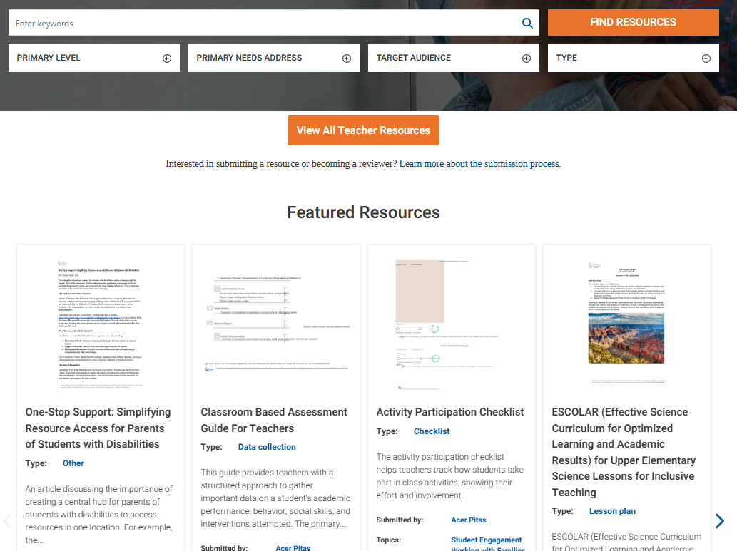
Notes:
Free as part of the Student Teacher Support Network
Includes liability insurance for all practicum
Comes with a year of support/resources
Free membership expires on July 31, 2025

Slide 35
Advocacy

Slide 36
When CEC identifies pending actions that may significantly impact federal policy, programs, or funding, it will alert CEC members and ask them to share their perspectives and expertise in order to better inform debates over such actions. What are these called?
Action Alerts
Call for Proposals
Smoke Signals
Dispute Resolutions

Slide 37
When CEC identifies pending actions that may significantly impact federal policy, programs, or funding, it will alert CEC members and ask them to share their perspectives and expertise in order to better inform debates over such actions. What are these called?
Action Alerts
Call for Proposals
Smoke Signals
Dispute Resolutions

Slide 38
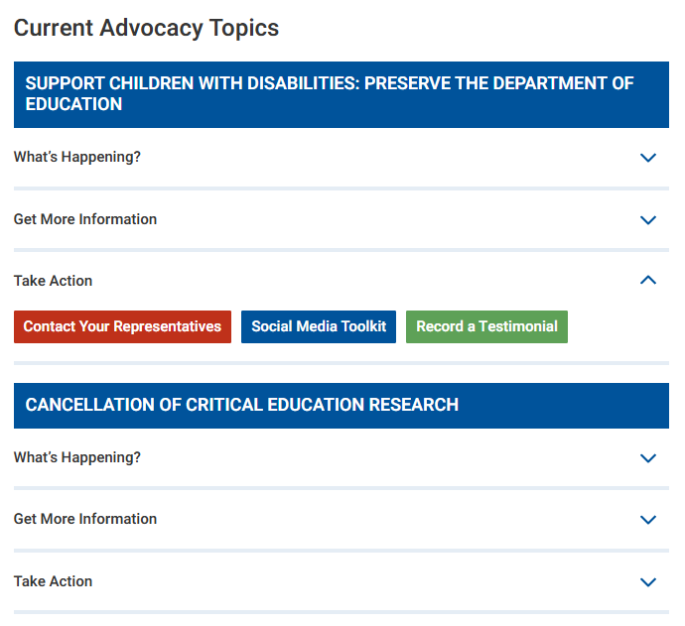
Notes:
Free as part of the Student Teacher Support Network
Includes liability insurance for all practicum
Comes with a year of support/resources
Free membership expires on July 31, 2025

Slide 39
What tool does CEC provide that allows members to create a customized State Call to Action to influence special education policy?
Advocacy Academy
Legislative Action Center
State Policy Dashboard
Public Affairs Forum

Slide 40
What tool does CEC provide that allows members to create a customized State Call to Action to influence special education policy?
Advocacy Academy
Legislative Action Center
State Policy Dashboard
Public Affairs Forum
Notes:
Before submitting your Call to Action, it's recommended to ask Kuna for resources and help reviewing or editing it!

Slide 41
Bonus Round

Slide 42
How many special interest divisions does CEC have?
12
21
18
6

Slide 43
How many special interest divisions does CEC have?
12
21
18
6

Slide 44
Add your own!

