Slide 1


The Top Ten Tips for Successful IEP Facilitation
CEC Student Teacher Resources
March 2023
Dr. Jane Strong
Middle Georgia State University

Slide 2




The Top Ten Lightning Round!
The DO’S
The DON’TS

Slide 3

The Top Ten Lightning Round!
The DO’S (Green means GO)
The DON’TS (Yellow means Caution!)
Start with positives about the student.
Speak in language everyone understands. (avoid jargon)
Treat parents and colleagues with your utmost respect and support.
Work as a collaborative team and work toward consensus.
Come prepared to your meeting and begin on time.

Slide 4




The Top Ten Lightning Round!
The DO’S
The DON’TS
Green = GO
Don’t discuss other students or disclose confidential information.
Don’t comment what is “fair.”
Don’t present parents with a completed IEP.
Don’t refuse to consider an idea or request.
10. Don’t remain silent.

Slide 5

The Details and the Nitty Gritty
The DO’S (Green means GO)
Start with positives about the student.
Suggested strategies include –
Have the upper elementary to high school student present about themselves in person or through a slide show or video.
Implement Student Led IEP processes.
Have a photo of the student present.
The Present Level of Academic Achievement and Functional Performance should begin with the student’s strengths.
Make the environment as low stress as possible with lighting and water, if feasible.

Slide 6

The Details…..
The DO’S (Green means GO)
2. Speak in language everyone understands.
Suggested strategies include –
Teachers often use many acronyms that parents are not
familiar with. Give the definition when you use it the first time.
Avoid overly technical language.
Share information in a way that communicates you want everyone to have a clear understanding of the topic, issue or goal.
Maintain fidelity to the specially designed instruction of the IEP.

Slide 7
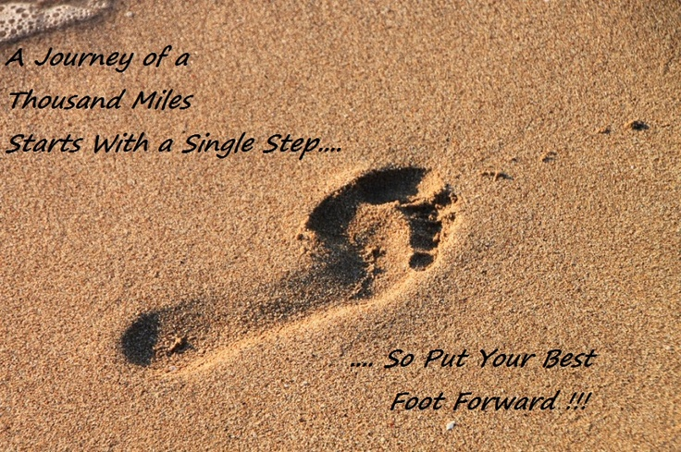
The Details…..
The DO’S (Green means GO)
3. Treat parents and colleagues with the utmost respect and support.
Suggested strategies include –
You always set out trying to be professional, but this is your reminder to “put your best foot forward.”
Parents are often feeling emotional so offer
sensitivity and support.
Have tissues available.
Take a break if things are extra emotional.

Slide 8

The Details…..
The DO’S (Green means GO)
4. Work as a collaborative team and toward consensus.
Suggested strategies include –
Consensus is consideration of everyone’s opinion in a fair and open process.
Does not require unanimous agreement but could you “live with it”?
Parents are your partners and members of the team.
Sometimes we cannot find consensus and there are ways for dispute resolution.
Ensure all areas of need have appropriately ambitious and measurable annual goals in IEP.

Slide 9


The Details…..
The DO’S (Green means GO)
5. Come prepared to your meeting and begin on time.
Suggested strategies include –
Have the right number of chairs.
Ensure office staff can direct parents to the meeting room.
Have copies of draft information ready for everyone.
Ensure you have a printer hooked up.
Professionals begin on time and portray efficiency.
Be sure to calendar your annual dates and plan ahead!

