Slide 1
Components of a Sustainable Committee Structure
Danielle Wieczorek
Brannan Meyers

Slide 2
In this breakout session, we will:
Demystify the act of delegation and explore its many benefits
Identify the barriers that prevent us from “letting go” and explore tips for overcoming them
Identify the “types” of committees that can be leveraged and the benefits of each
Review the core components of successful committee structures and practices
Access committee planning tools and resources to drive your component's success

Slide 3



Delegation:
Supports Sustainable Practices
Drives Success
Balances Workload & Structure

Slide 4

Delegation is TOUGH.
Why is that?
This Photo by Unknown Author is licensed under CC BY-SA-NC

Slide 5
Common Rationale:
Fear of failure
Loss of control (or the conception/fear of losing control)
Inaccurate/ineffective work leading to:
  Work carried out correctly
  Delayed timeline
“I’ll do it better.” “I can do this.” “This is my ‘baby!’”
Reluctance to let go of what they know best
Inability to identify suitable tasks/don’t know where to begin
Notes:
Effective delegation can be hindered by a number of barriers, including:
Fear of losing control
Delegators may worry that tasks won't be done correctly or on time if they delegate them. However, delegation can be a vital part of a role.
Lack of trust
Delegators need to trust that their team members can complete tasks, and team members need to trust that they'll be allowed to do so. Micromanaging can destroy trust and discourage accountability.
Lack of confidence
Delegators may lack confidence in their employees' abilities or in themselves. Subordinates may also lack confidence and fear making mistakes or getting in trouble.
Attitude
Delegators may hold onto the idea that they must do everything themselves, or that they'll do it better.

Slide 6
This hurts EVERYONE
Develops a lack of trust/confidence in others, which:
  Leads to micromanagement (which can destroy trust and discourage accountability)
  Reinforces a lack of confidence within the team
  Contributes to a culture of fear around making mistakes or getting in trouble
  Discourages opportunities for peer-to-peer accountability
  Takes away growth opportunities for others
  Discourages partnership and creates silos
  Negatively impacts volunteer bench/pipeline

Slide 7

Demystify and Overcome

Slide 8
Fear of Failure?
Ask & assess:
  What if they fail?
  What if something new is discovered?
Permission to fail
Failing forward

Slide 9
Overcoming Fear of: Loss of Control
Establish and document clear expectations (deadlines, duties, responsibilities, resources to leverage)
Shift focus from processes to outcomes
Establish check-in and support structures
Build tools and resources with them
Ensure you are an accessible safe space – they will come to you when they need you

Slide 10
Overcoming Fear of: Only I Can Do It
Ensure they understand the vision and purpose (what and why)
Align tasks and responsibilities to their interests, talents, and skills
Autonomy leads to sense of responsibility
Empower>Enable

Slide 11
Benefits of Delegation
Improved efficiency
Better (and more) resources and tools
Engagement increases
Collaboration increases
Creativity increases
Trust increase

Slide 12
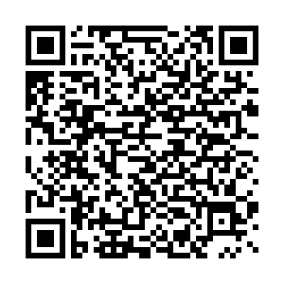
Successful Practices
Committee charge/description
Shared committee and board understanding of:
  Responsibilities
  Authority and decision-making power within the committee vs. proposals to board
Recommended structure and roles

Slide 13
Provide Resources and Onboarding
Meet the board and build relationships
How the board functions and individual roles
Contextualize the purpose behind committee, its formation, and its charge
Provide description and committee charge
Written and detailed timeline and expectations
Templates:
  Reports to the Board
  Agendas
  Meeting minutes

Slide 14
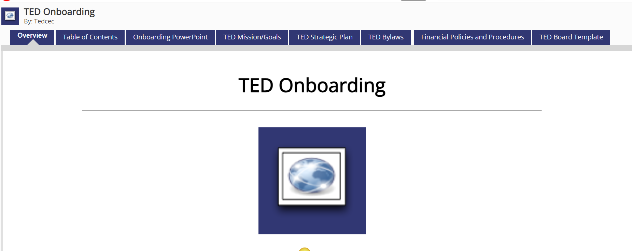
Onboarding

Slide 15
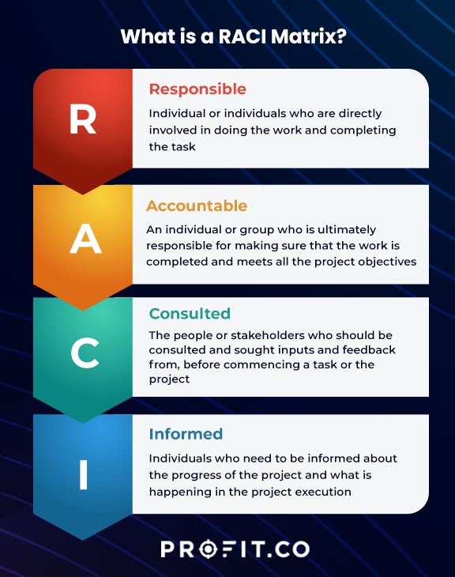
Additional Tool:
RACI Chart
Notes:
RACI project management to define roles and responsibilities for each task, project, program, etc.
https://www.profit.co/blog/task-management/raci-chart-and-its-use-in-project-management/

Slide 16
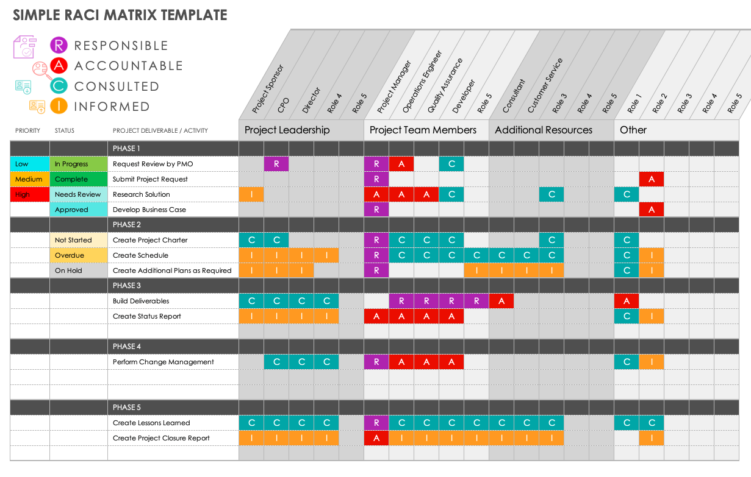

Slide 17
How to Use RACI Charts
Board Responsibilities:
Projects/tasks (Ex: Elections, newsletters, etc.)
Use for operational responsibilities (Ex: annual budgeting responsibilities)
Committee support/responsibilities
  Build out committee RACI
Committee Responsibilities:
Board reporting
Outline authority
Reiterate committee charge and responsibilities
Detail individual vs. collaborative items

Slide 18
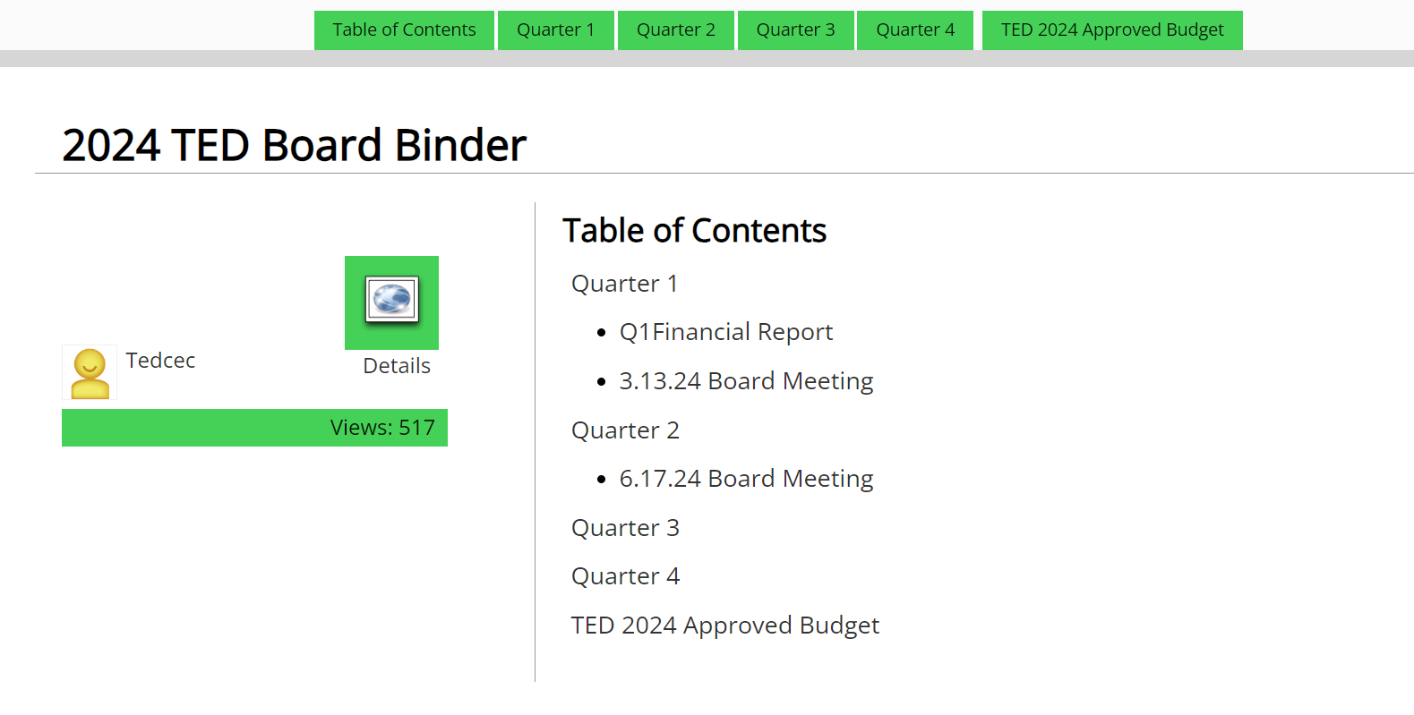
TED Resources Example

Slide 19
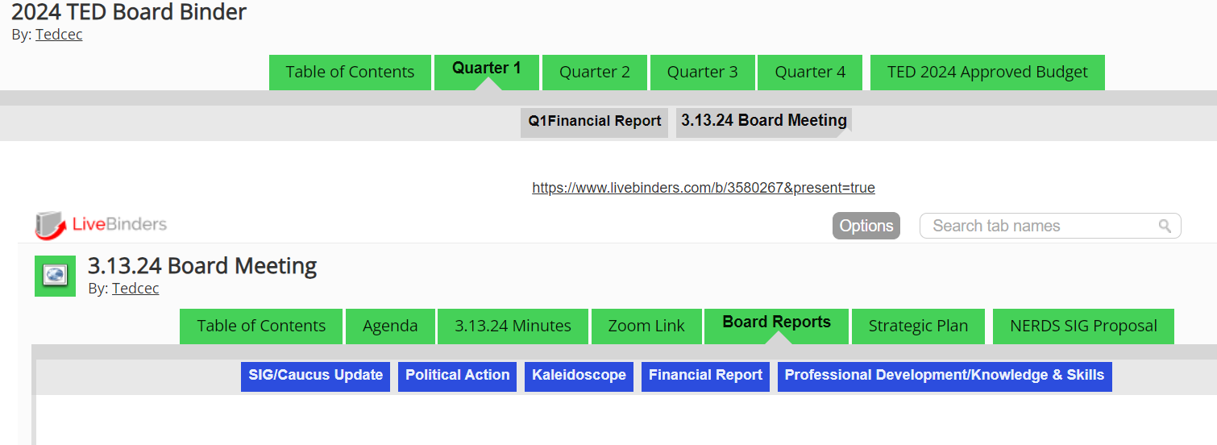
TED Resources Example

