Slide 1
Facilitating and Nurturing the Volunteer Experience
Danielle Wieczorek

Slide 2
Why this topic?
Members first
Most intimate of membership experiences
Personal growth that cannot be achieved without this experience

Slide 3

And most importantly, if not here…

Slide 4
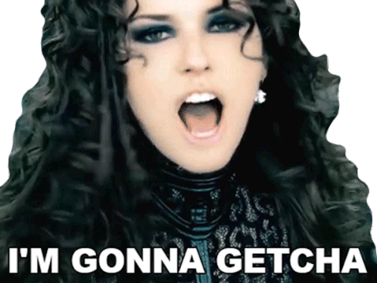
Notes:
Today, we’re going to discuss how you can get ‘em, support ‘em, and keep ‘em…. Before they walk away and say

Slide 5


Slide 6
Where did your CEC volunteer experience begin?

Slide 7
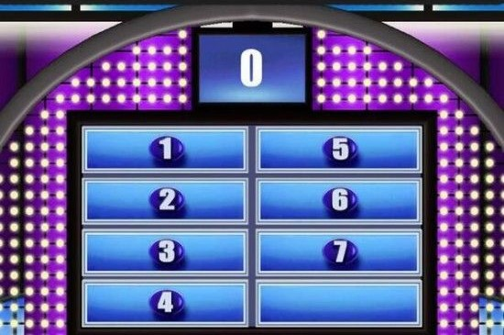
Raise your hand if you said…
Local Chapter
Student chapter
State or provincial Unit
Sub-division
Division
Informal volunteer role
Other

Slide 8
What if I told you that you were wrong?
…or kinda wrong, anyways.

Slide 9

It starts with the connection.

Slide 10
Every person, every interaction, every time.
Notes:
24/7 recruitment – balance hunger and hunter
Each person has potential – seek potential, not persona
Make the connection

Slide 11
Stewardship of Volunteers
Caretaker
Manages materials and resources
Supervise/support the experience
Creates connections

Slide 12
Little Things are BIG THINGS!
Follow-up on emails regarding interest (including Volunteer Square)
Thank those who give time
Seek to understand their interests, skills, talents, and personal growth goals
Discuss their professional growth and goals

Slide 13
What should we learn about them?

Slide 14
Motivation
What makes people want to get involved with your organization?
Do they have a personal reason for joining your volunteers?
Are they looking for a purpose, or do they have more time on their hands?
Are they looking for a career in your field and trying to make contacts?
What motivation tells us:
Helps us conceptualize a realistic idea of the person’s level of commitment
Aids in informing their placement/role in your organization

Slide 15
Goals and Outcomes
What do they hope to gain from volunteering:
Personally?
Professionally?
What skills are they looking to develop or refine through their experience?
What strengths or talents do they hope to exercise?
Do they have long-term goals outside of our component?
What goals/outcomes tell us:
Helps us understand where weaknesses may lie and their desire to grow
Can inform future mentoring opportunities
Can inform future sponsorship opportunities
Better understand how their strengths can be leveraged to support the component and the talents of others

Slide 16
Organizational Benefits of Volunteer Stewardship
Contributes to success and effectiveness in achieving goals and mission
Fosters a rewarding experience for volunteers
Enthusiasm, commitment, and motivation are amplified through engagement
Leads to improved retention and the utilization of each volunteer's unique skills, talents, and resources to maximize impact

Slide 17
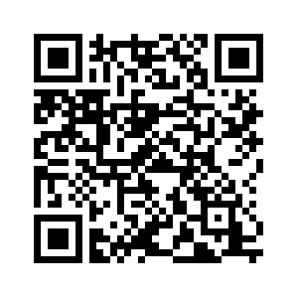
The 4 Pillars of Volunteer Stewardship (We’re reviewing 3 ☺)
Article from Volunteer Hub by Eric Burger

Slide 18
Pillar 1: Recruitment and Onboarding
Effectively recruiting and onboarding is necessary for volunteer stewardship because:
Sets the stage for your volunteers to have a positive experience, which is key for retention and maximizing impact
Recruiting well-suited volunteers and providing in-depth onboarding, raises the likelihood of long term satisfaction and engagement
Demonstrates your commitment to them and their talents
Reinforces senses of loyalty and belonging

Slide 19
Onboarding Tips
Start with introductions
Review board/organization’s culture and values
Use a shadowing schedule
Teach the technology
Define the roles and responsibilities of each volunteer; consider component’s needs in building these
For onboarding, you should set clear expectations and provide your volunteers with detailed overviews of their roles and responsibilities.
Offer comprehensive training and orientation sessions so your volunteers can learn more about your mission, values, procedures, policies, and specific tasks.

Slide 20
Pillar 2: Training and Development
Training and development play several major roles in stewardship, including:
Provides volunteers with the knowledge, skills, and confidence to perform their roles
Enhances volunteer contributions to the organization
Demonstrates your commitment to supporting their growth
Keeps them engaged for better retention rates.
Empowers them to tackle new challenges, take on leadership roles, and make more meaningful contributions to the organization's mission

Slide 21
Training/Development Tips
Offer hands-on training and learning to build confidence (ex. Prepare a board update, pull membership lists, etc.)
Create/update manuals or online resources for future reference
Collaborate with CEC staff to assist with niche training topics

Slide 22
Pillar 3: Support and Recognition
Provide a supportive environment
A culture of support and appreciation attracts new volunteers and aids in volunteer retention Supported, recognized volunteers become advocates for your organization, promoting the activities and mission to others

Slide 23
Support & Recognition Tips
Make sure volunteers have access to everything needed to perform roles effectively
Recognize past volunteers at events and/or online
Offer flexible scheduling options
Show gratitude with handwritten notes
Establish a formal recognition program or an award system to honor exceptional volunteers

Slide 24
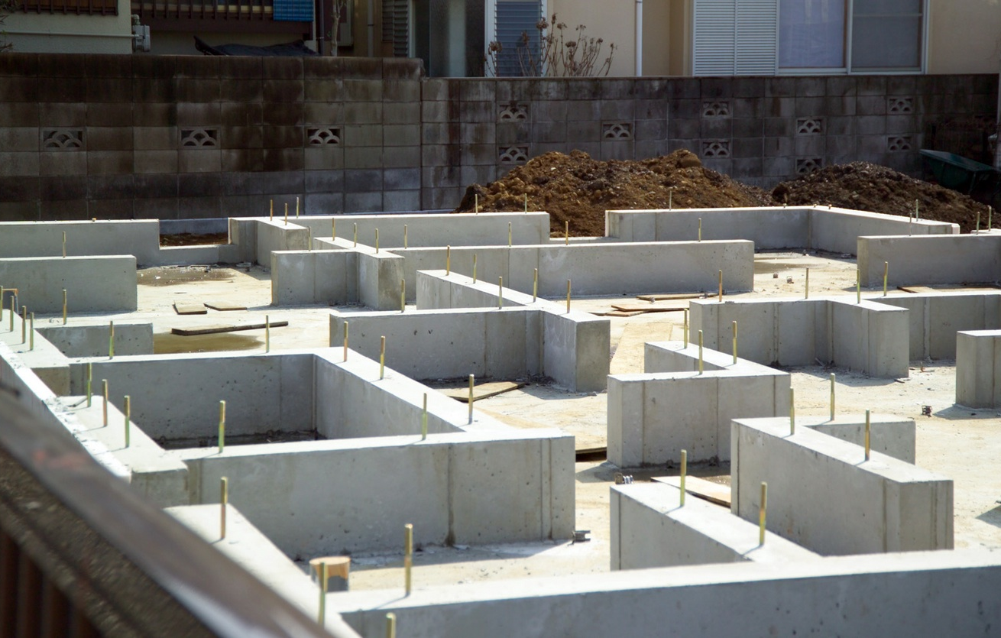
Lay the foundation during recruitment efforts.
This Photo by Unknown Author is licensed under CC BY-NC

Slide 25
Recruitment Dos
Host engagement events like informational sessions
Make details about the roles available and election/appointment cycles accessible through your website
Streamline your application process
Provide a reliable contact person
Provide job descriptions
Include realistic time commitment expectations

Slide 26

Recruitment Boo-Boos
Lack of transparency regarding pre-requisites
Out-dated bylaws hindering accessibility
Cold board/volunteers
Out-of-date contacts
Unrealistic job responsibilities and time commitments
Lack of follow-through
Uniformed membership
This Photo by Unknown Author is licensed under CC BY-SA

Slide 27
Tools & Resources
CEC Support (Unit Town Hall PowerPoint)
Board Meeting Basics
Instructions for Pulling Division Membership Reports
Instructions for Pulling Unit Membership Reports
BoardEffect Roberts Rules of Order Cheat Sheet
Volunteer Job & Committee Description Templates
Avoiding Legal and Financial Pitfalls Training Resources
Recruiting and Supporting New Volunteers
Notes:
CEC Support (Unit Town Hall PowerPoint)
PPT includes all details regarding staff support and resources for components. Topics covered include: new member onboarding basics, volunteer recruitment, Volunteer Square, and repackaging CEC resources for your members.
Board Meeting Basics
Originating from the 2023 Leadership Institute, this document covers all "basics" of board meetings! Topics covered include best practices, minutes, officer reports, improving meetings, consent agendas & how it can help your component, agenda outline, motions/voting related to Roberts Rules, and more! – Can adapt into your own training

Slide 28
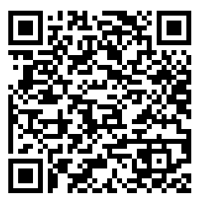
View resources:
THANK YOU!
Components Team: components@exceptionalchildren.org

