Slide 1
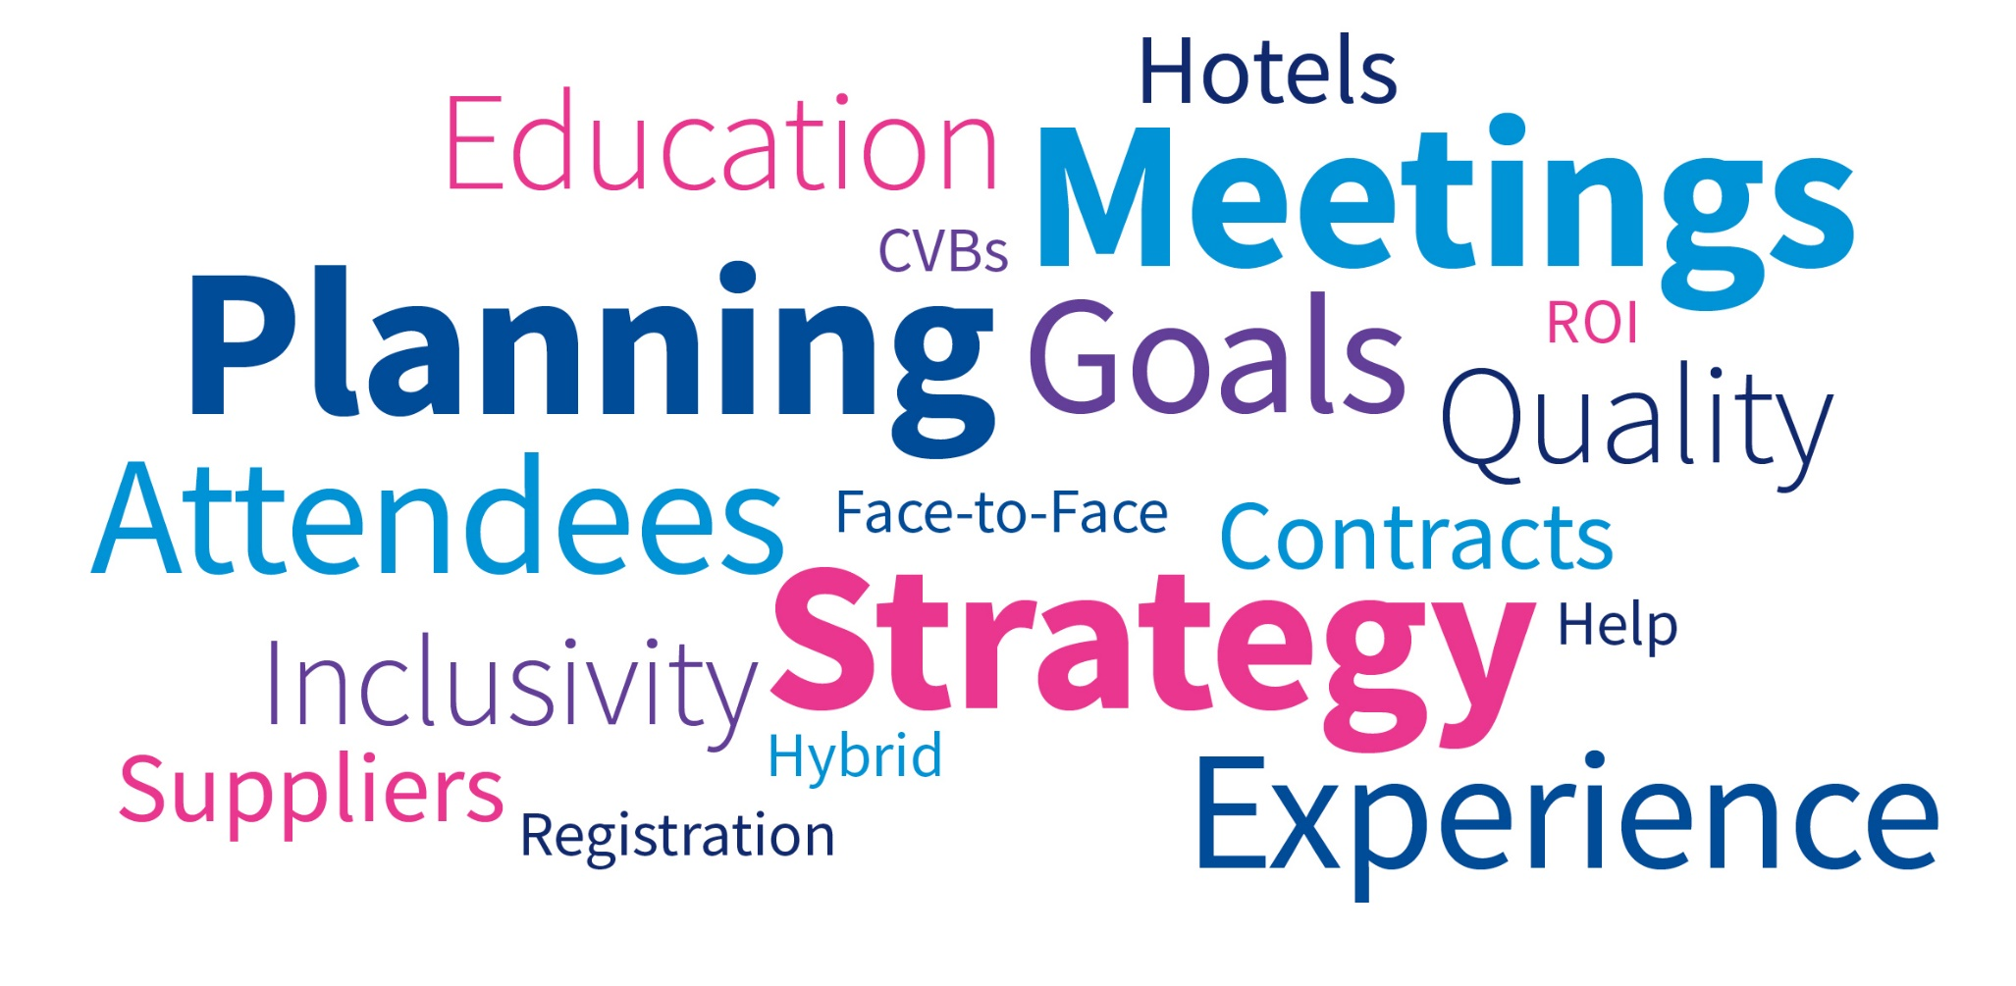

Slide 2
Today’s Goals
To provide tips on running an event including:
  What you should consider when bringing groups of people together:
    The goal of the event
    The “B” word
    Education
    Create memorable, favorable experiences
    Connection and networking opportunities
    Details to consider
    Sponsorship overview
Notes:
Melissa
tips on running an event including: determine the “why”, setting a budget, picking a location, sponsorship opportunities, and more. We encourage you to ask questions throughout the presentation.

Slide 3
Resources
Who should you work with? Who can help?
  CEC headquarters
  Destination CVBs
    A CVB is a Convention and Visitors Bureau or tourism bureau. These organizations provide education and resources to local communities and travelers with the aim of promoting travel to a location, events and conventions in the area, and other hospitality business.
    http://www.cvent.com/rfp/convention-visitors-bureau-directory-ee12b9994b424e4f91f7d48ae60d170c.aspx
  National Hotel Sales Contacts/Partner
  Leverage relationships, big picture opportunities; CEC has Global Representation with Hilton, Hyatt, Omni and Marriott Hotels
  Leverage your CEC relationships and be knowledgeable on where other Units and Divisions are holding their events
  DMC’s
  Local Planning Committee
  Local Schools
Notes:
Sharyn Start, Be transparent…with CVB’s & Global Sales Partners they should be client advocates, increase engagement with hotels, connect you with key contacts, advocate for your organization connect your event with the spirit of the location.

Slide 4
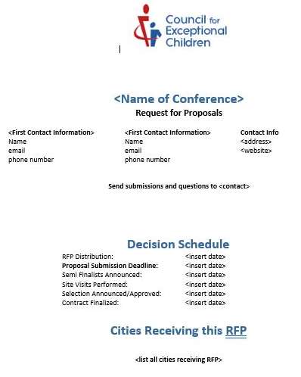
RFP Template
Notes:
Melissa
Example of an RFP template. Make sure to include important information and past history from the event including hotel pickup and F&B history.

Slide 5
Planning Your Event
Establish Goals and Objectives
Type of Meeting
  Face-to-Face
  Hybrid
  Digital/Virtual
  Revenue Generating
  Educational
  Social, Networking, Engagement
Target Audience
Content Delivery
Attendee Experience
What does success look like?
Notes:
Melissa- determine the “why” Goals for organization and attendees,
Sharyn- what type of meeting, will educational credits be offered?, ROI for success

Slide 6
The “B” Word - Budget
Set financial goals for meeting
  Profit goal: Revenue exceeds expenses
  Break-even goal: Revenue equals expenses
  Deficit goal: Expenses exceed revenue
Creating a budget
  Incremental budgeting: using previous year’s meeting history
  Zero based budgeting: no past history
Budget elements
  Revenue: registration fees, exhibitor/sponsorship sales, merchandise
  Expenses: Fixed versus variable costs
    Fixed: AV, meeting space rental, security
    Variable: Food and Beverage, specialty items (swag bags), hotel rooms
Notes:
Melissa- establishing a budget, what are the organizations goals, do you have a past information on total spent or is it a new event/meeting? Do you know what your fixed costs are? How many attendees are you estimating for?

Slide 7
Attendee Experience
You have your goals and objectives – now think about your attendee.
  What does that experience look like?
  What is the lifecycle of the event
  How do we communicate with individuals throughout the year?
  Ask Why?
Notes:
Sharyn Start – I included this as we believe that a meeting is no longer space, rates and dates. Same old, same old is not going to work. When I discuss experience – it starts from when the event is announced, when the attendee goes to register, sign up for sessions, marketing the event, communications to the attendee, the know before you go is a good example, to the end of the event, and how far are you taking that event into the future.

Slide 8
Location, Location, Location
Things to consider when choosing an event location:
  History of your event (where have you already been)
  Survey results
  Geographically attractive/desirable/will it sell
  Safety first
  Politically correct
  Perception
  Convention Center/multiple hotels/under one roof
  Off-site venues
  Affordable
  Walkable
  Attractions
  How will the destination support your event?
Notes:
Melissa Start
You understand type of event, goals and objectives, attendee experience – now let’s talk about the details to consider when choosing an event location. Your attendees should be top of mind when considering all of these details.

Slide 9
Hotels
Things to consider when choosing hotels:
  How many guest rooms does your event need?
  How much meeting space/exhibit space do you require?
  Room set up?
  Does the hotel contain your event? Overflow?
  Big Fish
  How far out are you booking your event?
  Special accommodations?
    VIPs
    Sub-blocks
    Student blocks
    ADA rooms
    Suites
  Date flexibility?
  Concessions & comps
Notes:
Sharyn Start….service, you’ll get a good indication during the RFP, site selection process, meet and or interact with as many people at the locations being considered

Slide 10
Hotel details…details…details…
Set-up
  Will all of your meeting rooms stay the same throughout the event? If not, will the venue charge to change the set-up?
  Will you need rooms locked (staff offices, expo hall, etc.)?
Wifi
  Is Wifi provided in meeting rooms and public areas? If not, what is the cost?
AV
  Are you allowed to bring in your own AV, or is there a company you must use?
Electrical
  Will you need extension cords, power strips, etc. at tables or at registration? Will there be a charge for those?
Partners
  Who are they at the venue, can you bring in outside partners?
Notes:
Melissa Start
Here are some common items when planning and contracting meetings. Many of these items can be noted in the RFP and negotiated during contracting.

Slide 11
It’s all in the details…..
Registration
Sponsor/Exhibitor/Display tables
Staff office/storage
  Is storage close enough to wherever you need to move your boxes, or do you have a dolly/cart/someone who needs a workout?
Private rooms
  Nursing room
  Sensory room
  Prayer room
Restroom availability
  Will you need family restrooms?
  Gender neutral restrooms?
  Does your registration team know where the restrooms are (number one question you’ll be asked!)
Notes:
Sharyn Start
When you’re thinking about where to put your various events/sessions/etc., think about the following (if you need them, and where they can go). Think about what makes the most sense from navigating the venue (put registration closer to where people will enter, for example) as well as space limitations (maybe there’s only one room big enough to hold the keynote)

Slide 12
Food & Beverage
Are you providing meals/beverages as part of your event?
  If not, where can attendees go for lunch/breakfast/coffee?
  If yes, where will it be? Working lunch, unique space options, etc.
  Can the hotel or city provide special discounts at restaurants for your attendees
Have you asked for/considered dietary restrictions?
  Common restrictions/allergies:
    Vegetarian
    Vegan
    Allergen-free (dairy, nut, gluten, soy, seafood)
  Ask the venue to indicate ingredients and/or dietary highlights on displays
  Negotiate any requested considerations PRIOR to contracting
Notes:
Melissa Start
Do your research ahead of time on any dietary or food allergies. You can request to work with the chef on special meals and gluten free and vegan options.

Slide 13
Sponsorships
Analyze touch points throughout your event that are sponsorship opportunities.
  Where are you branding?
  What are you showcasing to your attendees?
  Event Announcements
  Registration Pages
  Educational Sessions/Speaker Introductions
  Footprints, Floor decals
  Attendee Give-a-ways/Tote Bag/Water bottles/
  Food and Beverage/Coffee Breaks/Water Stations
  Off Site Events/Venues
  Banners/Signage
  Hotel key card
  Transportation companies/step/escalators/elevators
  Collateral – Pre/During/Post
  Guest Room Drops
  Awards/Entertainment
  Exhibitors
  Suppliers - Photography/Florists/Destination
Notes:
Sharyn Start

Slide 14
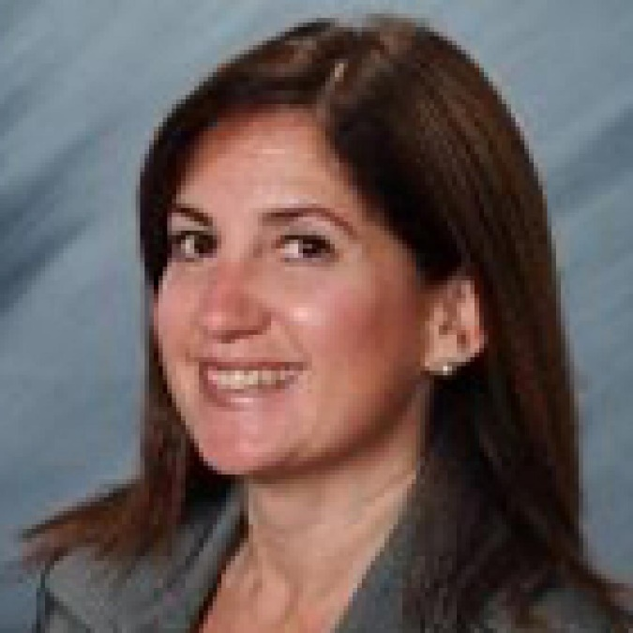
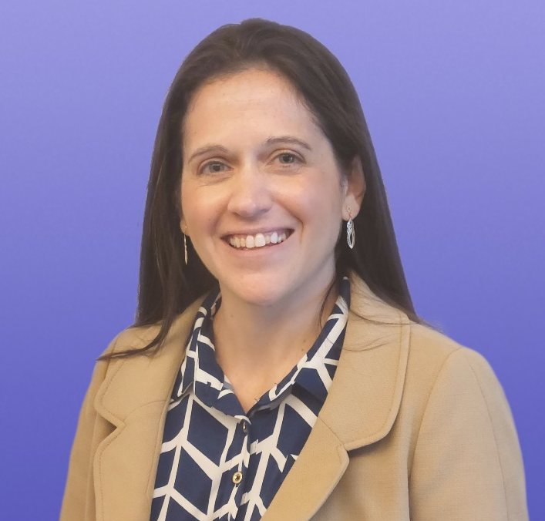
Questions & Answers
Sharyn Weiss
Director, Strategic Partnerships
sweiss@exceptionalchildren.org
Melissa Trout, CMP, DES
Senior Meetings Manager
mtrout@exceptionalchildren.org

