Slide 1

Charting the
Journey
MEMBER
Elisa Pratt, MA, CAE, CVF, FSAM

Slide 2

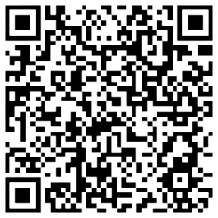
Welcome!
Elisa Pratt, MA, CAE, CVF, FSAM
  Association antagonist, nonprofit nerd
  25+ years association management
  Engagement & Ldr. Development
  Certified Association Executive
  Fellow Society of Assn. Management
  Chapter & affiliate expertise
  Member-focused
  Mission-driven

Slide 3
WHO ARE YOUR AUDIENCES
WHAT DO THEY VALUE & WANT
CURRENT STATE MAP
WHAT ARE THEIR PATHWAYS IN
HOW/WHEN/WHY DO THEY ENGAGE
FUTURE STATE MAP
Today’s
Plan
We only have 40 Minutes!

Slide 4


Slide 5
A Member Journey Map
Tells the story from the member's point of view
Creates understanding and empathy for members' experiences
Visualizes psychological, emotional, and physical aspects of member interactions
Provides insights into current member experiences
Designs improved future experiences
Fosters cross-functional ownership of the member experience
Identifies areas for improvement in member interactions

Slide 6


Slide 7


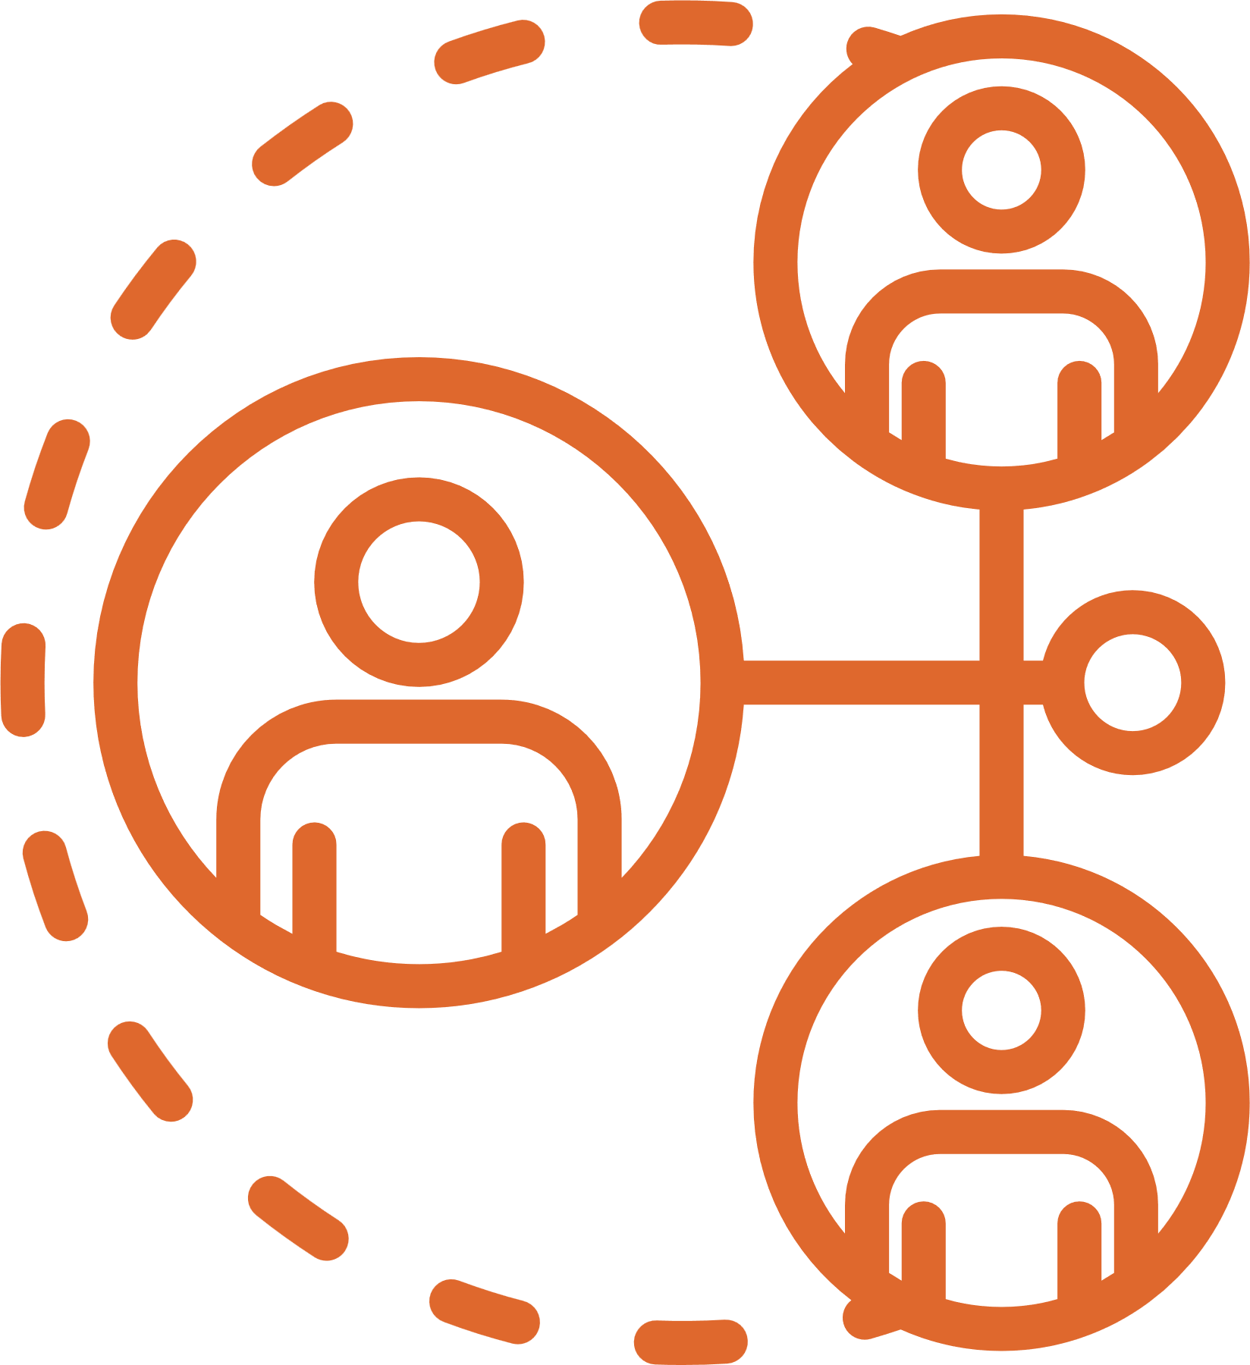

Before We Begin . . .
What do we need to know before we try to understand the member journey?
Who owns the member journey
What are we trying to achieve
What data do we have
Who will we want to engage
The member’s journey didn’t begin & won’t end with joining!

Slide 8
Who are your target
AUDIENCES?
Members, prospects, clients, stakeholders, volunteers, attendees, customers, subject matter experts, etc.
WHO are you really targeting??

Slide 9

Target
Personas
  Who do you want to engage with?
  But more importantly who needs, or would benefit from you?

Slide 10
What do they really
VALUE & WANT?
Its not what you think they need, but what they really consider a return on their investment.

Slide 11
How will we know
WHAT
THEY
WANT
Purchase data
Behavioral data
Participation data
We could ask them!!

Slide 12
Current State
MAP!
Define the touch points, itemize the engagements in order to understand their experience, emotions and POV.

Slide 13
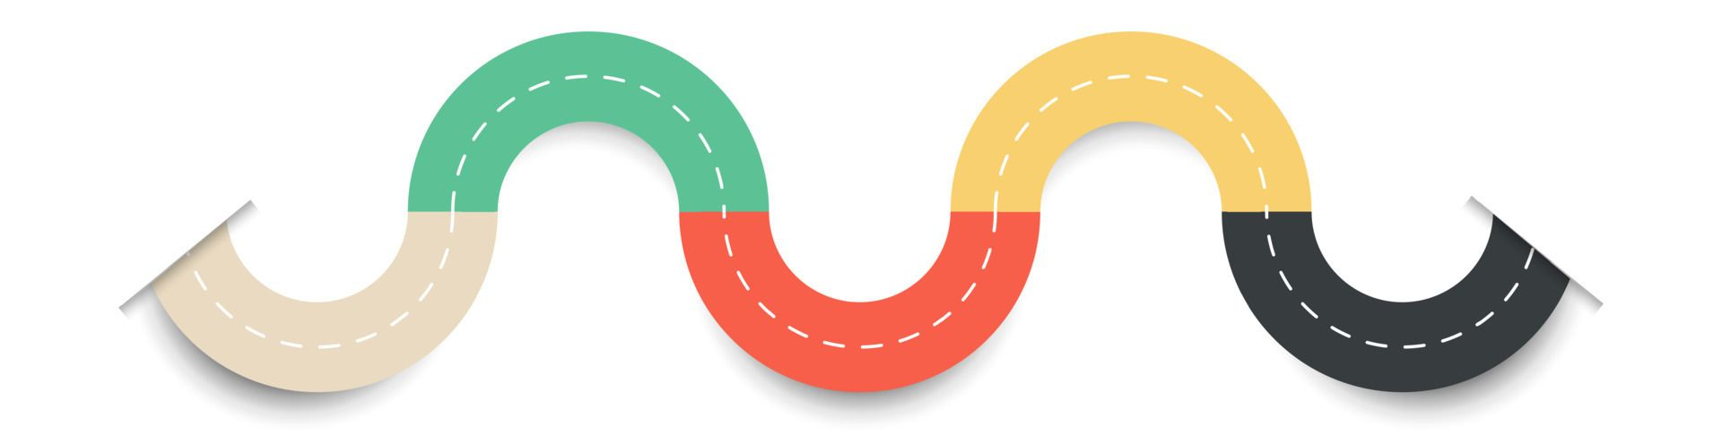
Current State Mapping

Slide 14

Current State
Map
Points of Entry
Every Touchpoint
Decision Points
Engagement Points

Slide 15

The Member Journey
Awareness
Interest
Join
Retention

Slide 16
There is a lot more to it . . .
What is their need / pain point?
What options and resources are available?
How do they come to know CEC?
Why do they want to join?
Why do they want to stay?
What emotions, considerations and evaluations take place?

Slide 17
The Loyal Member Journey
Retention
Champion
Volunteer
Leader

Slide 18
Phase or Stage of Journey
Begin by establishing the phases of your members’ experience.
Touchpoint or Action
Detail every outreach, contact, communication, activity, opportunity within that phase.

Slide 19
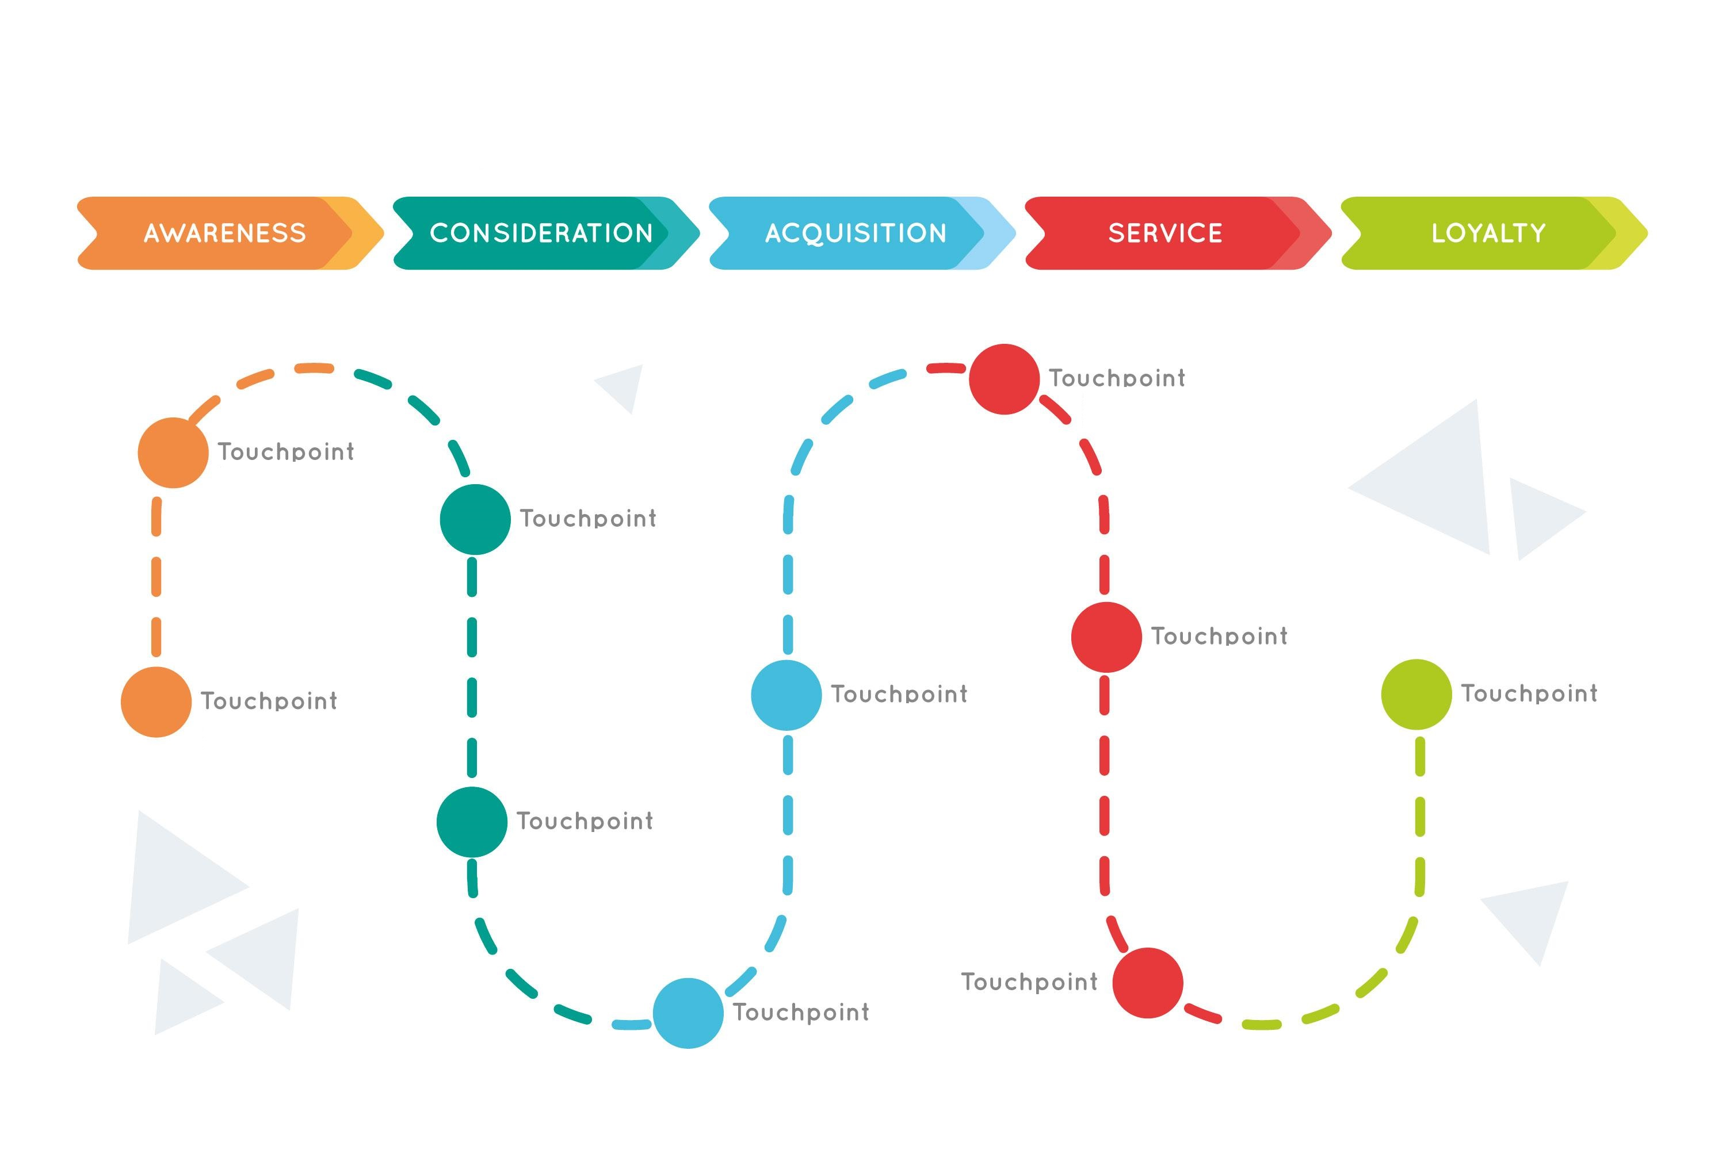

Slide 20
Member
Goal
At this stage what is your member trying to gain or achieve?
What is their reaction or experience with the organization during this stage or because of these actions?
Emotional Experience
Opportunities
What could we do differently, stop doing, or do better?

Slide 21
Phase
Action or Touchpoint
Member Goal
Emotional Experience
Opportunity

Slide 22
Future State
MAP!
What do we want our member experience to be like?

Slide 23
Focus on just ONE audience!
Prospect
Member
Student
Dropped Member
Volunteer
Leader

Slide 24
Phase or Stage of Journey
Member
Goal
Emotional Experience
Touchpoint or Action
Opportunities

Slide 25
Thank You ! !
If you want to learn more or have any questions, please feel free to reach out to me. Again, thank you so much for your time.
Elisa
Elisa Pratt, CAE, MA, CVF, FSAM
Founder & Chief Strategist
Brewer Pratt Solutions, LLC
elisa@brewerprattsolutions.com

