Slide 1
Recording Notice:
We will be recording today’s sessions.
Please mute yourselves and select your video preferences accordingly.

Slide 2
Membership lists and data
Q2 2024 Town Hall
Notes:
LP

Slide 3
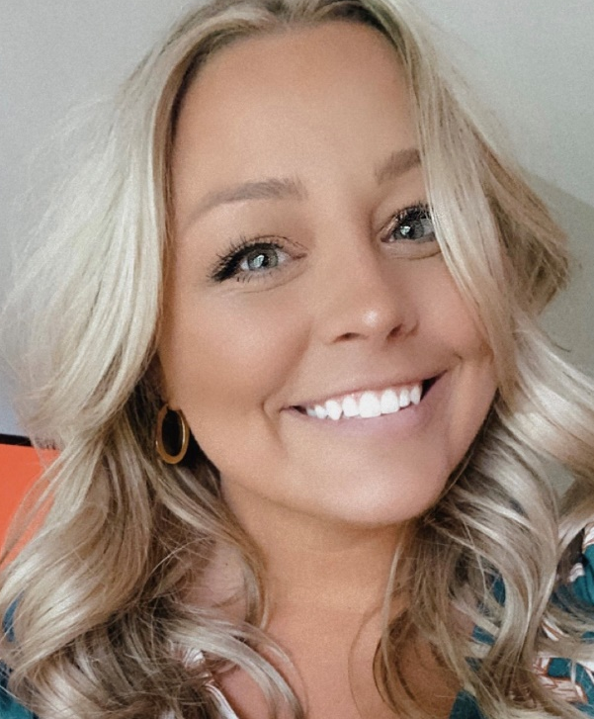
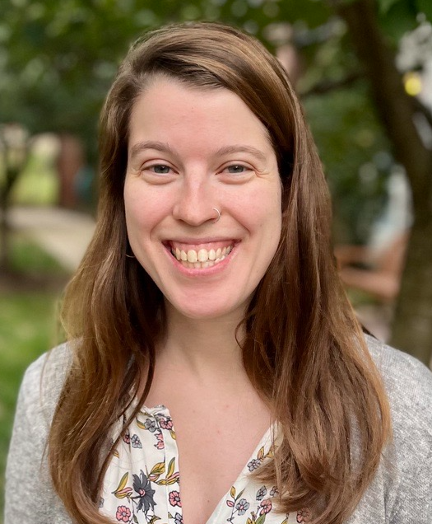
Staff Introductions
Danielle Wieczorek
Component Services Manager
Caroline Schwartz
Component Services Manager
Notes:
Before we get started, please allow me to introduce myself as today’s facilitator, and my colleague Caroline, who is assisting with today’s Town Hall!
My name is Danielle Wieczorek and I am your go-to contact at CEC headquarters, serving you as the Component Services Manager. As the component services manager, I provide support to our components, concentrating most of my support within our state and provincially based Units. I joined CEC’s staff in April of 2022. As your CSM, I am able to offer varying levels of support to you and your Unit’s board, equipped with seven years of training/resource development, component management, and membership and engagement experiences, addition to my nearly 10 years of volunteer management experience. I am looking forward to building relationships with each and every one of you.
With me today is Caroline Schwartz, CEC’s other component services manager. Caroline, would you like to introduce yourself?
Thanks for having me, Danielle. I am excited to be joining you all today. I have been with CEC since September of 2022, coming on board after 4 years of classroom special education teaching experience. My role on our components team supports a variety of our committees including our diversity and yes I can committee. I also support our student chapters and their advisers. In addition to my role with CEC, I also work with MAASE, a CASE State Subdivision, as an administrative assistant.
Thanks, Caroline! Caroline will be joining us today to assist with questions in the chat, as well as taking notes during our conversations today! Thank you, Caroline, for joining us this afternoon!

Slide 4
Agenda
Welcome, Attendance & Intro to Town Halls
Membership Reports
  How to access
  Review report types
  How to Leverage Your Findings
Digging into Data
  What to use and why
  Excel Tips & Tricks
  Building a report
A CEC Second
Closing
Notes:
Today we will discuss the following items listed on the screen. As we cover these topics, we will also have a number of new resources to share with you. All of the resources will be available to you on the Unit Resources page on the CEC website during and after this session. Today’s PowerPoint will be emailed to you all and will be posted to the Unit Resources page in October following the final session offered.

Slide 5
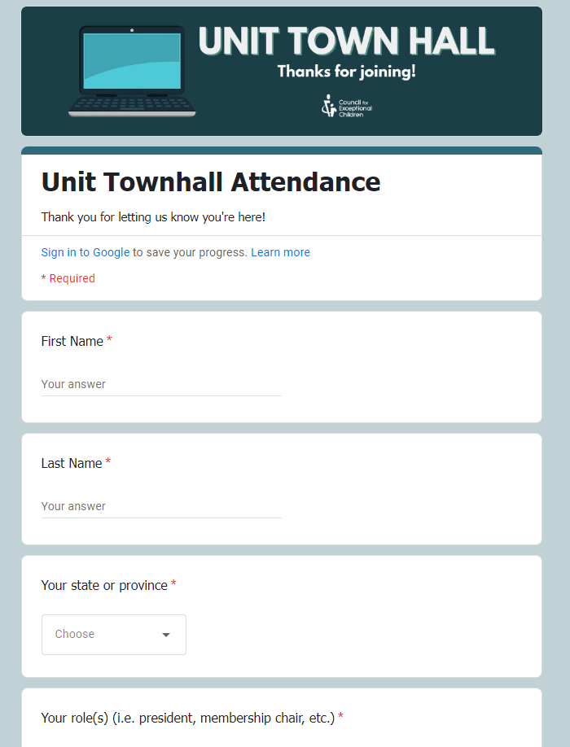
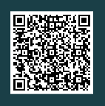
Attendance
Complete the attendance form
Update your display name in Zoom to include your first name and Unit (ex. Danielle, IN)
Enter your role in the chat in your Unit in the chat
Notes:
LP
Before we get started, please complete the attendance form by either scanning QR code on the screen with your cell phone, or by using the link in chat.
*SHARE LINK*
Link: https://forms.office.com/r/0DPBX4Mz8v
We are also asking you to update your Zoom name to include your name and Unit and then tell us your ROLE in the chat!

Slide 6
How to Update Your Zoom Name
Windows | macOS | Linux
On the Zoom in-meeting controls, click Participants participants-or-channel-button.png.
Hover your mouse over your name, then click the ellipses more-button.
Click Rename.
A pop-up box will appear.
In the pop-up box, enter your display name.
Click Change.
Android | iOS
On the Zoom in-meeting controls, tap Participants participants-or-channel-button.png.
Tap your name, then tap Rename.
A pop-up box will appear.
In the pop-up box, enter your display name.
Tap Done.
Web
On the Zoom in-meeting controls, click Participants participants-or-channel-button.png.
Hover your mouse over your name, then click More.
Click Rename.
A pop-up box will appear.
In the pop-up box, enter your display name.
Click Change.
Notes:
LP
If you’re unfamiliar with how to update your Zoom display name while on a call, I’ve shared instructions with you on the screen. You can also review the instructions using the link in the chat
*SHARE LINK*
How to update: https://support.zoom.us/hc/en-us/articles/8715431556621-Changing-your-name-on-Zoom

Slide 7
About CEC’s Town Halls

Slide 8
Quarterly Town Halls
New topic every quarter
  2-3 sessions
  Audience varies, invitations via email, Unit Leadership Community
Benefits of attending:
  New resources
  Networking with fellow Unit leaders
  Announcements and reminders from CEC
Notes:
Past topics:
Mind Mapping and Strategic Goal Setting
Coaching, maximizing your network, resource & guide
Social Media & Events
Timelines, Canva templates, platform-specific tools
Supporting Students Members
About Gen Z, student member benefits, membership cycle, CEC programs, supporting student chapter advisors
Welcoming New Members
CEC programs/resources, welcome letter template and writing guide, how to implement, report pulling
Membership Renewals
Report pulling, communication and email templates/guide, review of CEC’s practices
Recruiting and Supporting New Volunteers
Social media templates, Volunteer Square, coaching, preparing your board

Slide 9
Membership Reports
Where to find them.
What you can learn.
How you can inform leadership.

Slide 10
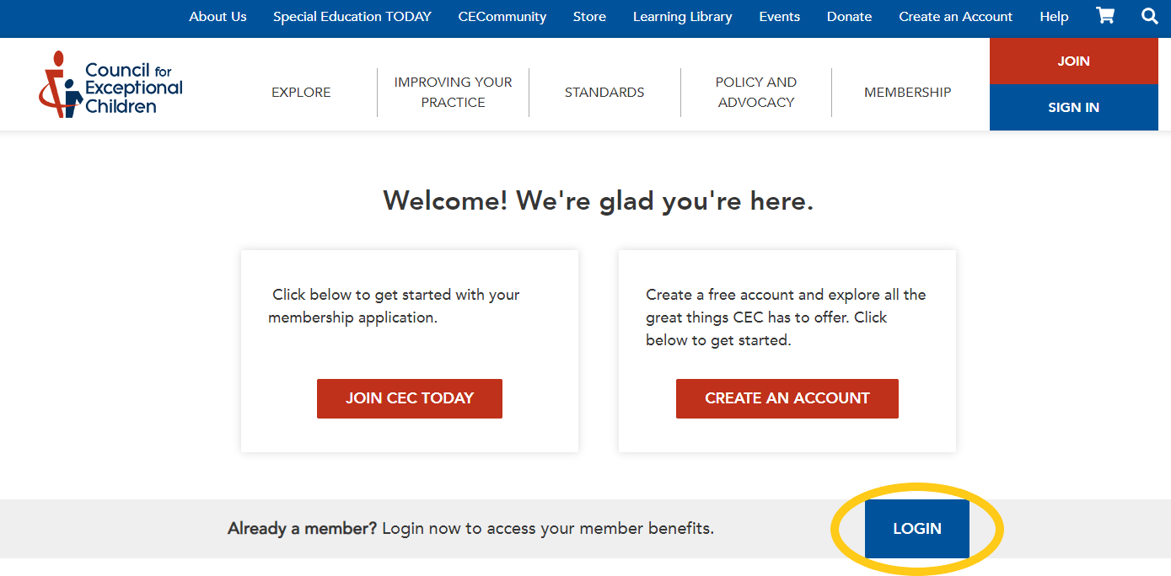
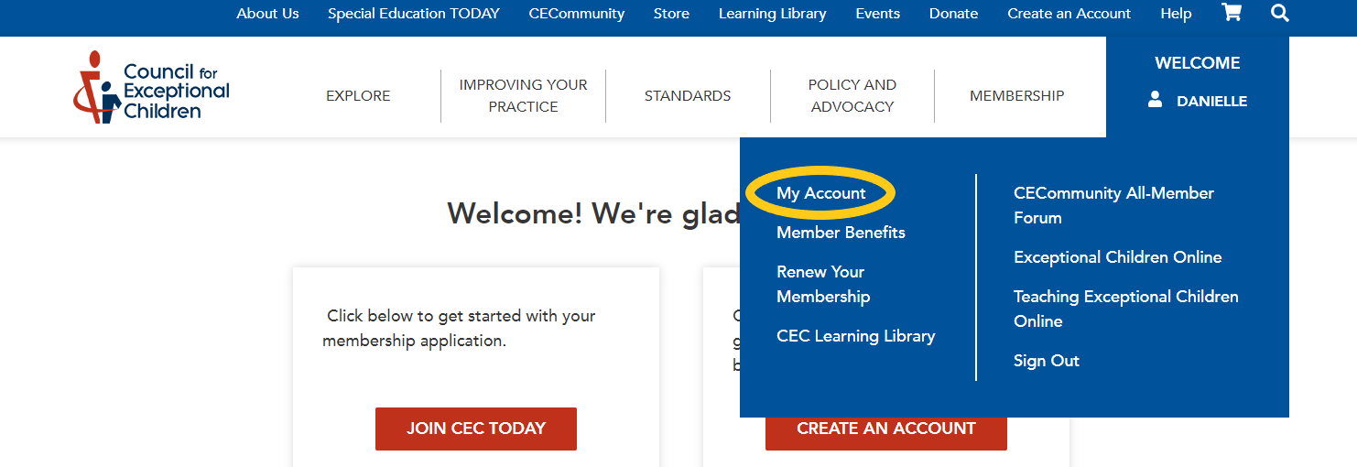
Accessing Reports
Login to your account on the CEC Website
Once logged in, the red/blue buttons in the top corner will change to blue and read “WELCOME” and include your name.
Next, click (or hover your mouse) over your name and select “My Account.”

Slide 11
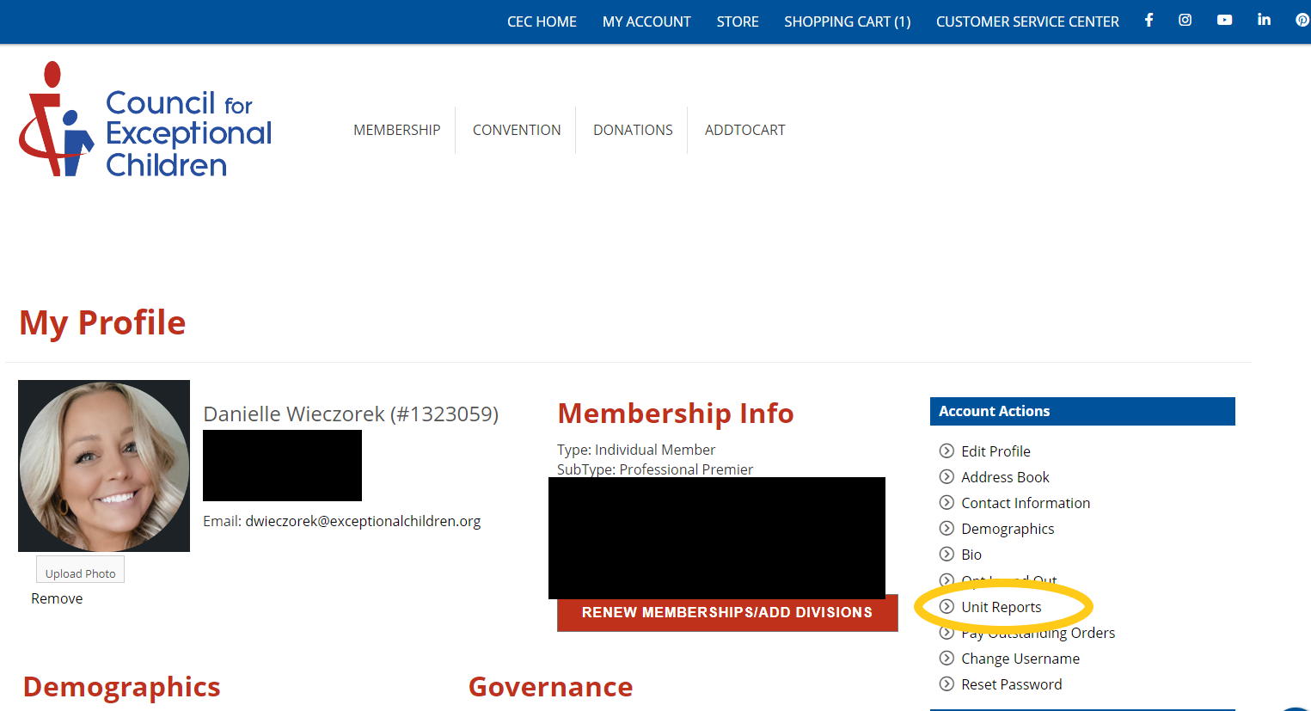
Accessing Reports
On this landing page, under “Account Actions” select “Unit Reports.”
On this new page, select the report you want to run and complete the necessary information. Please note the following:
  The red asterisk means that data entry is required.
  "Member Category” displays “Company Members” as an option, but CEC has no company members. Do not make a selection here.

Slide 12
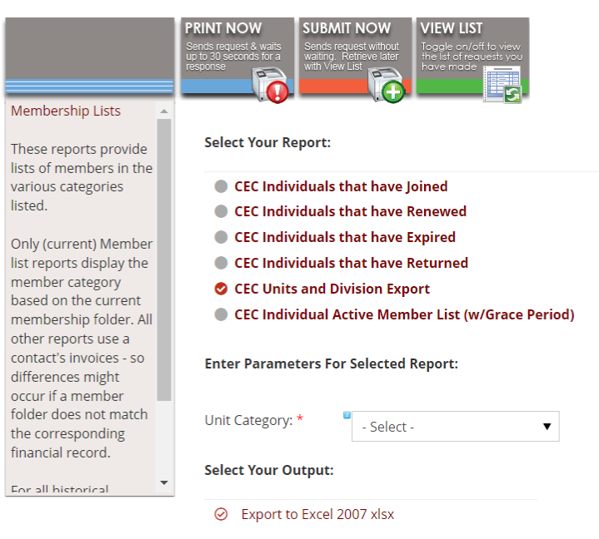
Types of Reports
Joined
  New members in given time-period
Renewed
Expired
  Lapsed Members in given time-period
Returned
  Lapsed members in given time-period
Unit & Division Export
  All current members and their Division membership
Active Member List
  All current members, including “grace period”

Slide 13
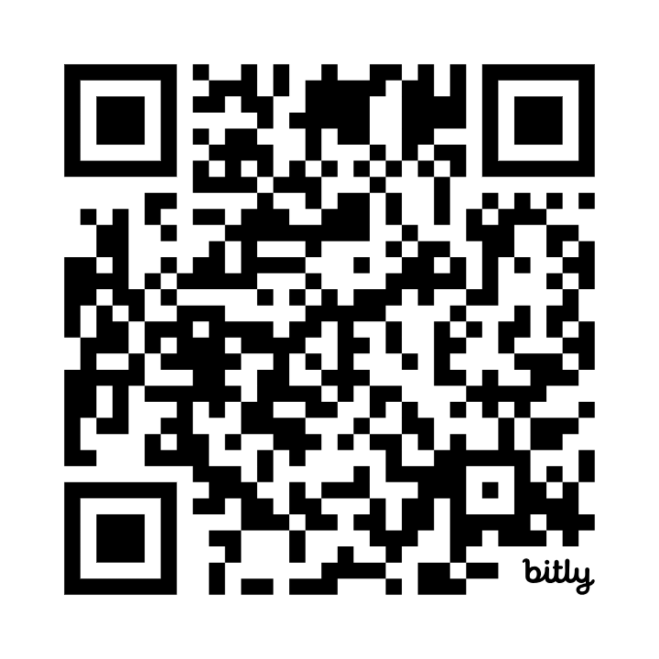
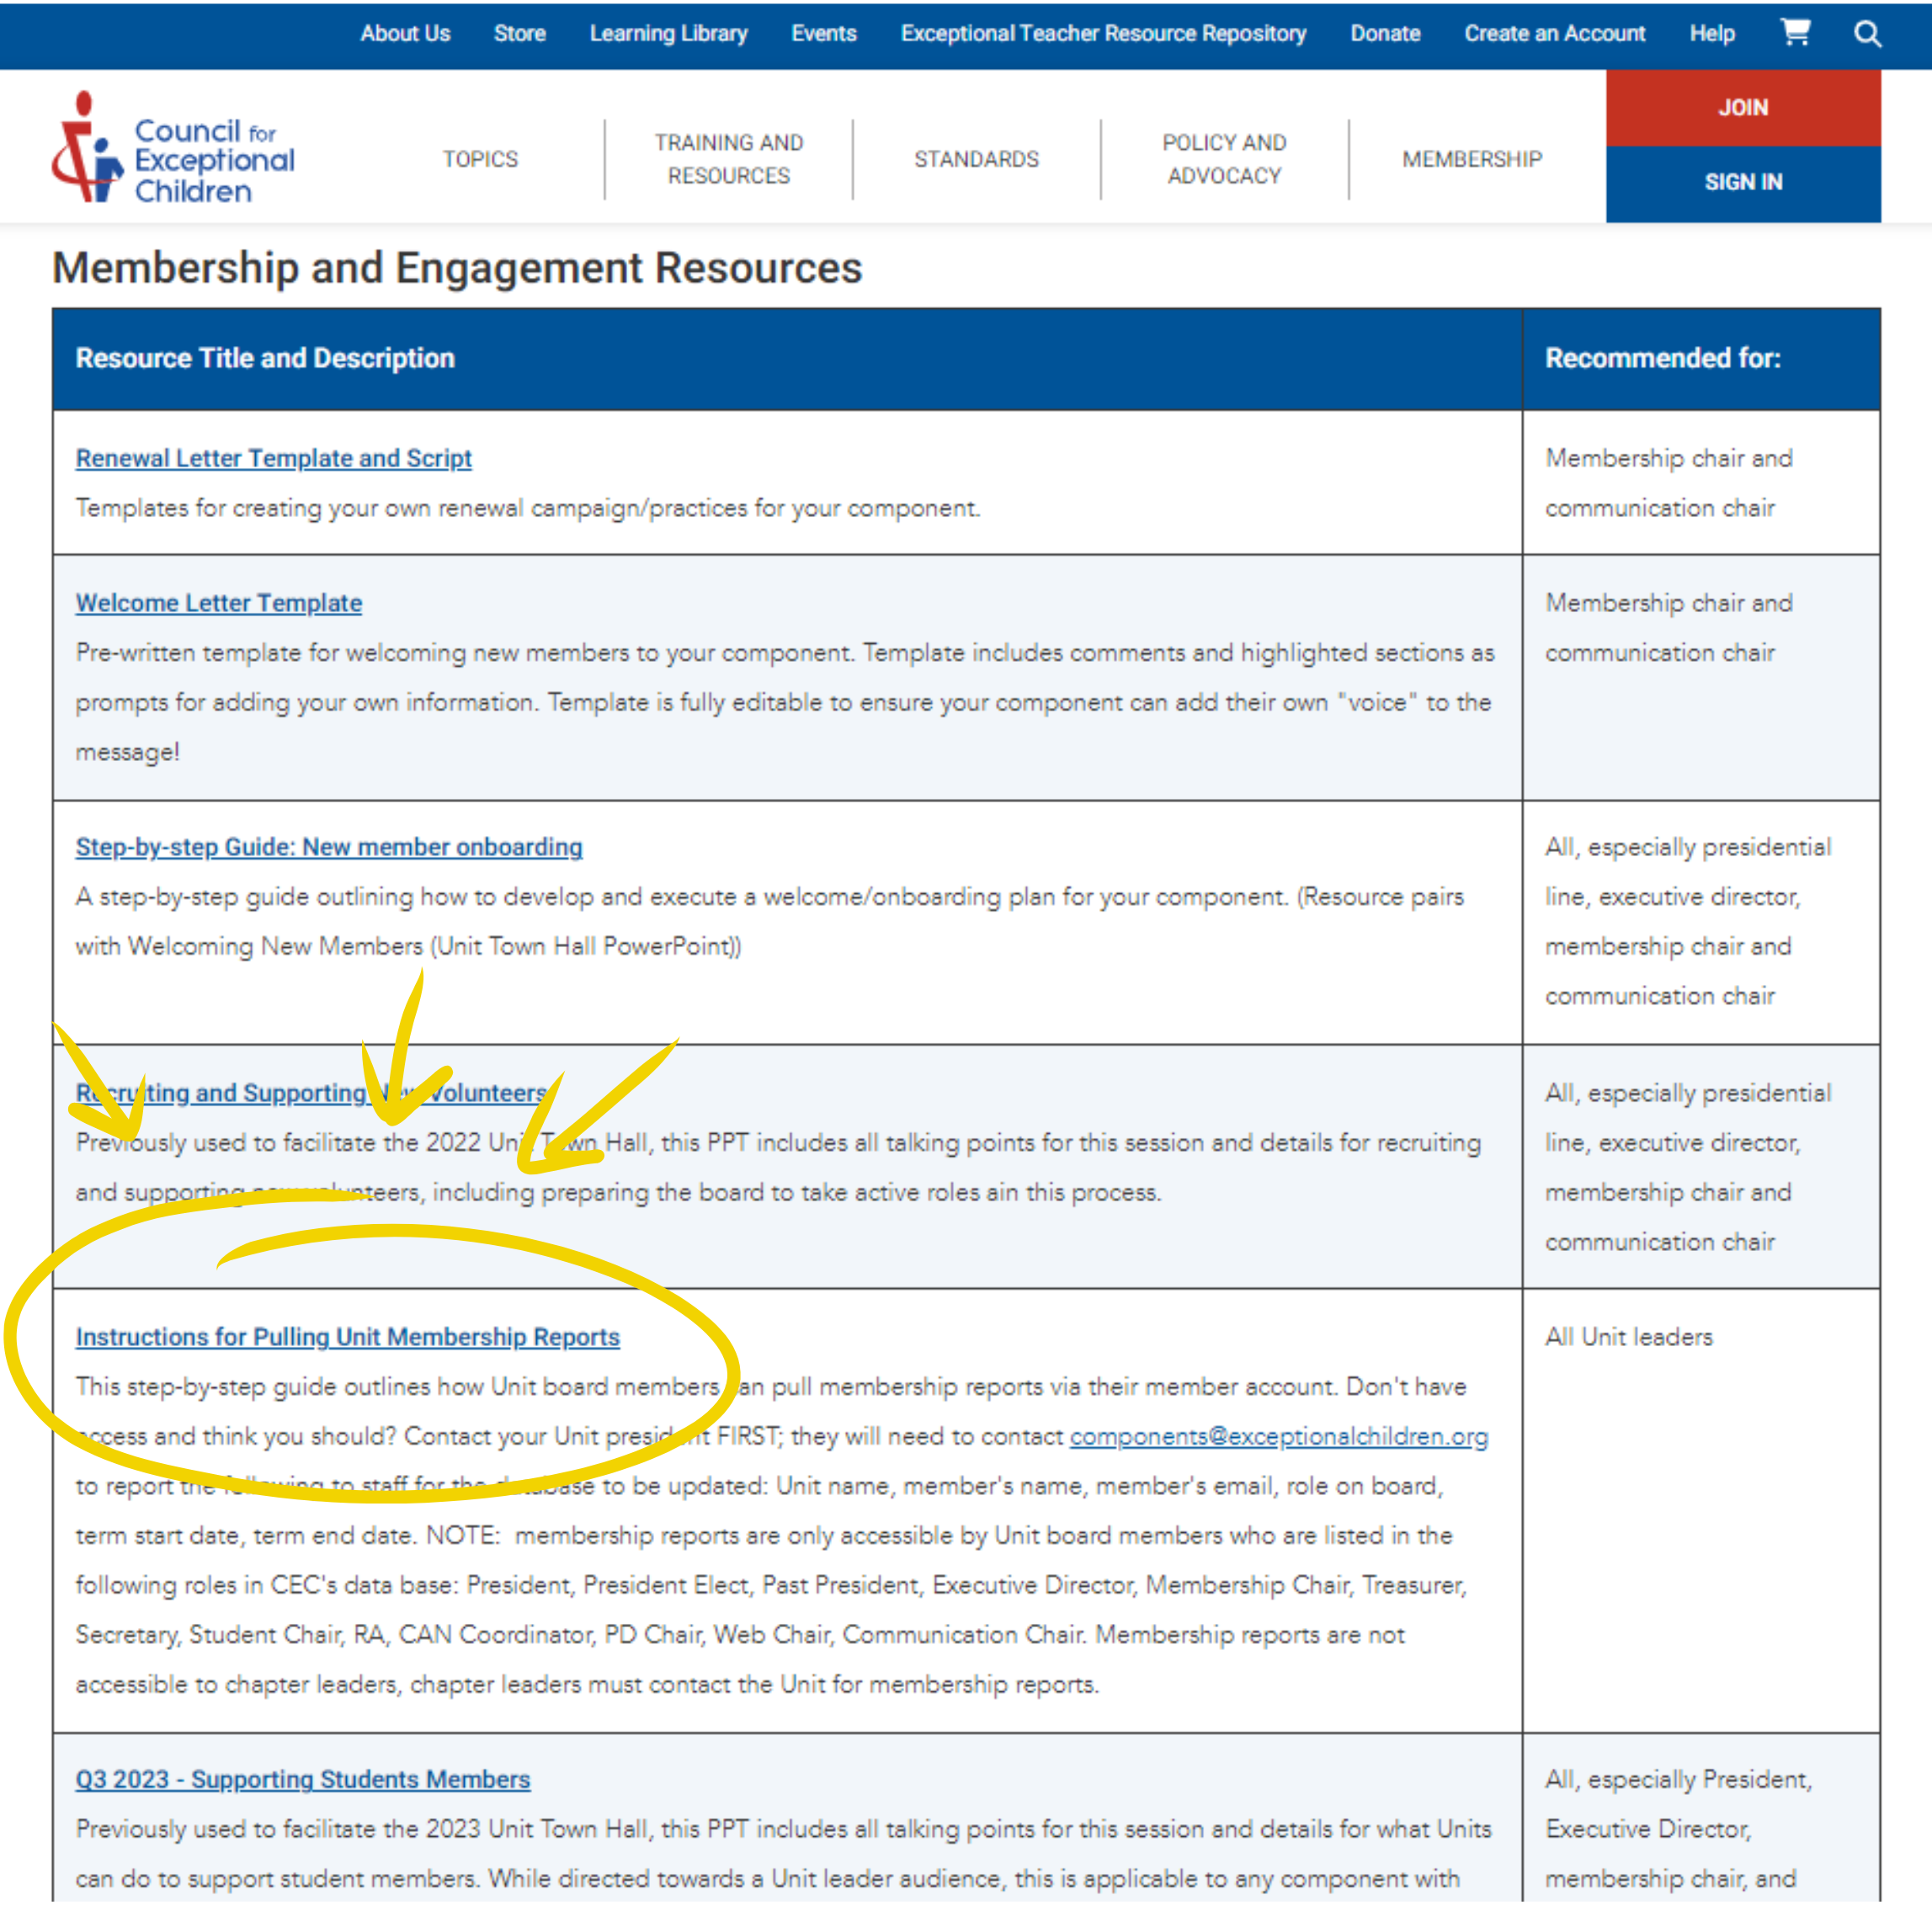
Resource
Instructions for Pulling Unit Membership Reports
Notes:
Membership and Engagement Resources: https://exceptionalchildren.org/engage/resources/membership-and-engagement-resources

Slide 14
Group Poll
Would your Unit/membership chair/committee benefit from a “cheat sheet” of information available in each report?

Slide 15
How to Leverage Your Findings

Slide 16
What’s Available
Professional role
Employer
Address
Membership dates
Membership Type
Division Information

Slide 17
What You Can Learn
Identify key areas (regionally) of membership, consider nurturing these to:
  Maintain membership
  Collect testimonials
  Contact building leadership to identify particular needs of the school/district/department to ensure relevant programs and resources are provided to them
Highly concentrated areas of membership which can inform:
  Possible regional chapter locations
  In-person programming opportunities
  Membership renewal campaigns
Employment data:
  District and school system insights
  Roles/types of roles to inform potential areas of interest for programs, communications, etc.
  Potential partnerships
  Identify potentially influential leadership in your state/province

Slide 18
What You Can Learn
Areas of interest related to programs, PD, etc.
Potential groups or regional areas for networking opportunities
Opportunities to connect with Divisions for potential partnerships for programming/PD/networking
Under-represented areas where membership campaigns could bring in new membership
Trends in data to inform:
  Board operations
  Goal setting
  Board and volunteer recruitment efforts
  Areas of deficit requiring “priority” shifts

Slide 19
What You Can Learn
Identify key stakeholders in districts, school systems, etc. for:
  Potential membership drives
  Recruitment of specific member types/professionals
  Potential speakers/presenters for virtual and in-person events/programs
  Potential partners or sponsors

Slide 20
Digging Into Data

Slide 21
What to Use and Why
Reports from CECommunity and membership reports
Tools
  Excel
  AI
Retaining Data:
  Store in shared files with board
  Update regularly
  Report changes in membership to board

Slide 22
Excel Tips and Tricks
Sort by various categories and use the count to inform charts and graphs
CTRL + F
  Search & Find
  Replace
  Replace & Find
  Charts using similar data
Create multiple sheets within your Excel document to extract the data you want to examine. Recommend pulling out
In separate sheets, sort and backfill “empty cells”
  Recommend doing this for:
    Employer
    Employment
    City and zip codes

Slide 23
Artificial Intelligence
Chat GPT, or other forms of AI can help to:
  Categorize types of employment
  Categorize employer types
  Categorize service providers

Slide 24
Example
Showcasing two membership reports shared with Board members.

Slide 25
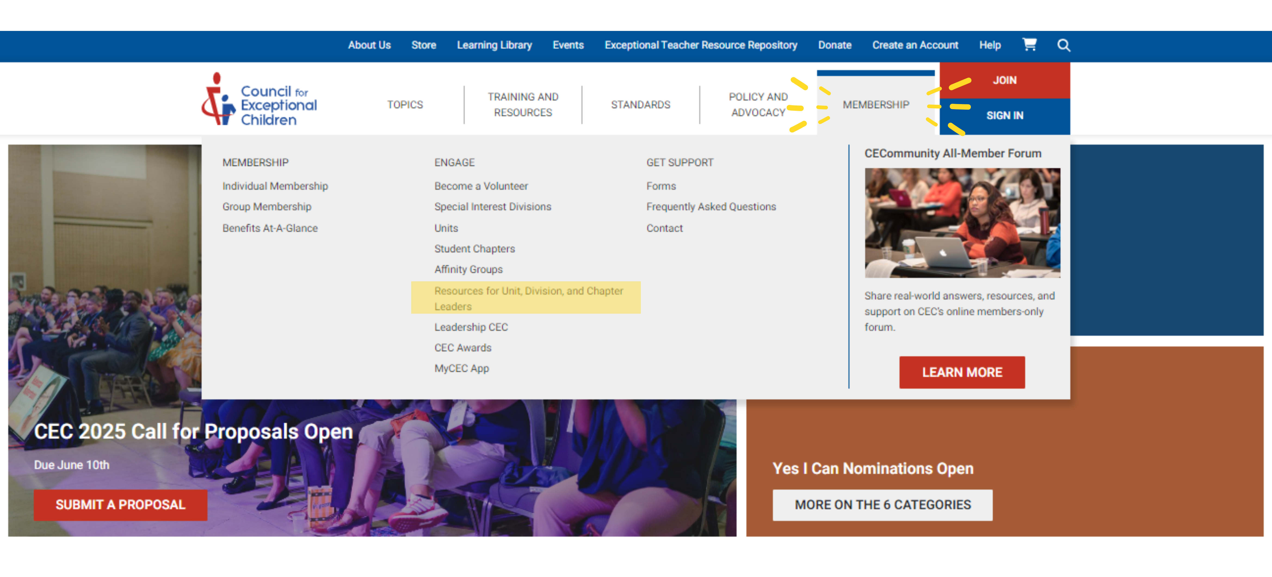
CEC Second: Preview of Resources
CEC is launching an updated Component Resources page for our leaders!
Ideas for future resources? Contact our team!
Component Services Team, components@exceptionalchildren.org

Slide 26
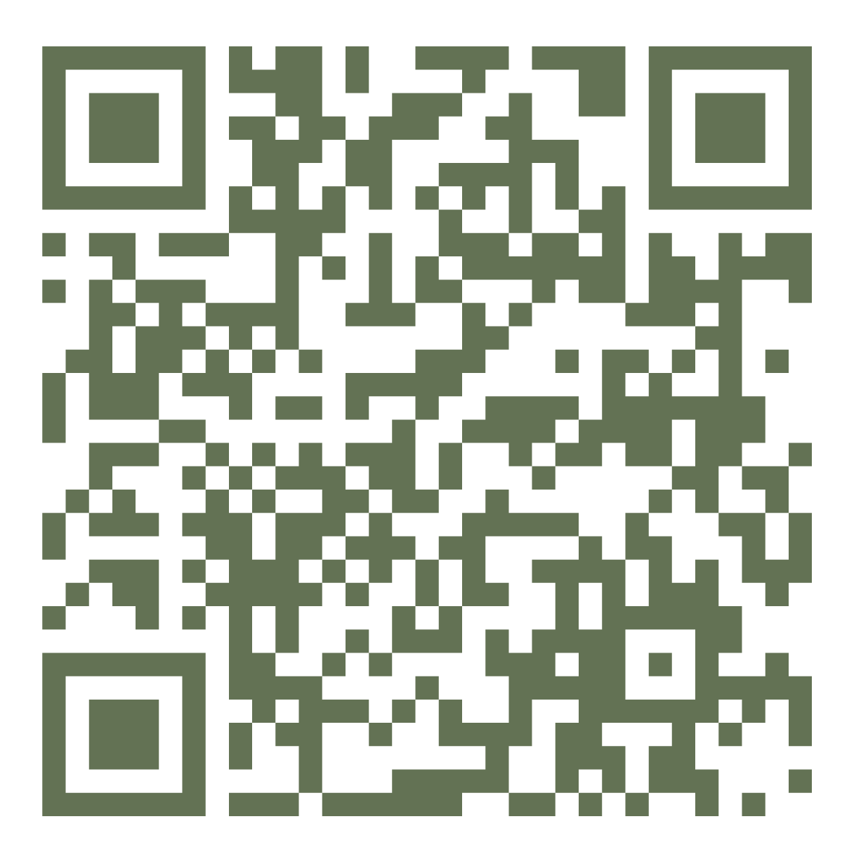
Request New Resources
Notes:
https://cec1785.wufoo.com/forms/q1c6fjr00uat130/

Slide 27

CEC Second: Member Opportunity
CEC is offering $40 gift cards to the first 24 accepted resource submitters in 2024!
Have you created any useful resources this year that have been working well in your school setting?
Share them with us so you can support other teachers! Questions? Contact pd@exceptionalchildren.org
Notes:
New resources have been added to the Exceptional Teacher Resource Repository - check them out here! Have you created any useful resources this year that have been working well in your school setting? Share them with us so you can support other teachers! Don’t forget, we are offering $40 gift cards to the first 24 accepted resource submitters in 2024!

Slide 28
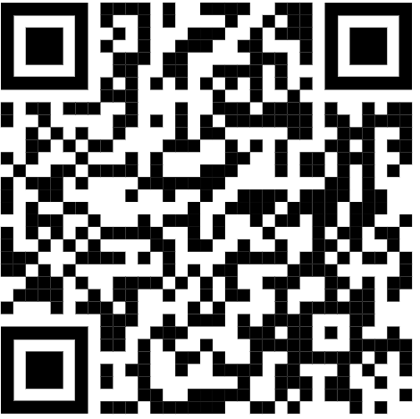
THANK YOU!
Help us do better & complete our survey!
Danielle: dwieczorek@exceptionalchildren.org
Brannan: bmeyers@exceptionalchildren.org
Caroline: cschwartz@exceptionalchildren.org
Team Email: components@exceptionalchildren.org
Notes:
LP
https://bit.ly/3Jh1MXB

