Slide 1
Social media and special events
Q2 2023 Town Hall
Notes:
LP

Slide 2
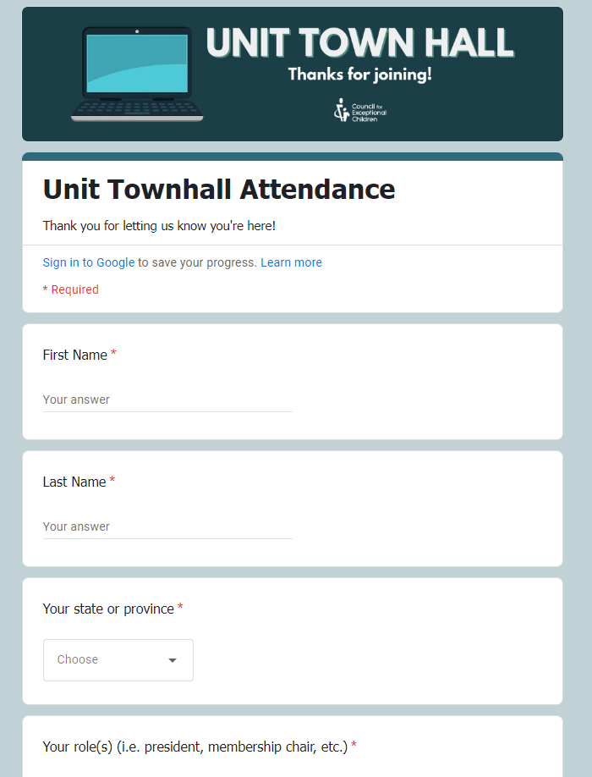
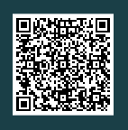
Attendance
Complete the attendance form
Update your display name in Zoom to include your first name and Unit (ex. Danielle, IN)
Enter your role in the chat in your Unit in the chat
Notes:
LP
Before we get started, please complete the attendance form by either scanning QR code on the screen with your cell phone, or by using the link in chat.
*SHARE LINK*
Link: https://forms.office.com/r/0DPBX4Mz8v
We are also asking you to update your Zoom name to include your name and Unit and then tell us your ROLE in the chat!

Slide 3
How to Update Your Zoom Name
Windows | macOS | Linux
On the Zoom in-meeting controls, click Participants participants-or-channel-button.png.
Hover your mouse over your name, then click the ellipses more-button.
Click Rename.
A pop-up box will appear.
In the pop-up box, enter your display name.
Click Change.
Android | iOS
On the Zoom in-meeting controls, tap Participants participants-or-channel-button.png.
Tap your name, then tap Rename.
A pop-up box will appear.
In the pop-up box, enter your display name.
Tap Done.
Web
On the Zoom in-meeting controls, click Participants participants-or-channel-button.png.
Hover your mouse over your name, then click More.
Click Rename.
A pop-up box will appear.
In the pop-up box, enter your display name.
Click Change.
Notes:
LP
If you’re unfamiliar with how to update your Zoom display name while on a call, I’ve shared instructions with you on the screen. You can also review the instructions using the link in the chat
*SHARE LINK*
How to update: https://support.zoom.us/hc/en-us/articles/8715431556621-Changing-your-name-on-Zoom

Slide 4
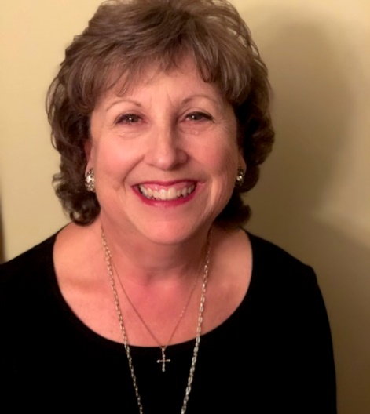
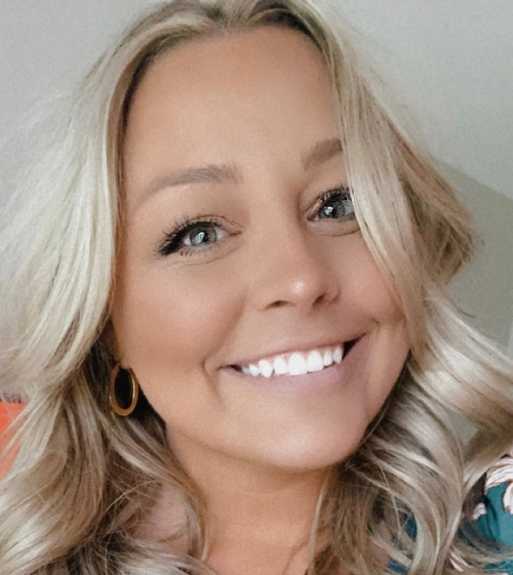
Welcome!
Luann Purcell,
Unit Resource Advisor
Danielle Wieczorek,
CEC Component Services Manager
Notes:
LUANN CEC- Danielle Wuh-zor-ick
Now that everyone is settled in, we’d like to welcome you to the Social Media & Special Events town hall!

Slide 5
Agenda
Event Promotion
At the event
Following the event
Engagement strategies
Building and maintaining a social content library
Notes:
LP
Today we will discuss the following items listed on the screen. As we cover these topics, we will also have a number of new resources to share with you. All of the resources will be available to you on the Unit Resources page on the CEC website during and after this session. Today’s PowerPoint will be emailed to you all and will be posted to the Unit Resources page in June following the final session offered.

Slide 6
Social Media and Event Promotion
Discussion:
How does your Unit currently use social media for special events?
Notes:
LP
“As we transition into the content, we would love for a couple volunteers to please share how their Unit uses social media for its special events? Feel free to share how you use it to promote the event, how you use it when the event is taking place and/or how its used following the event.”
Wait for responses. 2-3 Units should share.
“Thank you for sharing! Let’s start our session today with Instagram—first, we’ll cover the types of posts you can make on Instagram.”

Slide 7
Types of Posts: Instagram
Grid:
  Grid is the bread-and-butter, the 'main' posts you put on your Instagram account. It can be photos or videos. It's what people see when they click on your profile.
  Features: Photo and video posts, can also contain “reels.”
Reels:
  Longer video posts that are posted on your “grid” and in the “reels” section of the profile page
Story:
  Stories are a feature where users can capture and post related images and video content in a slideshow format. Stories can be modified with the typical features of the popular social media app.
Highlight:
  Highlights allow you to save and categorize your Stories on your profile so followers new and old can still view and interact with past Stories, well after that first 24 hours expire
Notes:
DW
Instagram a great platform to reach Gen X and younger, especially younger millennials and Gen Z.
The “grid” is the bread-and-butter, the 'main' posts you put on your Instagram account. These posts can be photos or videos and are what people see when they click on your profile.
Grid posts could include (*share only 3-4):
Photos from the last event, tease this year’s
Countdowns
Highlight sessions and/or speakers
Important updates/reminders
Highlight things to do in the area
Share hashtag to use
Promote sponsors
Announce your theme
REELS
Reels are longer videos that post to your grid and a separate “reels” section on your page. Reels are great for messages from the board, planning committee, or “hype” videos to get people excited about attending your event OR for recapping the event after it’s come to a close!!
STORY
Stories are a feature within the Instagram app where users can capture and post related images and video content in a slideshow format. Stories can be modified with stickers, additional text, links, swipe up options, etc. Stories are only posted for 24 hours.
Story posts could include:
Q&A Feature
Share grid photos to story with swipe-up to register, visit event webpage, access information, etc.
Highlight things to do in the area
Speaker bios & topics
“What to Pack” or “What to Bring”
“This or That” interactive image (repost tagged images)
Share the hashtag to use
Promote sponsors
Individual story posts can also be added to your account’s “Highlights.”
Highlights allow you to save and categorize your Stories on your profile so followers new and old can still view and interact with past Stories, well after that first 24 hours expire! You could have a highlight for your event specifically—that way anyone wanting to go back and see what’s been shared can easily do so!

Slide 8
Other Types of Posts
Twitter
  Tweet:
    Photos, GIFs, videos
    Text
  Retweets
  Quote tweets
Facebook
  Posts
  Event page
  Videos
  Stories
  Sharing
Notes:
DW
You can also post to Twitter and Facebook.
Both platforms allow you to post videos, text and images. Facebook typically reaches millennials and older.
Twitter is an easy platform to navigate with features like retweeting other accounts’ posts! For events, this is a great place to engage with your followers by asking them to join in on a conversation during or after the event, sharing photos, etc.
Facebook allows you to do the same by posting your own content and “sharing” others’ posts, but with a bonus feature of creating an event page for your event—this is easy publicity for your event!

Slide 9
Content: Keep these in mind!
IG Grid specific: Make sure to post plenty of photos – people will not follow accounts that are only information/text heavy!
When posting informational images:
  GENERATE EXCITEMENT!
    Tell them what to look forward to, who’s going to be there, and what they should plan for (packing, travel, parking, etc.)
    Keep information quick & easy to read, break up on multiple images in the same post if needed
General:
  Keep it branded! Don’t use too many different formats and colors
  Use your logo
  Use captions that call for engagement (comment, tag, etc.)
Notes:
DW
As you begin to consider how these platforms and their unique features will be used, there are some parameters that should be in place:
Instagram for example, should have a mixture of both photographs and text based/design-based images. Too much text or design work focused-posts will not only clutter your feed and will become “white noise” to your followers.
When you are posting any informational/text heavy images, be sure to not over complicate things. Give them the facts/details necessary and direct them where they can get more information. To do this, you can also use multiple images to relay information in a “slide by slide” manner. You should always generate excitement when doing this as well! Consider adding an image or caption that calls for engagement such as “tag someone you’re excited to see,” or “comment below with your conference must-haves, ours is ____.”
Finally, you will want to ensure there is consistency in your posts and accounts. You can do this by maintaining your brand by using your designated logo on each site, maintaining similar fonts and color schemes. Not only is it aesthetically pleasing, it promotes familiarity with your organization and calls attention to your posts so they are more easily recognized when followers are scrolling!

Slide 10
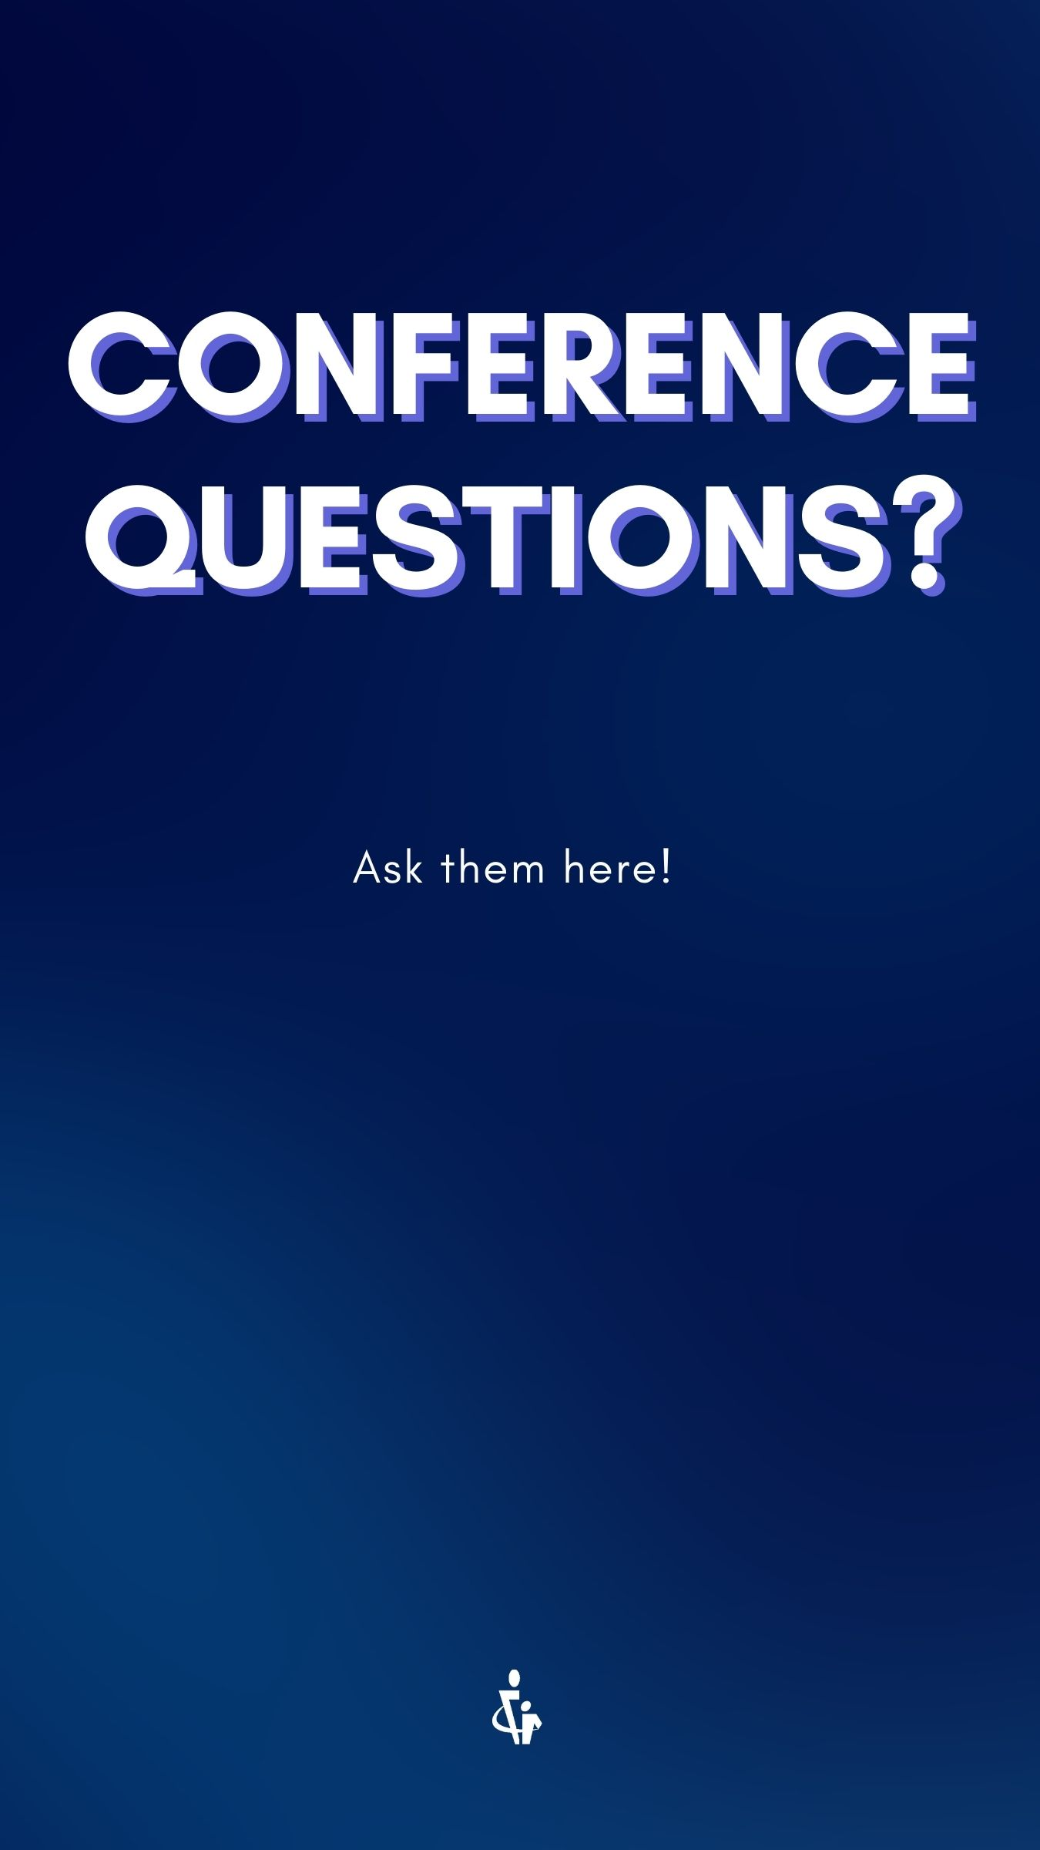
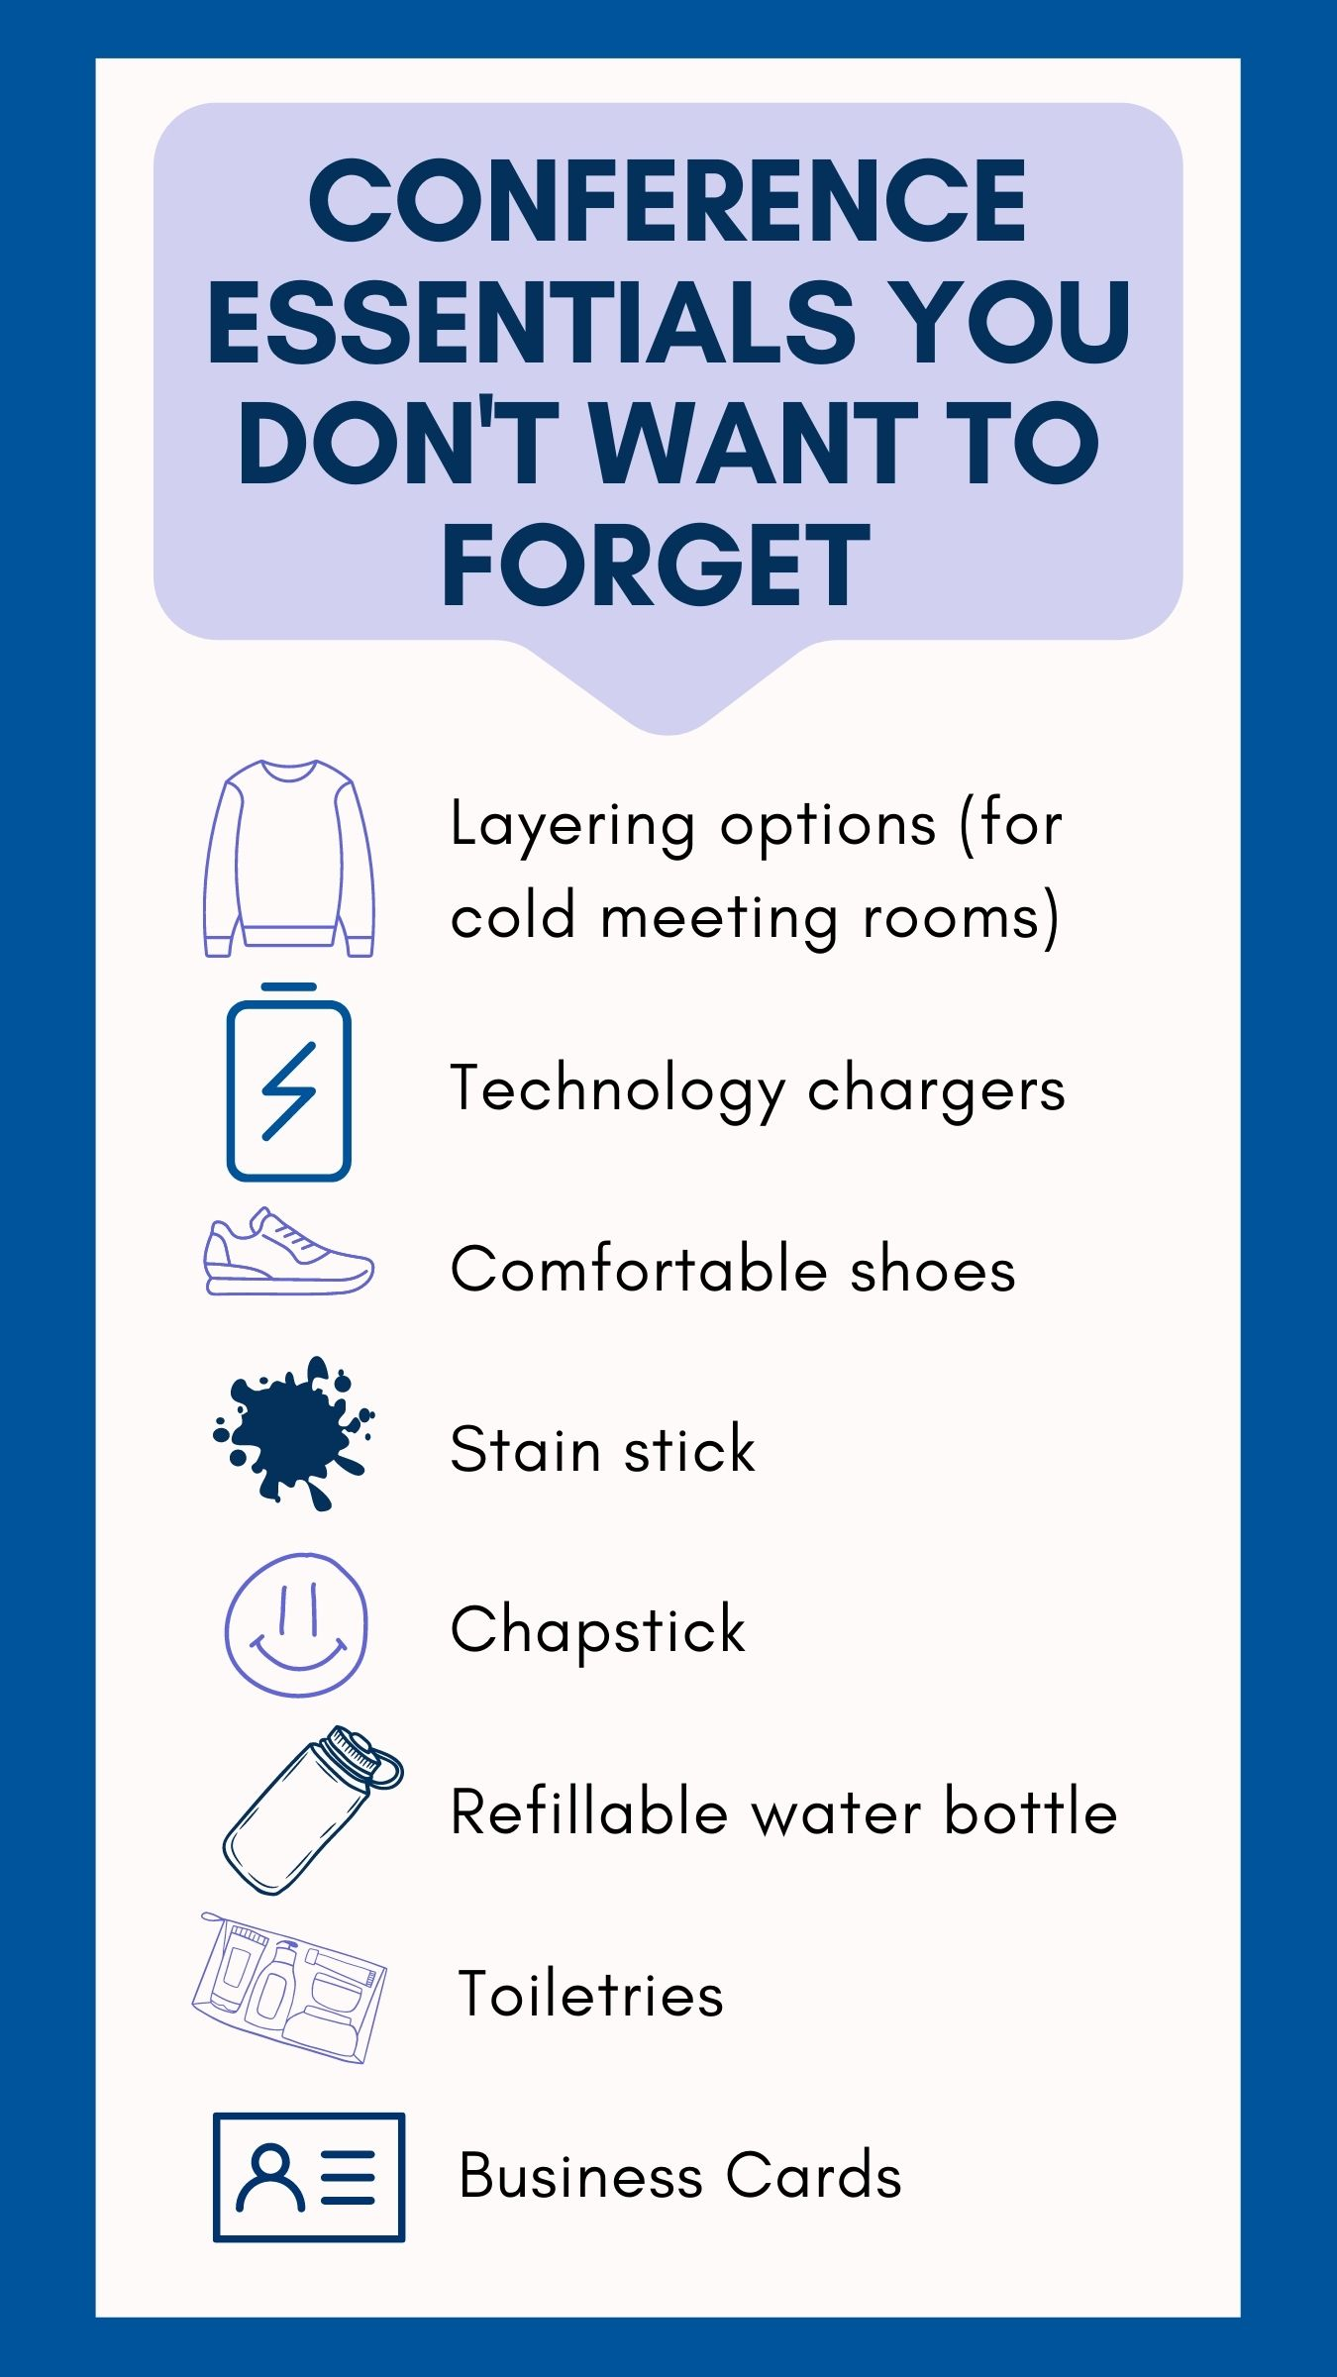
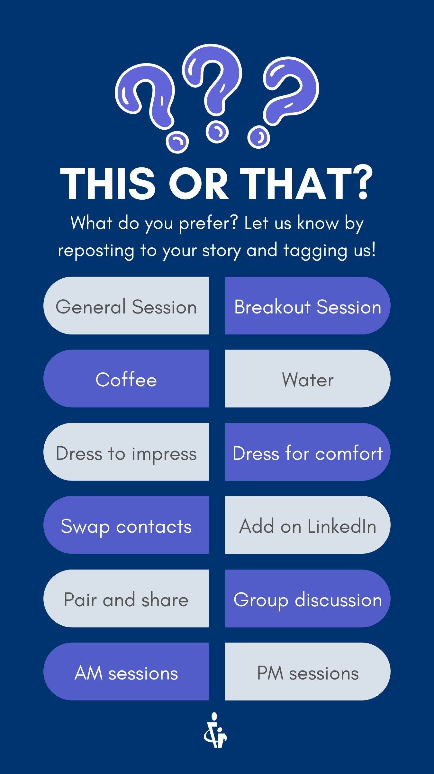
IG: Engagement Strategies
Answer questions using Q&A feature Instagram
Ask followers to share their favorite photos from past events/conferences (have them tag you)
Ask them about their “packing essentials” for conferences
Use “This or That’s” to get people tagging you for reposting
Tag other relevant accounts in posts or stories to make it easier for them to share
Notes:
We’ve mentioned engagement a few times so far! While engagement can include posting on your grid, you can also use stories to promote engagement. Here’s a few engagement strategies you can consider using for Instagram.
Instagram has a Q & Feature—use the shown template and simply add the “question sticker” to solicit questions from attendees! You can respond individually OR reply “publicly” on your story!
Make a post asking for attendees to share their favorite conference or social event photo to their story & to tag you on their stories—then you can repost their images and make a highlight “Our Members”
Use the “conference essentials” to inform members what to bring and then, on another slide, ask them what’s something they always pack for the event!
You might also remember the “This or That” craze companies, bloggers, universities, clubs, etc. used during 2020/2021 to spark engagement during the pandemic. This is a EASY way to engage your members! Simply post the image from the template and repost when your members tag you back! Engagement and connection CAN be built on social media before your event.
The more your attendees engage with before the event, the more follows you will get AND the more content you can collect and repost! These are three sample Instagram/Facebook stories you can post and are available on the resources page.

Slide 11
Social Media at Events
Notes:
DW
Are you posting DURING your events?
You should be!
This unique mission informs your attendees, attracts followers and engagement, all while making everyone not in attendance else feel a serious case of FOMO so they attend the next event!

Slide 12
Posting During Your Event
Twitter and Instagram are the places to post real-time updates (and Facebook if using the story feature).
Twitter | Instagram
Live tweet from a session, quote impactful statements and statistics Retweet/quote tweet posts from attendees Highlight sessions or breakouts to attend Alert if seats are full Highlight a session you’re expecting low attendance at Poster sessions Highlight Keynote speakers Post reminders: “General Session 2 is starting in 15 minutes!” “Heat wave! Temperatures are up to 85* outside today, be sure to pack a sweater for the session rooms!” Photos from breakout sessions | Grid Once per day (minimum) General session photos, award winners, etc. Daily recap (several photos) Keynote speakers Stories Repost/share photos (with good image quality) Daily recap/highlights Photos of Registration area/video clips High-level overview of the day ahead (posted in mornings Go live Highlight vendors & tag them Keynote speakers Include bio and session overview
Notes:
DW
During your event, Twitter and Instagram are the places to post real-time updates (and Facebook if using the story feature).
Here’s a few ideas of how you can keep your content coming during your event!
We have a few ideas listed on this slide for you to reference in the future—these include reminder posts, highlighting sessions, engaging with other members via social, etc.
This is also a great way to engage any speakers or sponsors—encourage them to have attendees tweet during sessions, share facts, etc. while tagging your Unit, the speaker and/or sponsor along the way. Promotion, engagement and awareness all tied into one!!
Generally speaking, e recommend posting at least once per day on your IG grid while the event is happening, and as often as you’d like on stories.
Twitter can be as often as you’d like to tweet information, photos and reminders
Facebook should only be posted on multiple times a day if using the story feature on Facebook, otherwise, stick to 1-2 posts a day either highlighting what will be happening that day, or post at the end of the day to recap today’s schedule and add another post to share what to look forward to tomorrow.

Slide 13
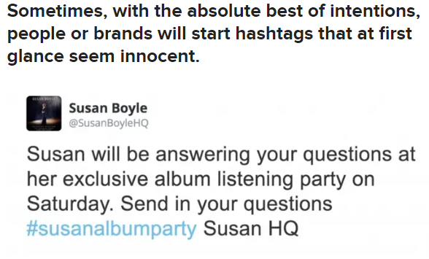
Tips for Planning Ahead
Create a schedule
  What, when and who
  Pre-schedule posts
    Hootsuite ($)
    Loomly ($)
    Buffer (Free)
Pre-determine your hashtag
  Test and research it!
Text-heavy posts and captions:
  Bank of caption options
  Draft early, check grammar and spelling
  Create the posts early
Notes:
DW
The BEST thing you can do is plan out your posts ahead of time as much as possible. Some content can be created and scheduled out BEFORE the event—but remember, these are only for the grid, Tweets and Facebook posts—you cannot currently schedule Instagram or Facebook stories, but you CAN schedule Tweets, and posts on Instagram and Facebook. You can search these companies if you’re interested in exploring their plans.
If you plan to use a conference/event hashtag, be sure to TEST AND CHECK how it’s been used in the past! Not only do you want to avoid a “hashtag fail” like the image here, you also want to be sure the other content that appears when you search your hashtag is not tied to any posts, organizations, or conversations that are “unfavorable” when searching for posts/people using that hashtag.
When pre-planning your posts, consider making a bank of captions that can be used for images/moments you hope to capture and general captions that could be used for any post. This alleviates stress trying to find that “perfect” caption in real time.
https://www.buzzfeed.com/sam_cleal/hashtag-fails

Slide 14
Tips for Planning Ahead
Predetermine which sessions you are going to promote each day
  Select key sessions each day to take photos at/during
  Notify speakers you’ll be joining the session for
  Make a list of “shots” to get (what angle, posed vs. candid; registration, general session rooms, etc.)
Assemble a team
  Assign volunteers to take photos during sessions
  Holding an event on campus? Hire a student photographer!
  Coordinate a team of “influencers” who can volunteer that weekend to take photos, remind people to “tag” your Unit on social media, and promote the use of your hashtag
Notes:
DW
When planning you should also consider these two to-dos:
READ FROM SLIDES

Slide 15

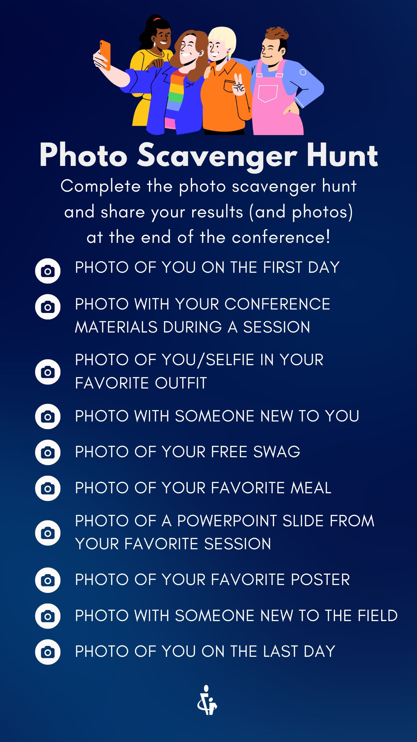
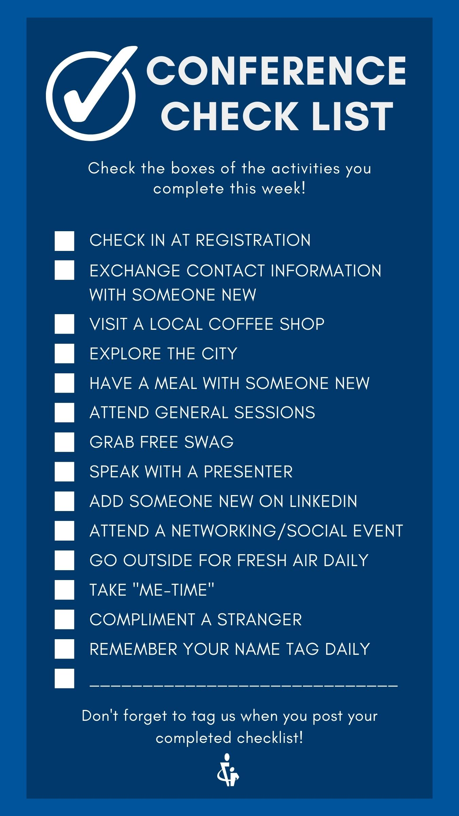
Engagement Strategies
Interactive stories that provide you with additional content/ability to repost
Things they can screenshot and repost themselves
Check-ins through out the conference
  Sliding check-ins, favorite session, shout out an attendee or presenter, etc.
Notes:
DW
You can also use general engagement posts on your grid and stories to keep people engaged throughout the week. Interactive stories are again, the easiest way to do this!
Here’s three sample templated you could use to do this!
The two examples on the right challenge members to engage all week long and provide you with content while encouraging networking and socialization with other attendees! The example on the left allows people to reflect, share and tag you to collect testimonials and reshare! This can also help you identify engaged attendees who may be interested in volunteering in the future, or in sharing additional statements and allow you to take a photo to share testimonials online for future events!

Slide 16
Continued Engagement
Have board members or others prepared to use your engagement posts/stories on their own social media to guarantee interaction
Show/highlight posts in general sessions, reference these throughout the conference
  Encourage presenters to engage
Share engagement plans with vendors and sponsors so they can participate too!
Notes:
DW
To ensure there is traction, be sure to set expectations with board members so they take part in creating content, as well as your vendors, sponsors and presenters. Everyone can contribute!

Slide 17
Social Media After an Event
Notes:
LP

Slide 18
Event Wrap-Up
Post a “Weekend Wrap-Up” with photos from the conference
Testimonials
  Collect testimonials from those who post
Promote your post-event survey (tell them to check their emails when it’s been sent)
Repost attendees' posts
Thank sponsors, exhibitors and presenters (tag them too, they will repost your posts!)
Have attendees share “Ah-ha!” moments from the weekend via stories
Tease next year’s event (if you have location and dates already determined)
Notes:
LP
After the event, your job is simple:
Wrap up the week with highlights, testimonials and encourage attendees to complete your post event survey!
You can tease next year’s event with a save the date post, thank vendors, sponsors and speakers, an even repost attendees’ posts to you story!

Slide 19
Your Social Media Content Library
Notes:
DW
During events, you can also “collect” content to build a content library!

Slide 20
Content Library
A content library is a “bank” of photos, videos and other content that can be used and reused on social media and in other virtual communications or promotions!
Why?
  Pages with more photos on the “grid” are interacted with more! Too many text-heavy posts means lower engagement (and they will start to scroll past).
Ask your members to send you photos too!
Notes:
DW
A content library is a “bank” of photos, videos and other content that can be used and reused on social media and in other virtual communications or promotions!
These photos can be of conference rooms, flat lays of pens, notebooks and materials, photos of members engaging with each other—anything that you find purpose in sharing or using in the future—EVEN if not for event promotion!
This can help you along your journey to ensure your grid is complex and not overly saturated with text or graphic heavy images.

Slide 21
Content Library
Store them in a shared folder
  Dropbox, Google Drive, etc..
Use tools for creating posts:
  Adobe Express
  Canva (we us this!)
  Crello
  Stencil
Notes:
DW
https://www.adobe.com/express/
https://www.canva.com/
https://create.vista.com/
https://getstencil.com/?tap_a=9103-1801f8&tap_s=2427717-630efb&tm_subid1=ticanalt
These files can be stored in a shared folder.
If you’re interested in exploring platforms to create posts with graphics, words, or fully-designed posts, we recommend using the platforms on the screen. Our go-to on staff for those without graphic design backgrounds is Canva!

Slide 22
Social Media Accessibility Resources
Making sure your content is accessible to everyone adds a little time but makes a big impact and sets a positive example for others. It's important to:
  Caption videos
  Include Alt Text on images
  Write posts in a reader-friendly way. Don't overcomplicate your language
  Use colors that contrast appropriately when using text in graphics. You can use a contrast-ratio tool.
Each platform has an accessibility guide. You can find them here.
Notes:
DW
This slide is a new resource on the Unit Resource Page.
We recommend ensuring your posts are accessible as possible by captioning your videos, providing alt text on images, using simple language and ensuring that your color choices don’t make it challenging to read and engage with your post.
Each platform has an accessibility guide. You can find them here: https://www.accessible-social.com/accessibility-101/accessibility-by-platform (Share link)

Slide 23
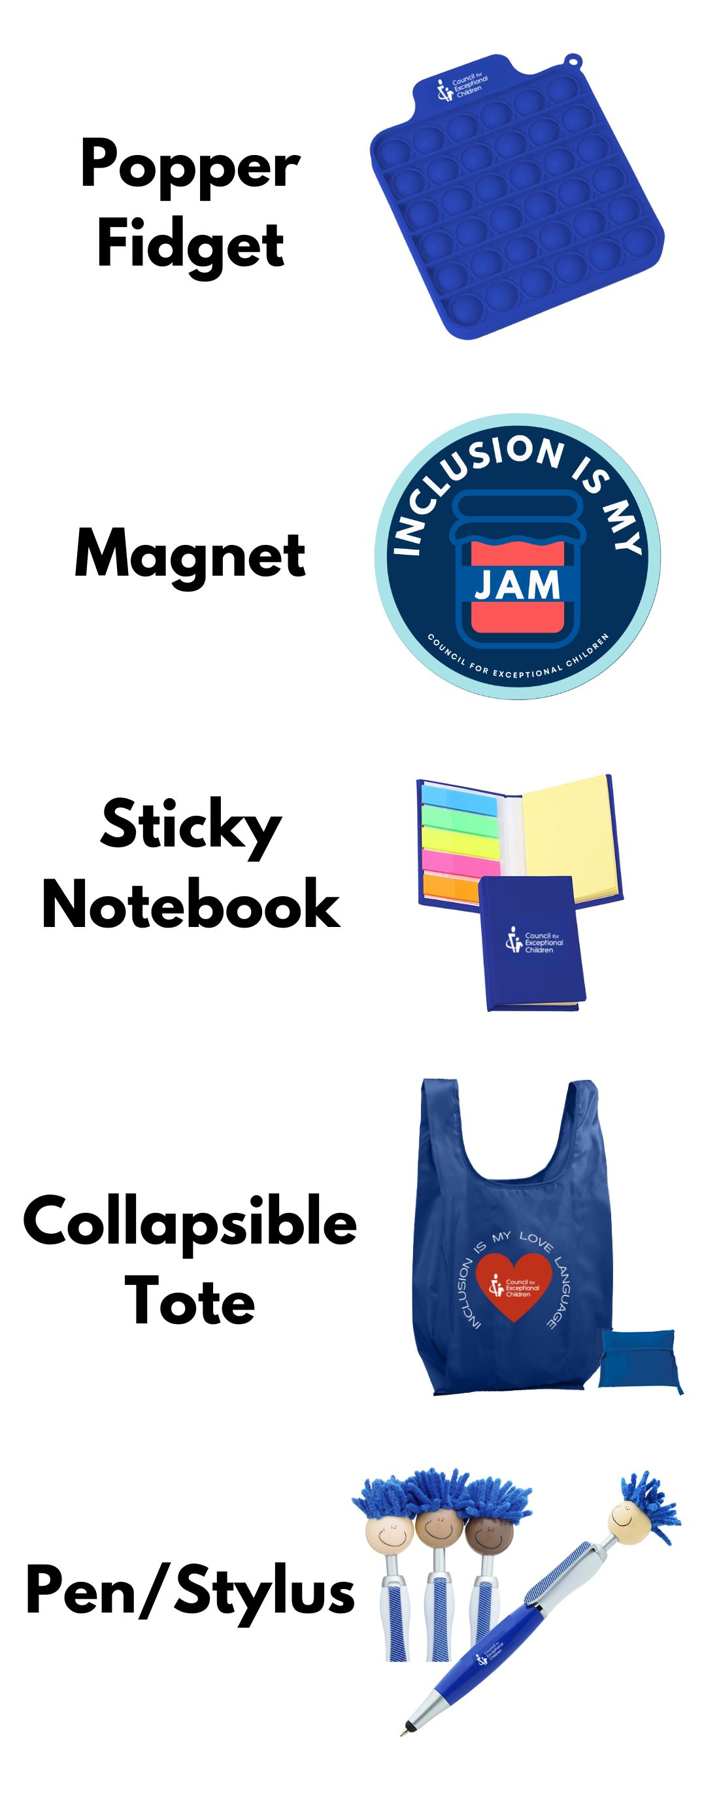
CEC Second: Free Swag for Events!
Hosting an event or promoting CEC membership at another conference?
CEC will send you up to 75 swag items for FREE to help spread the word (number determined by staff)!
Available for request by: Units, Divisions, Chapters and Sub-Divisions
Where to request: Via the Component Event Form
Head to the CEC website and click the “Membership” menu
Select “Resources for Unit, Division, and Chapter Leaders”
On the new page expand the “Membership, Meetings, and Media” drop down
Click “CEC Support for Unit/Division Conferences” and complete the form
Notes:
LP
https://cec1785.wufoo.com/forms/z1yoxv3m0b61lkt/

Slide 24
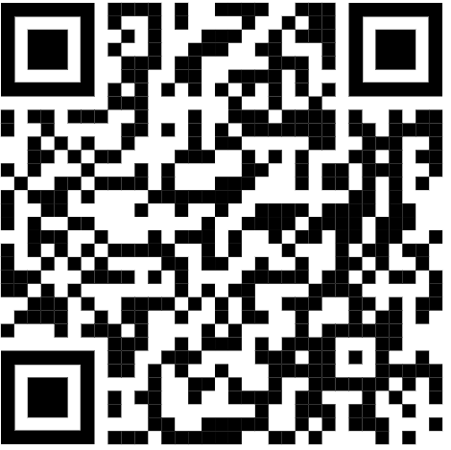
THANK YOU!
Thanks for all you do!
Help us do better & complete our survey!
Danielle: dwieczorek@exceptionalchildren.org
Luann: luannpurcell@gmail.com
Brannan: bmeyers@exceptionalchildren.org
Notes:
LP
https://bit.ly/3Jh1MXB

