Slide 1
Component Resources Webpage Review
Please enter your Unit and volunteer role in the chat!

Slide 2
Agenda
Review changes
Learn about resource “buckets”
Highlight key resources
How to access
Bringing it back
Q & A
Networking Time

Slide 3

GROUP POLL
Who has accessed CEC Resources in the past?

Slide 4
Updates to Organization
Out with the old:
Over simplified buckets
Obscure resource names
Outdated resources
Dropdown Menus
In with the new:
Resources categorized by function/purpose
Toggle between categories
Dual-locations for ease
Refreshed resources
Descriptions
Recommended audience

Slide 5
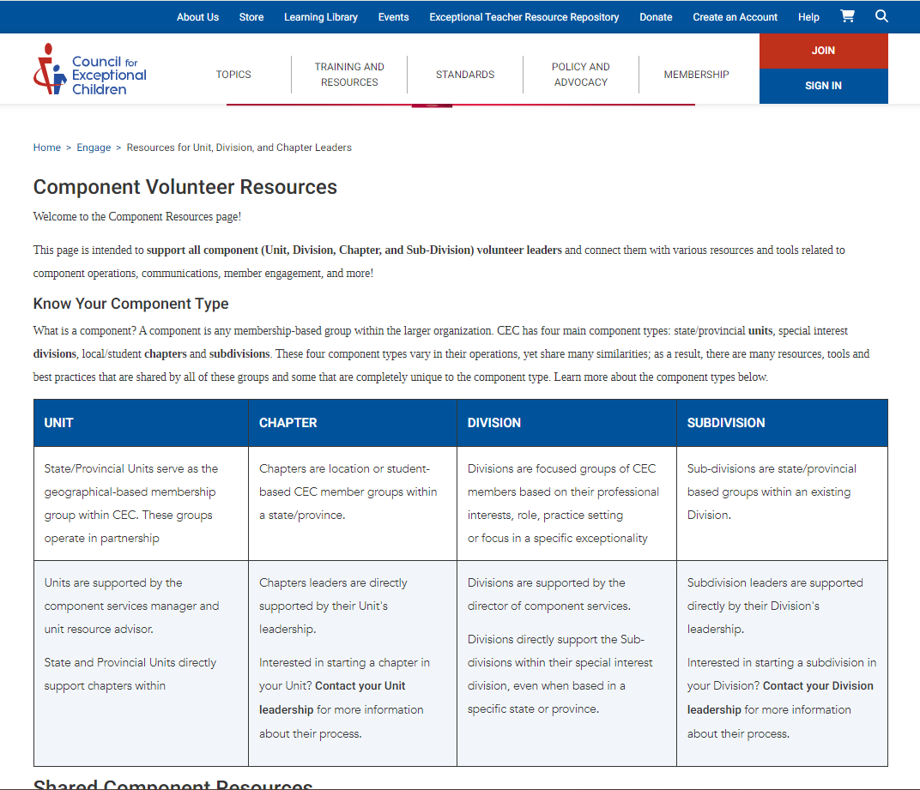
Homepage Refresh
Intro Section
Component type
Description
Sources of support

Slide 6
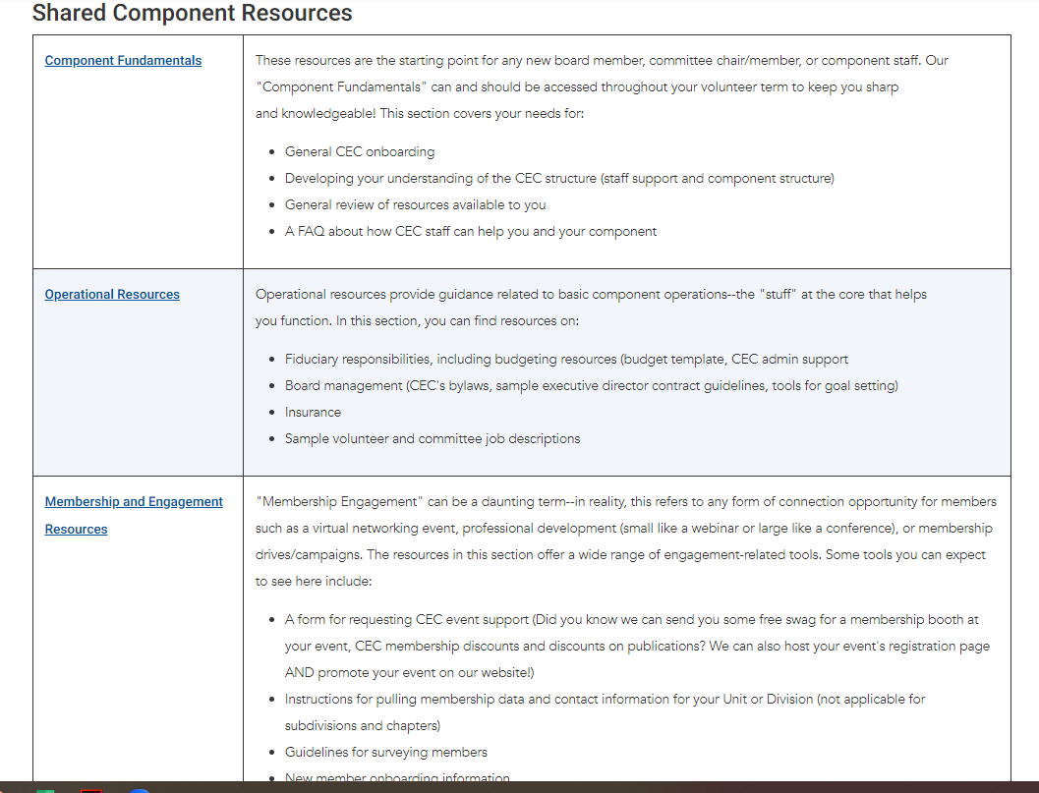
Homepage Refresh
Shared Resources
Landing page for each “bucket” of resources
Descriptions to aid in locating resources

Slide 7
Resource Organization
Component Fundamentals
These resources are the starting point for any new board member, committee chair/member, or component staff. Our "Component Fundamentals" can and should be accessed throughout your volunteer term to keep you sharp and knowledgeable!
Operational Resources
Operational resources provide guidance related to basic component operations--the "stuff" at the core that helps you function.
Membership and Engagement Resources
"Membership Engagement" can be a daunting term--in reality, this refers to any form of connection opportunity for members such as a virtual networking event, professional development (small like a webinar or large like a conference), or membership drives/campaigns. The resources in this section offer a wide range of engagement-related tools.

Slide 8
Resource Organization
Communication Templates and Resources
This section of resources contains a number of branding tools, sample social media posts, template communications and website resources.
Events and Virtual Programming Resources
Planning an in-person or virtual event? There’s so much to think about! Visit this page to make it all a little easier on you and find our helpful resources.
Policy/Advocacy
This section of resources contains a number of links connecting you with CEC’s policy and advocacy agenda, Legislative Action Center, staff contact, and more
Unit/Division Resources for Supporting Sub- Divisions/Chapters
These resources are available to all, but are intended for our Unit and Division leaders to aid in their support of their respective Chapters and Sub-Divisions. Intended to support your component’s operations and expectations of these groups,

Slide 9
Recently Added
2024 Fall Professional Development Fair Promotion Toolkit
Unit & Chapter CEC2025 Social Media Toolkit
What You’ll Find:
Important dates
Relevant links
Registration, event, sessions, etc.
Ready-to-use:
Captions
Images
Pre-written “information” summaries

Slide 10
In the Pipeline
Leadership Institute Resources
Student Chapter Resources

Slide 11
Accessing Component Volunteer Resources

Slide 12
Top Resources
Unit Logos
Division/Unit Web Request Form
Social Media & Unit Events (Unit Town Hall PowerPoint)
Instructions for Pulling Unit Membership Reports
BoardEffect Roberts Rules of Order Cheat Sheet
Board Meeting Basics
Volunteer Job & Committee Description Templates
Component Performance Matrix (Assessment Tool)
How to Update Your CEC Membership Profile Resource
Welcome Letter Template
Chapter Focused Resources

Slide 13
Bring it to the Board+
Review how to access
Highlight key resources that may be helpful to your peers
Review a new resource page each month
Activity:
Find & Share – assign each board member a resource to “find” and “share” a summary of the resource & how they (or others) can use it
Find for a friend – assign each board member a “buddy” on the board; share 3 resources you think your buddy might want to explore & share how to locate it

Slide 14
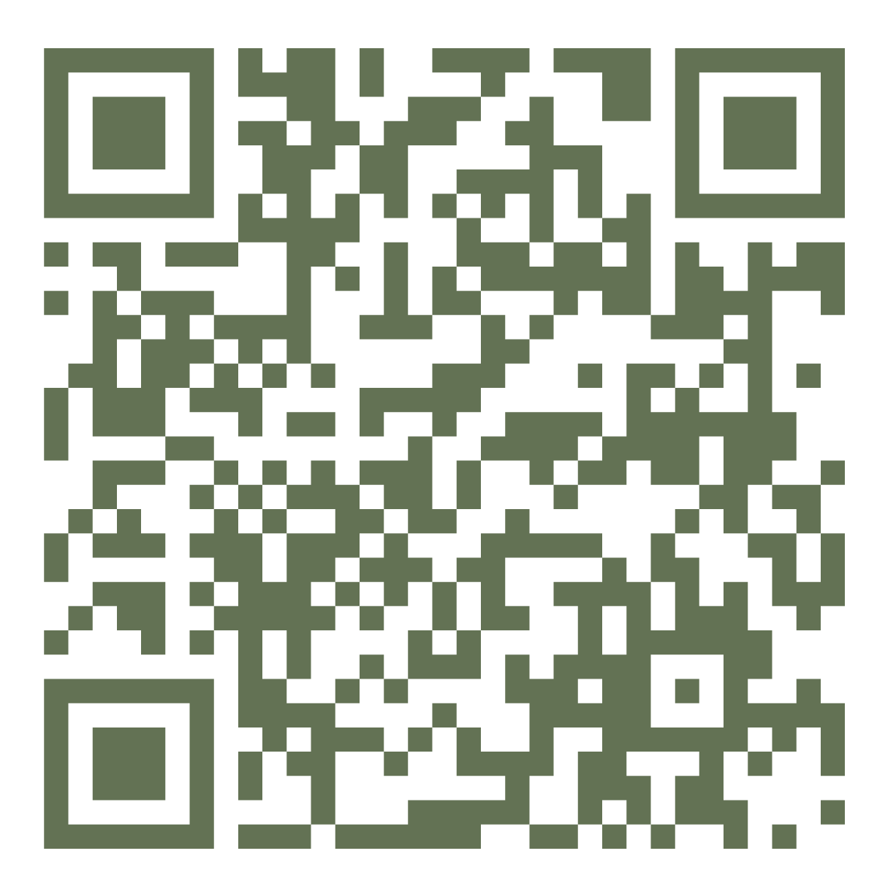
What’s Missing?
Complete (and share) this short survey to inform future resource topics and formats!
You can even suggest specific resources!

Slide 15

Questions?

Slide 16
Deadline to Vote: 11:59pm ET, Wednesday, October 30th
Board of Directors Election: What you need to know!
Learn about the candidates.
You will be able to rank all seven candidates.
Four new members will be elected and will serve one four-year term, beginning January 1, 2025.
Paper ballots were mailed in early October to members without an email address on file.
All members with an email on file as of October 1, 2024, will be sent an email via SurveyMonkey by October 12; the email contains your unique link to vote.
A downloadable ballot will be posted on this page once the election opens.
Five lucky voters will be selected at random to receive an Amazon gift card!

Slide 17
NETWORKING & OPEN DISCUSSION

