Slide 1
Recruiting and Supporting new volunteers
Q4
Notes:
LP

Slide 2
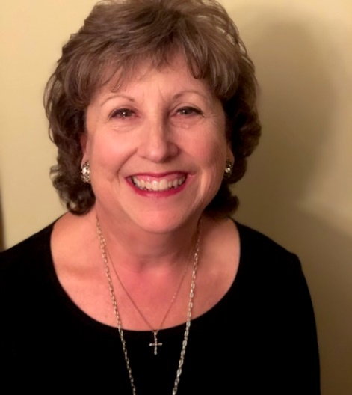
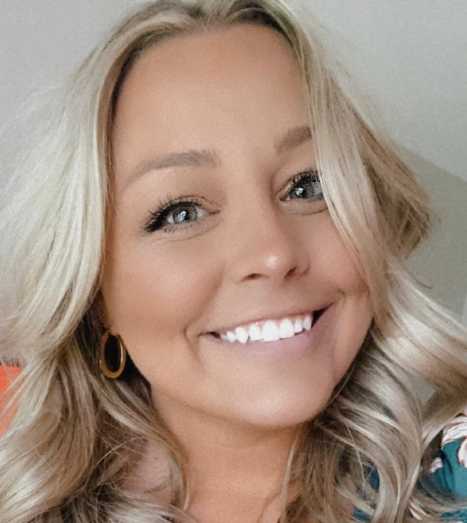
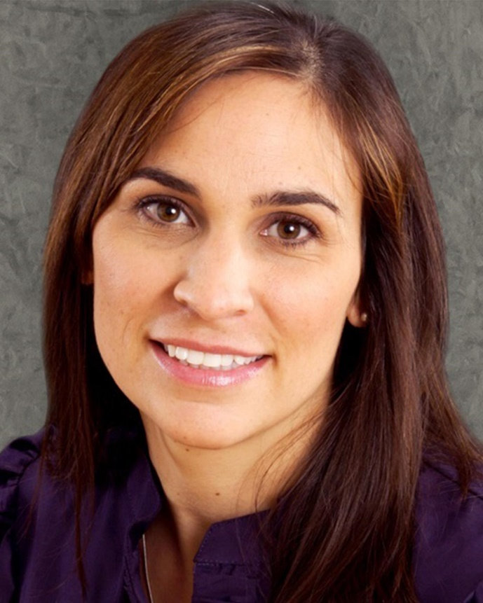
Welcome
Luann Purcell,
Unit Resource Advisor
Danielle Wieczorek,
CEC Component Services Manager
Danielle M. Kovach, Ed.D.,
CEC President
Notes:
LUANN CEC- Danielle Wuh-zor-ick

Slide 3
Please enter the following in the chat:
Let us know you’re here!
Unit
Name
Office/role with Unit
How long have you been in leadership with this Unit
Notes:
LP

Slide 4

Taking Notes? Have Questions?
Open email to luannpurcell@gmail.com and dwieczorek@exceptionalchildren.org take notes and include questions there! Send along to us so we can keep the dialogue going!
Notes:
LP

Slide 5
Agenda
Why it’s important to recruit volunteers
How to recruit volunteers, including tools and ideas!
Essential pieces for onboarding volunteers
Preparing your board to work with new volunteers
Additional resources
Notes:
LP

Slide 6
Why Recruit?
Notes:
LP

Slide 7
Value Add
Membership
Board
Connection to purpose
Connection to people
Exclusive experience
Influence change
Community
Higher engagement and stronger familiarity with organization offerings
New ideas
Creativity
Fresh perspective
Identify areas for growth
Notes:
LP
Volunteerism is a value add in two forms: adds value to the membership experience AND to the board
Volunteerism provides members with a direct connection to a greater purpose and passionate people looking to make an impact and influence change. Volunteerism also provides members with a sense of community and exclusive experiences like contributing to the planning and execution of events, having a hand in organizing new initiatives and programs, and sometimes exclusives such as attending the Leadership Institute. Ultimately, volunteering results in higher engagement levels, a strong connection to the organization, its purpose and offerings and deeper sense of connection to their peers.
When there is a desire to volunteer and a higher percentage of members engaged in volunteerism within the Unit, the board benefits greatly. It allows the board to function at a higher level while delegating roles and responsibilities to individual volunteers and/or committees, brings in fresh perspectives, energy and creative problem solving and creates opportunities for identifying and capitalizing on areas of growth.

Slide 8
Discussion
What challenges does your Unit have when it comes to recruiting (or onboarding) new volunteers?
Notes:
LP
Knowing that there are many benefits to volunteering for both the individual and the board, we recognize you may be facing challenges in the recruitment and/or onboarding process. Take a moment to reflect on your challenges and share with the group in the chat or by unmuting yourself.

Slide 9
Recruiting Volunteers
Notes:
DW
We know that recruiting volunteers can be challenging. Today we will discuss some ways you can start recruiting now without exhausting efforts, and instead sharing how you can use current happenings to open the door.

Slide 10
The Unit’s Responsibilities
Before recruiting members to volunteer, identify the following:
What need(s) are you trying to meet?
What roles need to be taken on?
How many people are required to fill this need?
What is the estimated time commitment?
Identify how they will report back to the board (if necessary)
Then..
Create a job description or committee charge
Market opportunity/opportunities
Language is important! Think about how you can sell the WHY in addition to the WHAT
Make sure someone is responsible for following up with interested parties and keeps notes on the interested individuals
Notes:
DW
First, let’s cover some of the responsibilities the Unit has before launching a full campaign to recruit volunteers.
Raise your hand if you’ve ever been asked to do something by a friend or colleague and agreed to help before you truly understood the scope of the work or task at hand. Thank you. Likely, many, if not all of you agreed to lend a hand at some point in time and were offered little to no context on how they wanted to be helped, felt useless, or felt like you gave up your time for no reason! Maybe you felt taken advantage of and gave far more than you committed and agreed to. All of this is frustrating—and as leaders in our Units, it’s critical that we prevent volunteers from feel this way.
This slide highlights key tasks to accomplish and questions to address before you provide a volunteer with a role. These questions address critical components needed to successfully market opportunities and sell the “real” experience. Remember—it’s not just about “WHAT” they’re doing, it’s also about WHY! As interested members reach out, make sure someone is following up with them! We call after the first date!

Slide 11
Next…
This person should also follow up with any member(s) not selected for the role or committee
Identify ideal qualities, talents or skills that are necessary to perform this role
Learn about their experience as a member (this will inform their perspective)Make sure someone is responsible for following up with interested parties and keeps notes on the interested individuals
This person should also follow up with any member(s) not selected for the role or committee
Onboard the new volunteer
Notes:
DW
Learn more about the interested members and ensure you follow up with members not selected for a particular role, or if there isn’t an immediate need for their generous offer of their time.
From here, we can onboard new volunteers! Before we discuss that, let’s chat about Volunteer Square and recruitment strategies.

Slide 12
Recruitment Tools and Ideas
Volunteer Square
Use and promote
Conferences and events
Use as a recruiting event
Provide micro volunteer opportunities
Take photos at events with volunteers and share on social media
Award or highlight volunteers on social media or website
Seeing this shows potential volunteers your appreciation of volunteers
Notes:
DW
DW
As you’ve likely heard about, CEC provides a one-stop-shop for our Units and Divisions in their pursuit of recruiting volunteers.
Link to form: https://cec1785.wufoo.com/forms/volunteer-square/ Link to report: https://cec1785.wufoo.com/reports/volunteer-square/
This tool is incredibly helpful in collecting and retaining information provided by interested members. Use this report when soliciting applicants for board roles, adding new roles, soliciting event support, when starting a committee, etc.
While Volunteer Square can help recruit support, it’s important to remember that your programs and events provide opportunities for your existing leadership to forge new relationships with potential volunteers. Keep an eye out for passionate members, thoughtful contributors and community builders—talk to them about opportunities, learn about them, collect their contact information and follow up! If you’re using micro volunteer roles during an event or your conference make sure efforts are made to make connections with these individuals!
Even remembering to post and share about your volunteers and the behind the scenes work they conduct can be helpful! When faces, names, roles played, jobs accomplished, etc. are shared, it helps the general member understand all that goes into your Unit’s efforts. You may know what it takes, but most people don’t! Helping to bridge that gap in understanding can serve as a call to members to see just how much goes into your work and how many hands are needed to accomplish great things. When they know more, they can better picture themselves in the roles.

Slide 13
Discussion
How does your Unit successfully recruit volunteers?
Notes:
DW
Your turn! Tell us a little about what is working well for you! How does your Unit successfully recruit volunteers?

Slide 14
Now what?
Onboarding and Preparing the Board
Notes:
LP

Slide 15
Onboarding
After a volunteer is recruited, vetted and placed into a volunteer role, the Unit should welcome and onboard them to prepare them for their as appropriate:
Detail expectations and ensure they have a copy of the job description and review their role/committee charge
Explain how the Unit works with the international organization
Explain the board makeup
Learn about their skills and talents
Answer their lingering questions
Notes:
LP
Onboarding is a critical piece of retaining volunteers—how often do you stick around if you don’t know what’s going on, who to talk to, or what you’re supposed to be doing?
Onboardings can take a mere 15 minutes for some roles while others, like a year-long committee, may take 30 minutes to an hour. As a board or the chair of the committee/team, decide what is most appropriate.
We’ve outlined a few basics that we’d encourage you to include, or consider including in your onboarding. At the end of the day, this is their first opportunity to forge a new relationship with a member of your board or a committee and feel confident walking into their new role.

Slide 16
Preparing the Board
“Eating your young”
Build up their plans, don’t tear them down
Tried something before and it didn’t work? Tell them why by providing historical context.
If you only tried it once, try again! Fix what went wrong before
“Yes and” can be empowering, “yes but” is not
Better to try and fail than to refuse growth due to perceived failure
Promise to seek to understand
Why are they proposing this?
Who is their intended audience?
What is their intended impact?
How is this related to their scope of work? (If it’s not, connect them to the right person to share their ideas with.)
Remember the membership landscape is everchanging—your membership changes every month and year!
Notes:
LP
Every board is in a different place when it comes to welcoming new volunteers, ideas and input. Here are things to keep in mind and practices that create healthy and well-functioning environments.
It can be SO easy to weaponize our experience and historical context when a new (or not-so-new) is shared. While we may not mean to do that, we must keep in mind that we can educate and evolve rather than teach and tear apart. Eating our young is real and it’s our job to remember that volunteering and contributing to their Unit’s growth is a part of their membership experience.
(Cover bullets)
Highlight that membership in their unit is CONSTANTLY changing. Just because it didn’t work 5 years ago doesn’t mean it wont work now!

Slide 17
The Board and Mentorship
Terms and term limits should be in place
Best practice for all non-profits
Limits and changes in leadership is encouraging to aspiring leaders and current volunteers
Coach and teach new volunteers – this is an additional role everyone needs to play into
Communicate vision and goals of the board to new volunteers; use this as a guiding tool when redirection is necessary
Notes:
LP
With any new volunteer, it’s important to keep in mind their potential pathway to Unit leadership. We were all green at one time!
Board leadership should turn over regularly – this keeps the unit growing, sustainable and accessibility.
Your board members should be prepared to coach and teach new volunteers. As you commit to “building your bench” your board must understand that a little extra TLC is necessary.

Slide 18
Tools and Resources
Notes:
DW

Slide 19
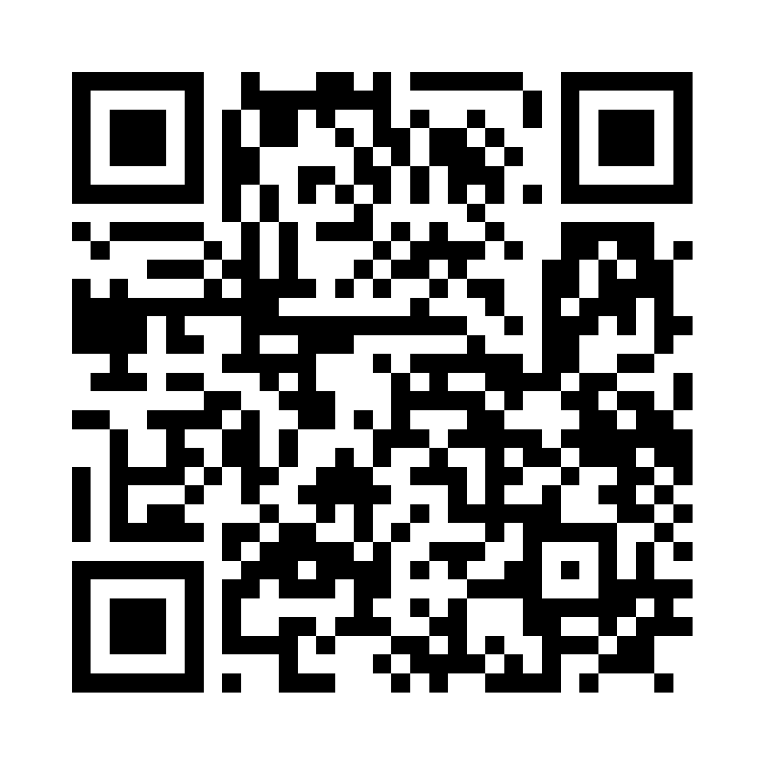
Available Resources – Scan QR Code!
Sample volunteer job descriptions
President, past president, president elect, secretary, treasurer, representative assembly, CAN coordinator, professional development chair, web chair, communications chair, student chair, membership chair
Sample committee description
Sample/ready-to-use Instagram and Facebook posts
Sample New York volunteer recruitment PDF
Notes:
DW
There are a number of resources we have to support your recruitment processes! You can access these through the Unit Resources Page. Feel free to scan the QR code now so you can check them out!

Slide 20

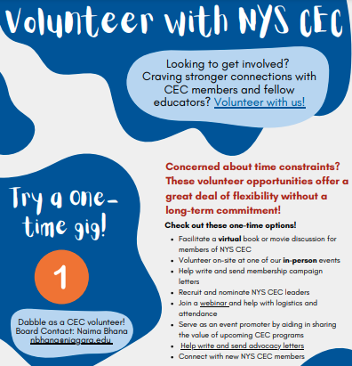

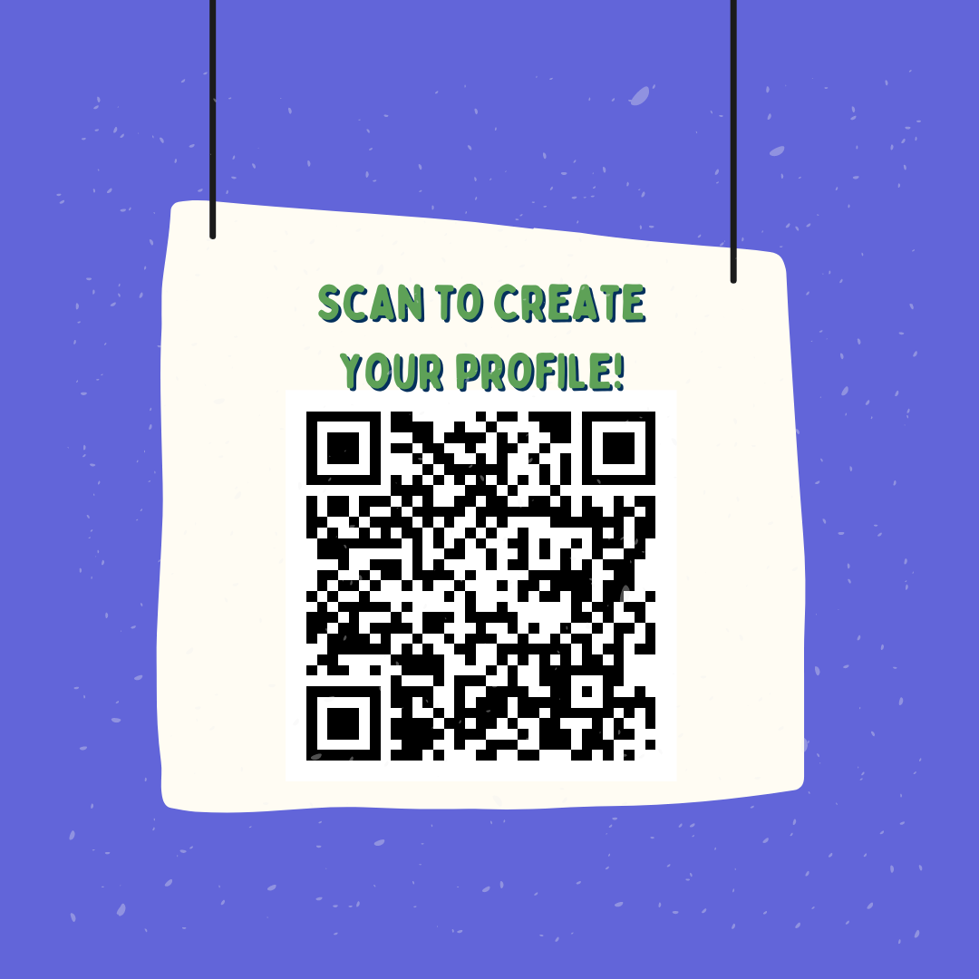
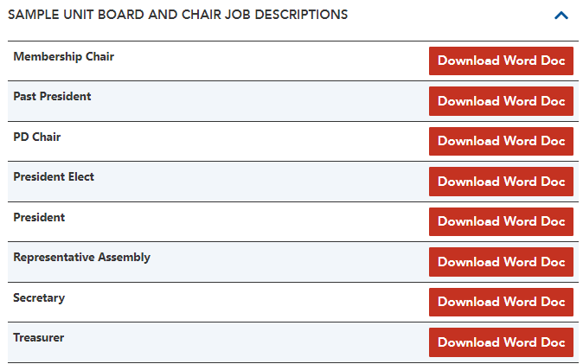
Available Resource Preview:
Notes:
DW
Here’s a quick view at what we have ready for you to view!

Slide 21
Questions?
Notes:
DW

Slide 22

CEC Second: For Student Teachers!
Notes:
DW
https://exceptionalchildren.org/jumpstart/registration
Our programs are your programs!

Slide 23

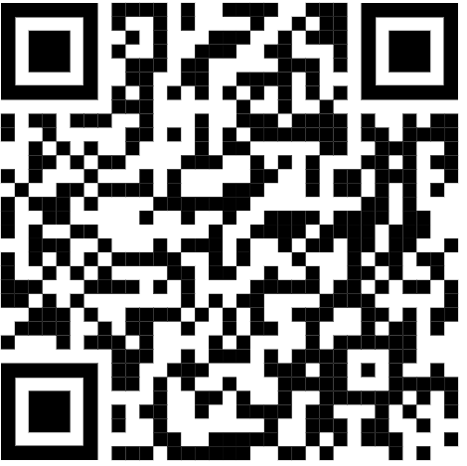
THANK YOU!
Thanks for all you do!
We are here to help!
Danielle: dwieczorek@exceptionalchildren.org
Luann: luannpurcell@gmail.com
Brannan: bmeyers@exceptionalchildren.org
https://bit.ly/3Jh1MXB
Notes:
DW

