Slide 1
Social Media Tips for advocacy Success
Alexandra Garvey, Communications Manager

Slide 2
General Posting Tips
Post photos and text posts before, during, and after the event.
Tag your legislator, your fellow volunteers, and/or CEC.
Share or repost content from other accounts by retweeting on Twitter, sharing on FB, or using an app like Repost to reshare Instagram photos.
Plan ahead.
  Save text posts in a notepad or in an email on your smartphone to make any small edits and publish on the day of the event.
Spellcheck is your friend.
  Twitter does not provide the ability to edit tweets, so make sure everything is spelled correctly before publishing. Spelling mistakes undermine the importance of your message and might deter another account from RT-ing.
Twitter and Instagram: @CECMembership, @cec_headquarters; #4specialeducation, #SELS2019
Check your unit and division social media accounts as well!
Notes:
We’re so excited to see all of your posts from the Special Education Legislative Summit, but there’s no reason you can’t get started now! It’s as easy as sharing who you will be advocating for, or tagging your Representative or Senator on Twitter. Twitter handles for members of Congress are listed under “Resources” on the Special Education Legislative Summit website. Just make sure to use #4specialeducation or #SELS2019 with all of your posts or tag us so we can easily find them, too!

Slide 3


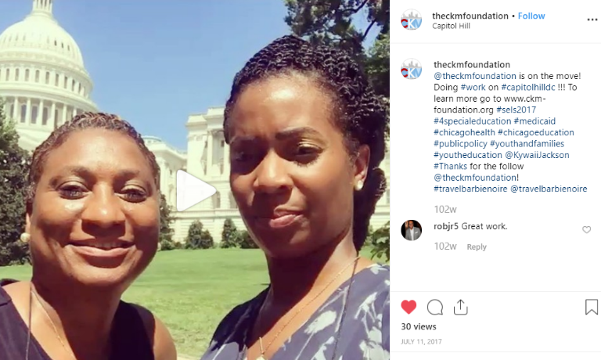
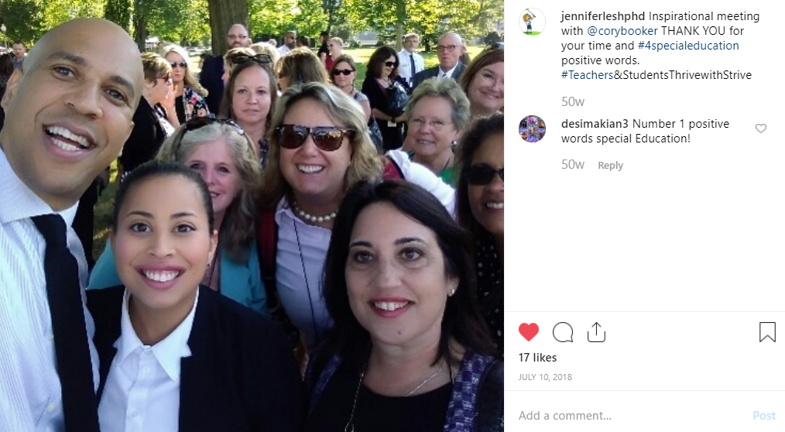
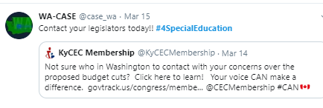
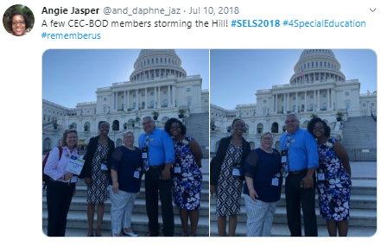
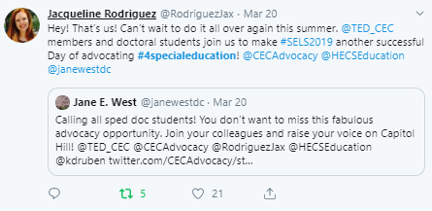

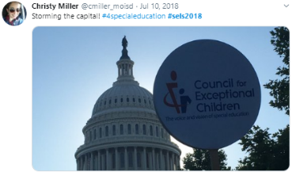
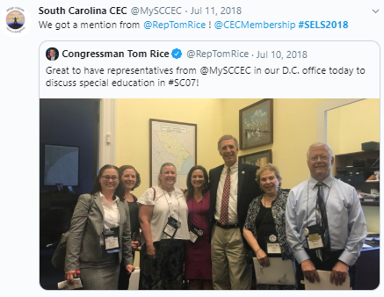
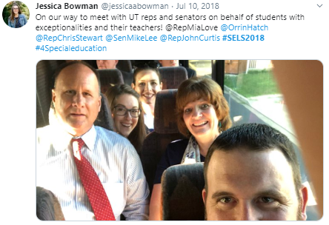
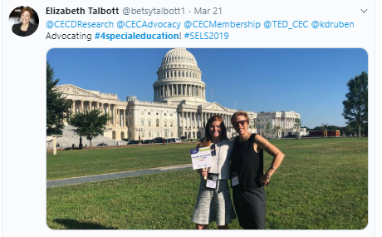
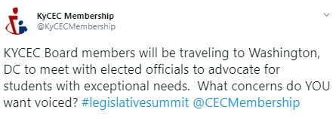
When and Where to Post

Slide 4
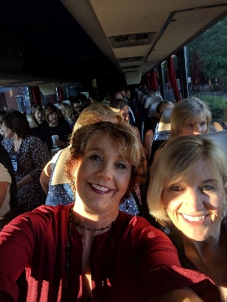
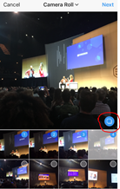
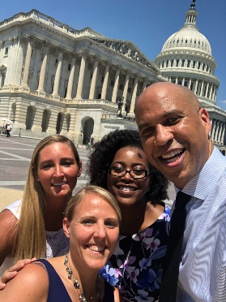
Sharing Photos
Keep in mind…
5 Tips for Taking Better Photos:
When (and when not) to take a photo op.
Condense multiple photos into a single post.
Upload your photos to the SELS Shutterfly.
To avoid harsh glare, trying taking a photo without a flash.
Force your camera to focus the photo on its subject by touching your finger to the screen.
Change your point of view: Be lower or higher than your subject.
Never take video while holding your phone vertically, always hold it horizontally.
Edit your photo using tools like Instagram, VSCO Cam, or Snapseed.
Notes:
Generally, photos receive more engagement than other type of Twitter and Instagram posts, so make sure to take them!
What to take photos of:
o You with your state legislator
o Group photos with all attendees in front of a legislative building
o Group photos on the way to the Hill (e.g., attendees in the bus together)
When speaking with your Representative, keep your focus on the conversation at hand; do not try to take photos while you are meeting with them. At the end of the meeting, politely ask your Representative if you can have a group photo (do not ask for individual photos or selfies).
Other Tips:
o Captured a lot of photos for Instagram? Condense them into a single post using the
carousel feature, which allows you to include up to 10 images in a post. You can
include up to four images in one tweet.
o Run out of characters for relevant user handles? You can tag them in the photo
instead. While it won’t be seen in the copy of your post, the tagged individual will still
receive a notification that they’ve been mentioned (and can RT!)

Slide 5
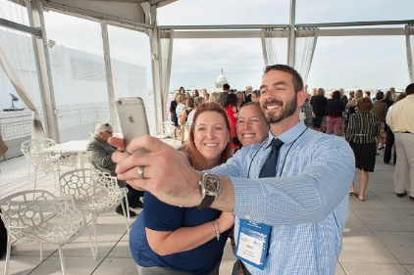
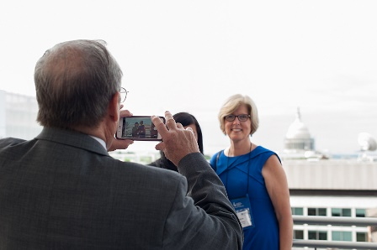
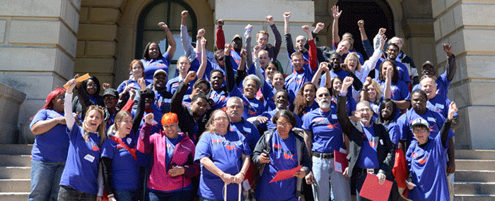
Taking Videos
Get behind-the-scenes.
Get real.
Get creative.
Notes:
Take your followers behind-the-scenes of your day on the Hill. On Facebook, videos receive even more engagements than photos. In addition, Facebook Live and other video assets are prioritized by Facebook’s algorithm over other content types.
As a general rule, we ask that you do not film when meeting when representatives.
Video to capture:
o Walking to your meeting
o Highlights from a meeting you just completed
o Sharing your story of why you advocate
When to Post: As close to real time as possible (but never during your meetings).
Other Tips:
o Have fun and take advantage of different effects for your Instagram Stories like
Boomerang (a mini video that loops back and forth) and Hyperlapse (time lapse
videos).
o Don’t have time to get your video up right away? Save the video using the down-arrow
feature in the upper-right hand corner. When you’re ready to post, look in the bottom
left-hand corner to open your camera roll with saved content.

Slide 6



Text-Only Posts on Twitter
Highlight important points or call your legislators to action with text-only posts.
Notes:
What to write about:
o Why you’re participating in SELS
o Calls to action (e.g. “vote” or “support” certain legislation) tagging your legislator
o Short, frequent updates on how the day is progressing
o Thank your legislator for meeting with you during SELS
When to post: A couple of days prior, let your followers know you’re participating in SELS. At the end of the day, don’t forget to send thank you messages and tag your legislator.
Other Tips:
o Keep your messages short and concise. Tweets can have up to 280 characters, but
you don’t need to use all of them!

Slide 7
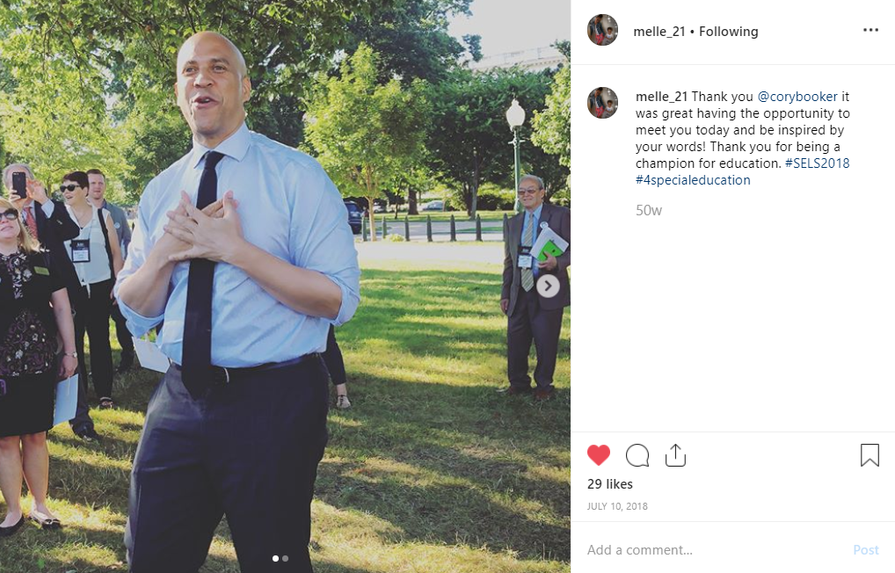
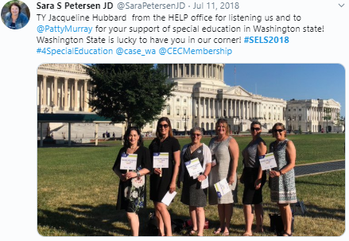
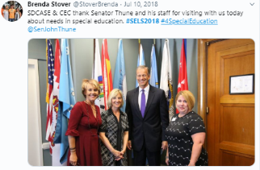

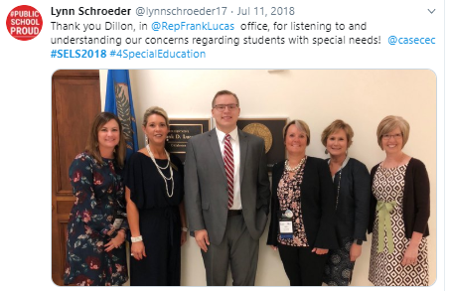
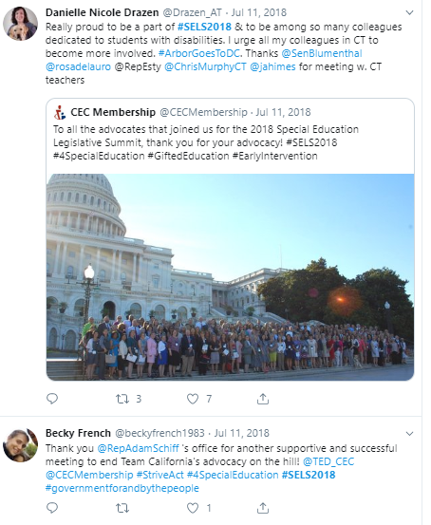
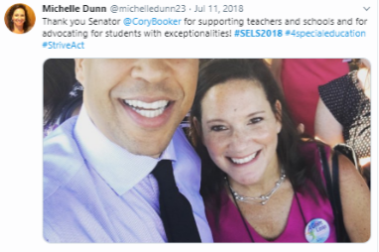
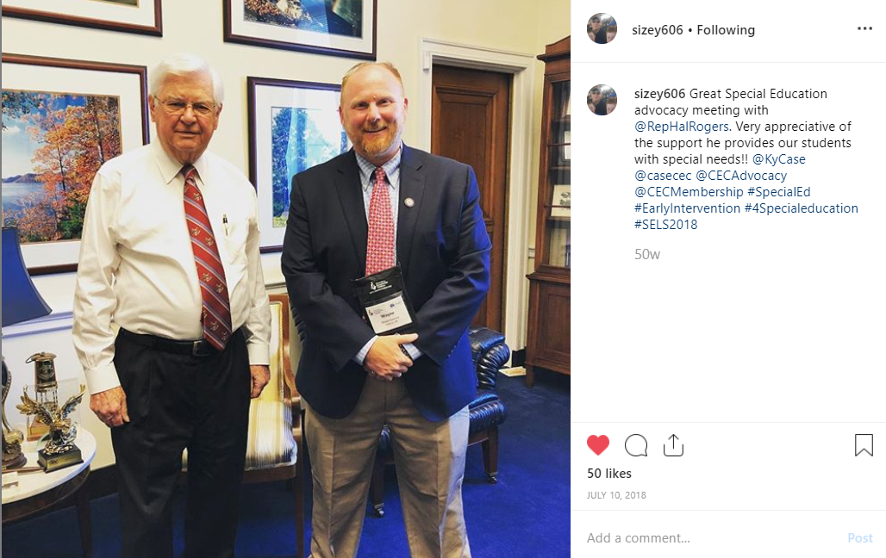
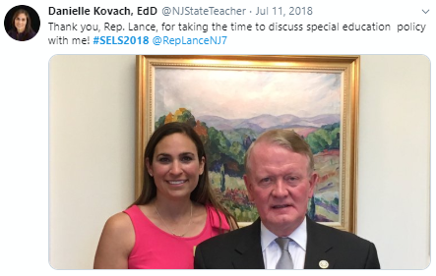
Don’t Forget to Say Thank You!
Notes:
Here are some great examples of how past SELS participants have thanked their congresspeople. Posts don’t need to be long, but clear, concise, and use proper hashtags and handles.

Slide 8
Questions?

