Slide 1
Quarterly Regional Support Townhall
Q2

Slide 2
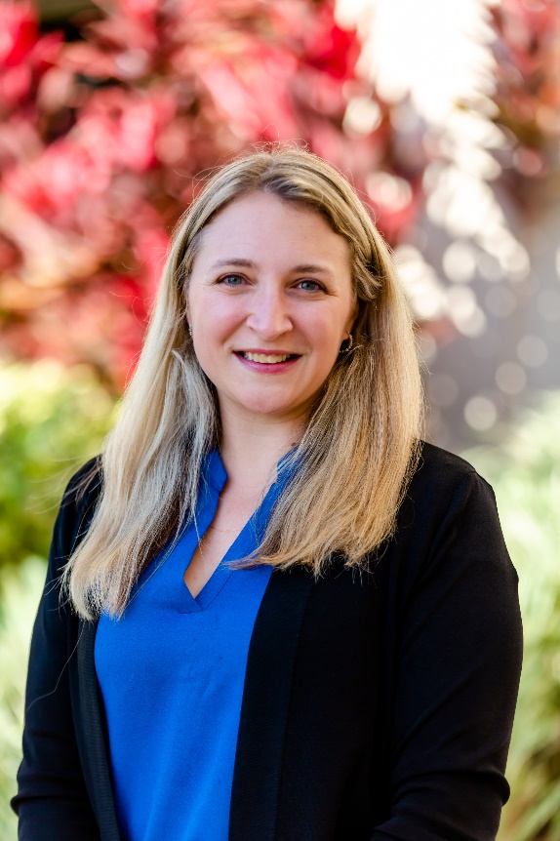
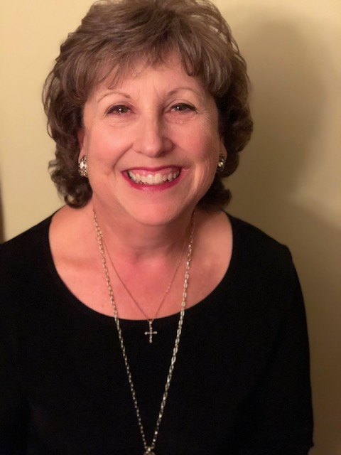
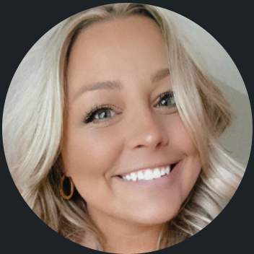
Welcome
Brannan Meyers, CEC Component Services Director
Luann Purcell, Unit Resource Advisor
Danielle Wieczorek,CEC Component Services Manager
Notes:
CEC- Danielle Wuh-zor-ick

Slide 3
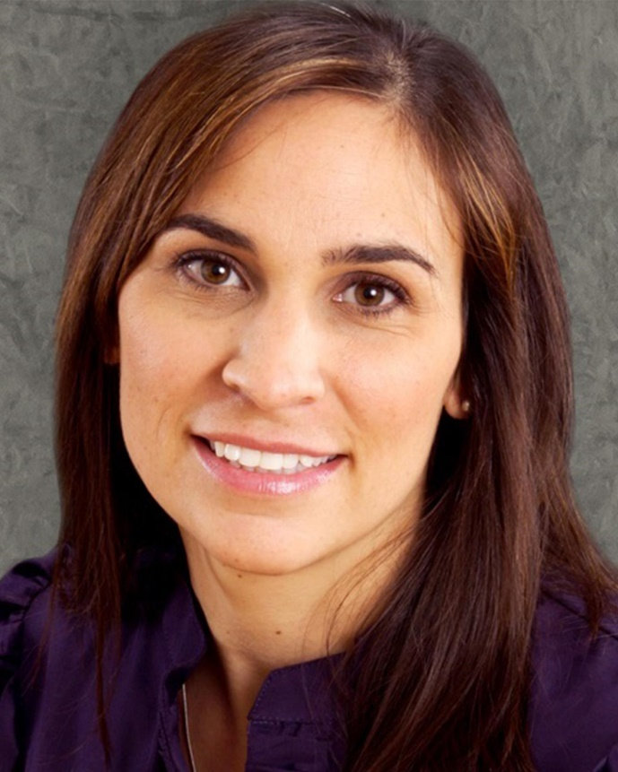
Welcome
Danielle M. Kovach, Ed.D.,
CEC President

Slide 4
Please enter the information below in the chat box :
Who is here?
Unit
Name
Office with Unit
How long have you been in leadership with this unit

Slide 5

First Things First
Open email to bmeyers@exceptionalchildren.org, luannpurcell@gmail.com and dwieczorek@exceptionalchildren.org
take notes there, send when done so we can keep the dialogue going!

Slide 6

Welcoming Your Unit’s Membership
Why is this so important
Where do you go to find who your new members are
When are you going to reach out
Who is going to reach out to them
How are we going to reach out to them
What are we saying
Notes:
This is what we are going to cover this hour and why we asked for you to bring your units membership chair or someone who is in that role. It is important that we ( cec international) know who is int his role so we can make sure they have the right settings in our system to get access to membership reports! We are going to go through the steps of why it is so important to welcome your units members, the steps you can take to get there successfully and tools to assist you on the way!

Slide 7
Why
Onboarding is a critical piece of new members’ acclimation to your unit
Consistency in kicking off the membership experience
Ensures connection from the start
Creates exposure to people and programs
Builds community
Intentional engagement between members
High ROI
Notes:
Imagine going to a restaurant and having the hostess give you a warm welcome, quickly followed by the waiter coming over to get your drink orders and tell you all about the evening’s specials.
Now imagine going to a restaurant where the hostess throws some menus onto a table for you without even saying hi, and then you’re left wondering who your server even is.
Odds are, you’re more likely to return to the first restaurant — and a good new member welcome letter works in a similar way.

Slide 8
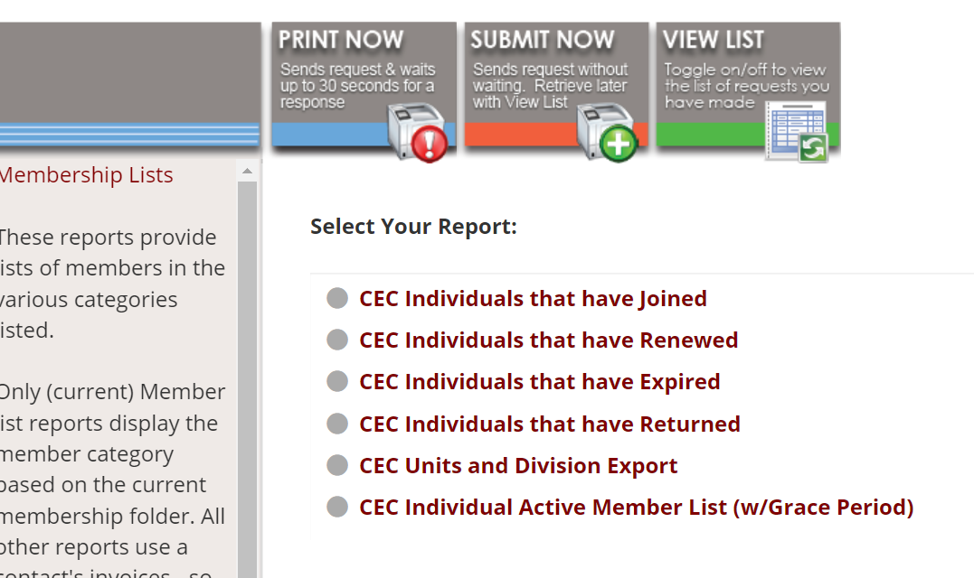
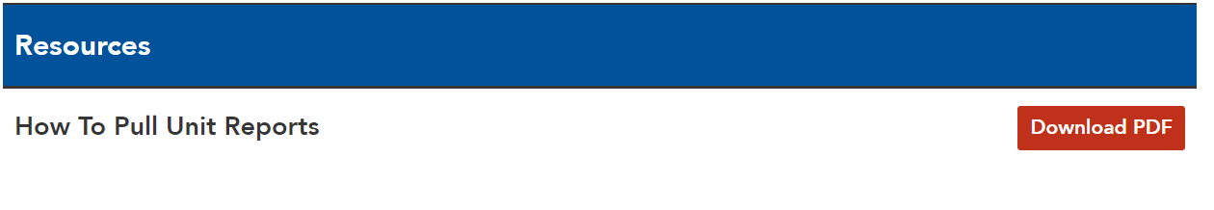
Where
Pulling Member List
https://exceptionalchildren.org/engage/resources/units

Slide 9
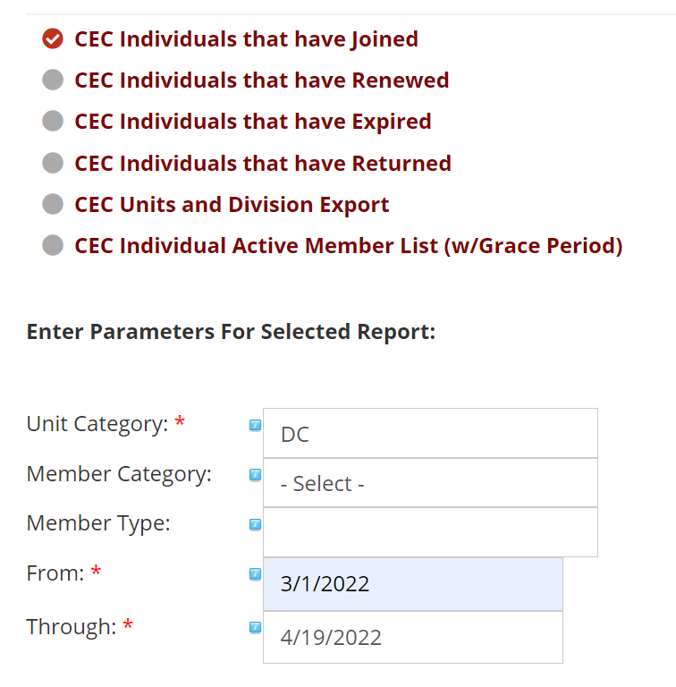
Where
Multiple reports you can pull
  New Members
  Renewed
  Returned
Notes:
New vs Returning, List to Pull- Understanding who your members are

Slide 10
When
How often will reports be pulled and welcome messages be sent? (Monthly? Bi-monthly?)
Establish dates by which these reports will be pulled.
Establish dates by which welcome messages will be sent out.
Create a process not a checkmark
Things to Consider:
Consider how often members are joining and any programs or recruitment initiatives that may make particular seasons busier. For example, if you are hosting a recruitment event, you may want to do these weekly for the month so as to not overwhelm yourselves if 25+ members join at once.
Notes:
Having a calendar ahead of time something that you can put on your personal calendar to remind you, or that you can know a specific date ( 15th of each month for example) you are more likely to do it. Also important to think of times when you may need to be sending more frequently!

Slide 11
Who
Who will handle executing the welcome and additional onboarding steps for your new members?
Will your Unit require more than one individual to execute this process?
Consider having your membership chair run this process or using a new member support committee!
When the lead for this initiative is named, they should move forward with the following steps, creating a committee or welcoming added support from non-board members as necessary.
Notes:
New vs Returning, List to Pull

Slide 12
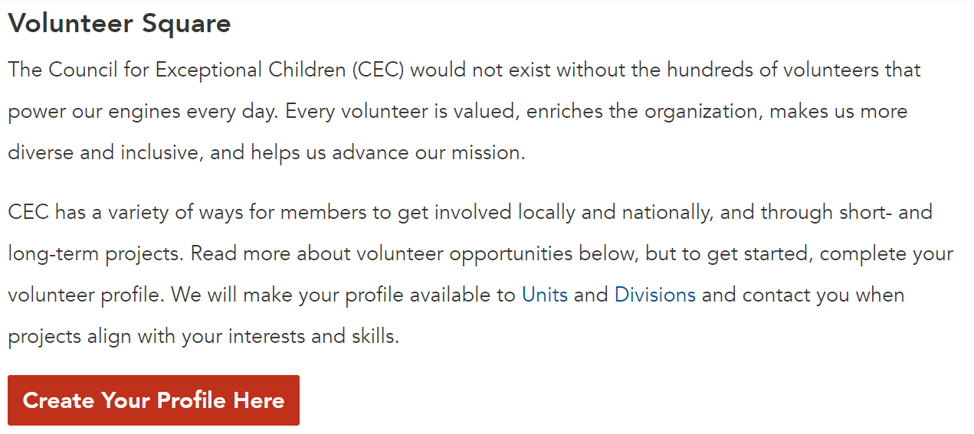
Who
This is a great opportunity to tap into Volunteer Square to involve individuals who have already expressed interest in volunteering!
https://cec1785.wufoo.com/reports/volunteer-square/
PLEASE NOTE: You can post the link to Volunteer Square everywhere, but the list of those who have signed up is confidential to division and unit leaders only.
Notes:
Are you aware of Volunteer Square? Job Descriptions?

Slide 13
Starting with a Warm Welcome
How
How do you welcome new members?
Tell us in the chat or unmute your microphone!

Slide 14
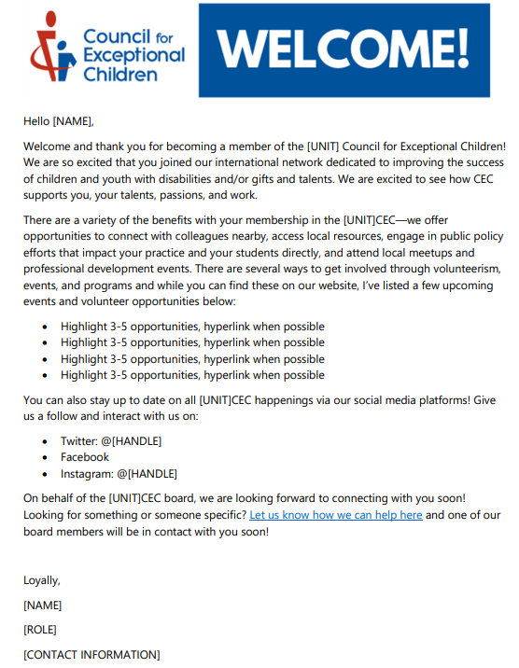
Sample Welcome Letter
Let them know…
You’re excited they’re here
How they can connect with members
What’s upcoming/what they can expect
Where to find important information
Of any action items that require their follow-up
Who they can reach out to for more information or with questions about your specific Unit
Notes:
The perfect new member welcome letter onboards your members in a friendly way that ups the odds of retaining them as a member for the long haul. The format and messaging of your new member welcome letter will vary based on your unit-but there are some best practices on what to include and what not to include that can help make it a little easier.
A “thank you for joining” membership letter should include a personalized greeting to the new member. Use the member’s first name in your salutation rather than a more generic greeting like, “Dear Valued Member.” This ensures they feel recognized as an important individual within your organization and fosters a friendly atmosphere for you both to get to know each other more.
Members keep your organization running — so let your new member know just how much you appreciate them being a part of your community. Aim to be specific and authentic in your thank you, letting them know that you value their time and participation. Thank yous are best given early and often!
3. Highlight Upcoming Events
Retaining your new members starts right away by helping them get more involved with your organization so they see the value of their membership. In your new member welcome letter, include a list of any upcoming events they may want to attend. Personally invite them and let them know you hope to see them there.
If you know their specific interests, you can also highlight any events you have that you think would be of particular interest to them. This shows them that you’ve paid attention to their needs as a member and are already working to make sure their experience is the best it can be.

Slide 15
Sample Welcome Letter
Let them know…
Reinforce Value
Manage expectations
Keep it Simple
Notes:
4. Reinforce the Value of Your Membership
In addition to events, highlight any other benefits your new members may want to utilize immediately. These could include things like mentorship programs, volunteer opportunities, resource libraries, or special member discounts. You want to help your new member see a quick reminder of exactly why they signed up. A quick bulleted list of all they can benefit from during their membership is an easy way to demonstrate that value.
5. Explain What New Members Can Expect
Your new member welcome letter sets the stage for what’s next. You send it very soon after the member has signed up, but that doesn’t mean it’s all you’ll do to help welcome them. Remind them that there’s more to come by listing what they can expect next from you. This could include a new member welcome packet, a full onboarding series through webinars or other meetings, or calls from you and other support staff.
Letting your new member know what they can expect next gives them something to look forward to and helps them get their footing with your organization.
7. Keep It Simple
In addition to keeping the background information about your organization brief, you’ll want to ensure your new member welcome letter is written in an overall easy-to-read format. Let’s face it — most of us have a lot of emails and mail to get through, so we skim. Your new members likely will, too, so by keeping your welcome letter digestible, they’ll be able to better engage with and absorb its content. This way, your welcome new members message won’t get lost in an inbox.

Slide 16
How have welcome letters helped you acclimate to a new community, role or organization?
Notes:
Engagement opportunity - drop in chat or come off mute

Slide 17
Beyond the Welcome Letter
Once your Unit already has a consistent Welcome Letter they send, Next Steps would be to focus on some additional Goals:
Goals may include:
  Retention of a target group
  Generating interest in volunteerism
  Increasing event attendance
  Peer-to-peer connection
  Membership recruitment
Follow through on promises or initiatives highlighted in your welcome letter

Slide 18
Program Ideas
There are many ways to engage in CEC membership. We’ll take care of the big-ticket items for all members. Consider the unique opportunities within your Unit and recruit your newest members to participate!
Onboarding buddies
  Pair new members with engaged, involved members
  Pair new members with other new members with similar interests, professions, etc.
Meet and greets
  New member meet and greet
  New member and board meet and greet
Sample experiences
  Attend committee meeting or rotate committees
  Attend a book club meeting
  Social gathering or networking opportunity
  Offer a guest pass—where can they bring along a non-member friend?
Highlight new members on social media or in newsletters to promote member to member connection
Solicit information from new members to connect them to programs or people
Offer to walk them through the CEC website/Unit’s website

Slide 19
Data Matters
History
  Do you know your membership trends
  What lead to these trends ( good and bad)
Going Forward
  Identify tracking tools for this new process
  How will you know it is working?
Notes:
Trends and history… important for the leadership to look at what their membership has been and constantly be aware of growth or loss… and if there was a growth—what were the factors so they can be repeated… the biggest thing I think about having a trending or history of membership is it keeps the numbers in front of them…the issue in front of them… ( Chart as resource that Luann created)

Slide 20
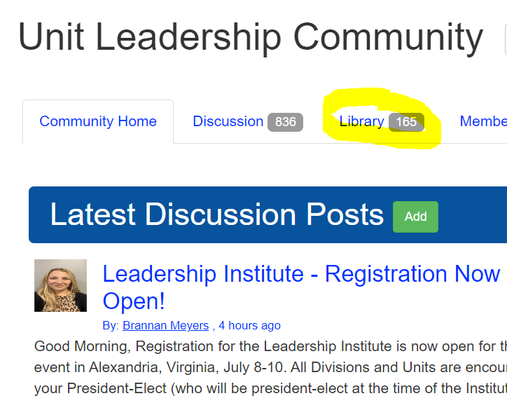
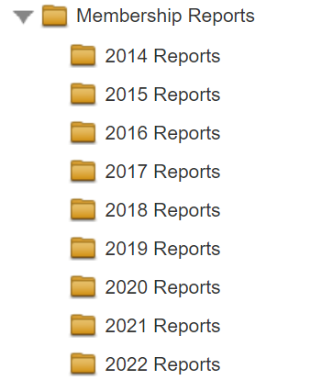
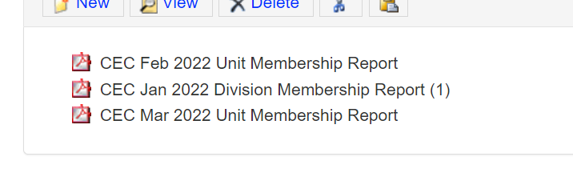
Where to Find Data
Notes:
https://community.exceptionalchildren.org/communities/community-home?CommunityKey=89865203-2504-4737-8b4e-be3c4399e6ac

Slide 21
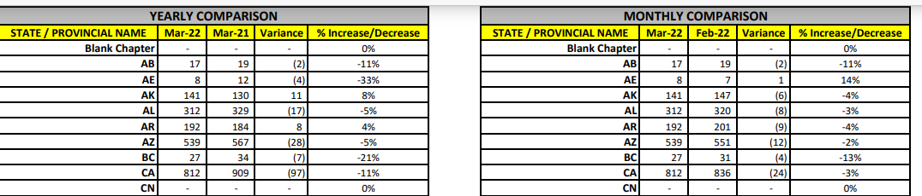
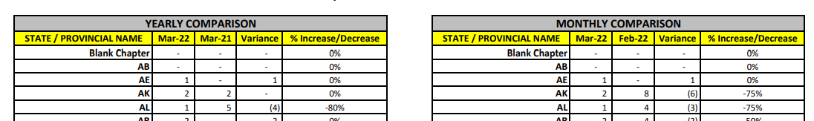
Where to Find Data
Notes:
https://community.exceptionalchildren.org/communities/community-home?CommunityKey=89865203-2504-4737-8b4e-be3c4399e6ac

Slide 22
Tools and Resources
CEC Resources
Email Systems & Tools
CEC Resources
  How to Pull Unit Reports
  Sample Welcome Letter
  Next Steps
  Danielle, Luann & Brannan
Moosend (free and paid plans)
Mailchimp (free and paid plans)
Constant Contact (paid plans only)
Smore ( free and paid plans)
Social Media Schedulers
Later (free and paid plans)
Hootsuite (free and paid plans)
Buffer (paid plans only)
Tweetdeck (free)
Notes:
We know we discussed a lot, and we have created tangible resources that you can bring back to your team/board and discuss how to implement and steps to take!

Slide 23
Save the Date
Leadership Institute
July 8th-10, Alexandria VA
1:00 pm on July 8th- 12:00 On July 10th
Book Hotel and Register Here:
https://exceptionalchildren.org/get-involved/cec-leadership-institute
Special Education Legislative Summit
July 10th-13th, 2022
Learn More : https://specialeducationlegislativesummit.org/
Notes:
Held in Washington, D.C., during July, the Special Education Legislative Summit (SELS) is an opportunity for educators from across the country to make a difference by advocating for change with Members of Congress.
Mark your calendars to join us July 10-13, 2022.

Slide 24

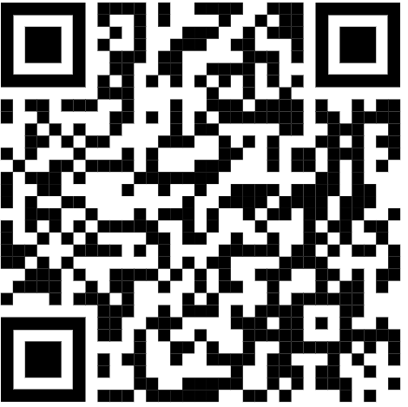
THANK YOU!
Thanks for all you do for CEC, Students, Staff, Family!
We are here to help
Brannan bmeyers@exceptionalchildren.org
Luann
luannpurcell@gmail.com
Danielle
dwieczorek@exceptionalchildren.org
https://bit.ly/3Jh1MXB

