Slide 1
Quarterly Regional Support Townhall: membership Renewals
Q4

Slide 2
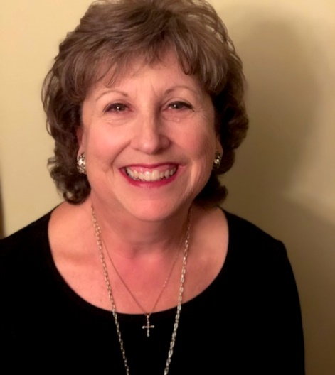
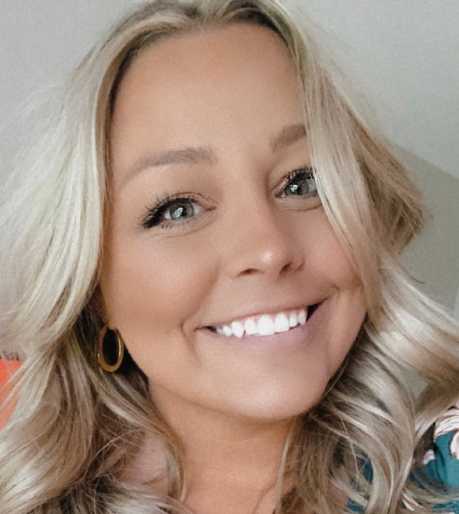
Welcome
Luann Purcell,
Unit Resource Advisor
Danielle Wieczorek,
CEC Component Services Manager
Notes:
LUANN CEC- Danielle Wuh-zor-ick

Slide 3
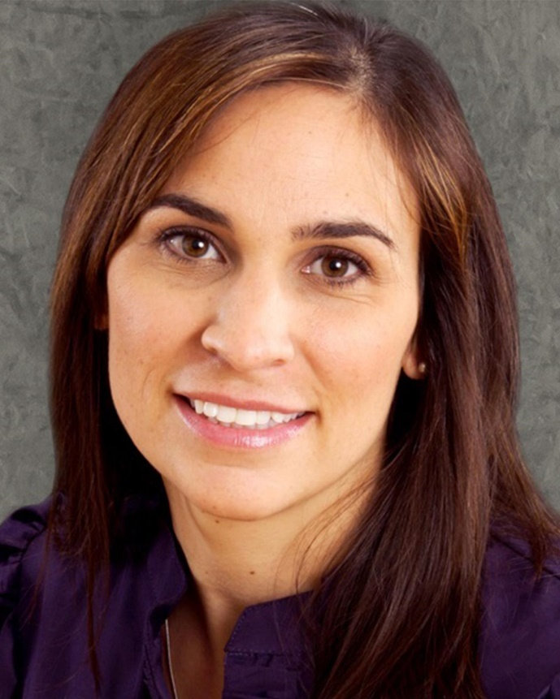
Welcome
Danielle M. Kovach, Ed.D.,
CEC President
Notes:
Luann

Slide 4
Please enter the following in the chat:
Let us know you’re here!
Unit
Name
Office/role with Unit
How long have you been in leadership with this Unit
Notes:
Luann

Slide 5

Taking Notes? Have Questions?
Open email to luannpurcell@gmail.com and dwieczorek@exceptionalchildren.org take notes and include questions there! Send along to us so we can keep the dialogue going!
Notes:
Luann

Slide 6




Renewal
More than just a bill!
Use Proposition Value
What’s coming up?
End of cycle benefits
“Bob, You Expire Tomorrow”
Too late
Notes:
DW When you get your electric bill- you don’t pay it because you got the bill, you pay it because you want electricity! Make sure to remind your members of the value they are getting.
What is the reason they should stick around for another year?
What exciting initiatives do you have coming down the pipeline that they would miss if they left?
If you’re worrying about renewal as soon as people are about to expire its too late, part of renewal is checking in throughout the year. Throughout the year, consider reminding them they are receiving this benefit (conference discount, free webinar, etc) because they are a member of CEC and Your Unit!
However once you get around renewal season think about offering a benefit ( a webinar that is complimentary to members) to reinforce your value.
Personal renewal outreach ( board members)

Slide 7
Poll
Does your Unit send anything to expiring members?
Notes:
DW/Brannan
Poll already created

Slide 8
CEC IHQ Practices:
Board contact
Membership renewal mailings
Email notifications
Let’s talk about where you can help!
Notes:
DW/Brannan
CEC has several practices it uses to connect with members regarding their approaching membership expiration
We send multiple forms of communication – mailings, emails, etc.
Elaborate on CEC board contact and their efforts monthly to reach out to expiring members and/or ask Dani to share if she is on the call
It is important to remember your members are more likely to open communications from your unit than from headquarters!

Slide 9

CEC Renewal Process
Member receives renewal notice
Member receives invoice
120 Days
90 Days
60 Days
Member receives renewal notice
Kevin’s email
30 Days
Member receives ‘Sorry to See You Go’ email
Member receives final notice
30 Days
7 Days
15 Days
Renewal date
Board email
Notes:
DW
This chart outlines CEC’s current practices– this likely looks familiar to those of you who attended the Leadership Institute!
Briefly describe the flow of these communications
Notice vs. invoice
Why we do a follow up “sorry to see you go” email
We will cover when the Unit should engage later in our time together

Slide 10
Why is your messaging important?
Retention:
Member retention can lead to seasoned members in volunteer roles
Sustain your advocacy work
Retain professionals in the field
Reaching out:
Building personal relationships
Connected membership
Value in the individual
Learn from them (why they are staying or leaving)
Notes:
DW/Brannan
If CEC handles these, why should your Unit be involved?
Your efforts can build and strengthen you retention rate—this isn’t just membership numbers focused—retained members means…
Your unit can recruit seasoned members in volunteer roles who may have a reach outside of your regular circle
Your advocacy work can be sustained and driven forward
Increased opportunity to retain professionals in the field!
Your reach out also…
Builds personal relationships and strengthens membership connectedness to people, programs and purpose.
Shows that you value the individual

Slide 11
Discussion
1. Why do you think members in your Unit are choosing not to return to CEC? 2. Why are others choosing to come back?
Notes:
DW/Brannan
Breakout rooms to pair together if possible (haven’t done this before bc attendance is so low

Slide 12
Why they’re leaving
In the 2021 Membership Marketing Benchmarking Report, Higher Logic asked associations why they think members don’t renew.
50% of associations say it’s because of a lack of engagement with the organization
Note: This number is growing – up from 41% in 2019 and 43% in 2020.
31% of associations believe it’s because members left the field, industry, or profession
29% of associations say it’s because members forgot to renew
Notes:
Luann

Slide 13
CEC Says…
Members most often report they are leaving the field
Coming soon: MORE DATA!
CEC is adopting a new platform that will gather additional data for more detailed metrics
Notes:
Luann

Slide 14
Retention > Recruitment
Retention
Facilitate regular communications
Connection with members
Connection to programs and interests
Continued attraction to value
Recruitment
Identify target groups and potential members
Identify values and interests
Targeted messaging
Sample experiences
Onboarding
Engagement efforts
Discounted membership/ incentives
Membership campaigns
Notes:
Luann
Remember, it is always less expensive and involved to KEEP a member than to get a member to join who has never been a member!
Also, a huge issue in the field of Special Education is the retention of teachers and other professionals in the field.
One of the big reasons people indicate they leave the field is their feeling of being unsupported… your unit/chapter can play a key role in helping your members feel connected and supported.

Slide 15
Data Matters
History
Do you know your membership trends
What lead to these trends (good and bad)
Are you asking members why they are leaving?
Track this information and use it to inform your future plans
Going Forward
Identify tracking tools for this new process
How will you know it is working?
Notes:
Luann
Trends and history… important for the leadership to look at what their membership has been and constantly be aware of growth or loss! Speaking with your members (leaving or staying) can help to inform your Unit’s plans, goals and vision.

Slide 16
When
Expiring
Before the membership has expired
1-2 months before
Expired
After the member has expired
1-2 months after expiring
Notes:
DW/Brannan
Let’s discuss when the Unit’s communication should fit into the CEC structure
Follow up with members who said they were renewing but have expired
Consider external factors like your state/provincial conference—will they need to renew to get the early bird rate? Etc.

Slide 17
Who
Identify your renewal team members!
Board members
Membership committee
Membership chair
Pass along messages or members to CEC staff when
Members are frustrated with the greater organization
There are concerns about renewing/how to renew
Notes:
DW/Brannan
Who can help with this process?

Slide 18
Discussion
How
What challenges do you see your Unit facing regarding renewal campaigns?
Notes:
DW/Brannan

Slide 19
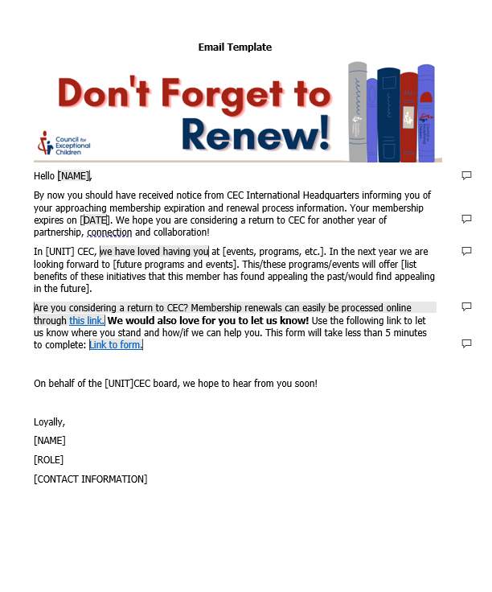
Sample Renewal Letter
Let them know…
You know their name
The value they bring
Where you have seen them
Where you want to see them
Things to look forward to
Their membership expiration date
Where to renew
Notes:
DW
New resource on Unit Resources page
Comments guide the resource editing process for your Unit

Slide 20
Tips
Personalize
Make it conversational in nature
Be direct regarding their expiring membership
Ask them about how membership is/has benefitted them
Link (or offer to share) membership renewal link
Include contact information (for you and CEC)
Be smart about the subject line!
Have chapters? Partner with them!
Notes:
DW/brannan Writing tips

Slide 21
Navigating Disgruntled Members
Who to connect them with
service@exceptionalchildren.org
(888) 232-7733 or (703) 620-3660
Live Chat
Knowing the difference between:
Unit offerings
CEC offerings
Division/Sub-division offerings
Chapter offerings
Notes:
DW
Remember, we can help! Share feedback with us or direct the member to us if necessary
Consider sharing feedback with other Divisions/subdivisions if the feedback is for them

Slide 22
Closing Discussion
What ideas do you have for your Unit’s renewal campaigns?
Notes:
Luann

Slide 23
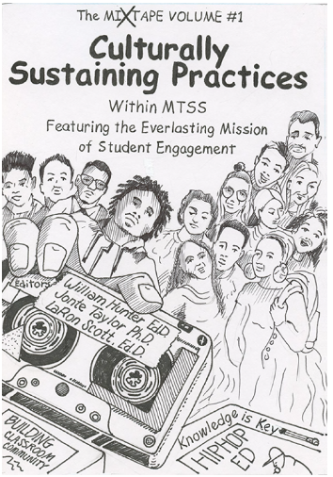
A CEC Second: PRESALE!
The Mixtape Volume 1: Culturally Sustaining Practices Within MTSS Featuring the Everlasting Mission of Student Engagement
Expected Release: Fall 2022
Intended audiences:
postsecondary institution faculty members, researchers, administrators
General and special education teachers
Parents
Others who work with youth with exceptionalities in the United States and globally.
#P6362 / ISBN Number: 978-0-86586-560-0
Presale Member Price: $34.95 (23% off)
Notes:
Luann
A quick CEC second: We will use these as quick reminders and notifications! Today’s “second” is reminding you of this pre sale!
https://exceptionalchildren.org/store/books/mixtape-volume-1-culturally-sustaining-practices-within-mtss-featuring-everlasting
Authors: William Hunter, Ed.D.
Jonte Taylor, Ph.D.
LaRon Scott, Ed.D.
#P6362 / ISBN Number: 978-0-86586-560-0
Presale Member Price: $34.95 (23% off)
Presale Non-Member Price: $44.95
Focusing on interventions, strategies, and considerations that can support teachers in working with all students academically and behaviorally, this book interweaves the spirit of Hip-Hop throughout its content. One of the consistent themes is building community for elementary and secondary students.

Slide 24

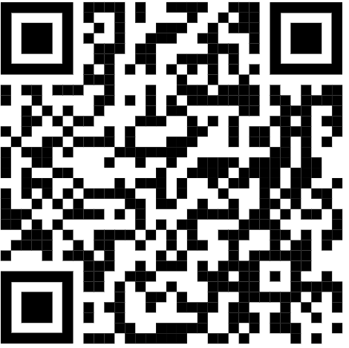
THANK YOU!
Thanks for all you do!
We are here to help!
Danielle: dwieczorek@exceptionalchildren.org
Luann: luannpurcell@gmail.com
Brannan: bmeyers@exceptionalchildren.org
https://bit.ly/3Jh1MXB
Notes:
Luann

