Slide 2
Beyond the Inbox: Enhancing Member Communications Through Email
Nick Cafferky + Hannah Hickman

Slide 3
Today’s Agenda
Building + running a successful email program within your means
Best practices for email marketing
Crafting compelling emails
What metrics to pay attention to
Notes:
This is what we plan on covering today:
What does it take to build and run a successful email program within your means
Best practices for email marketing
How to craft compelling emails that your members will be excited for
How to wade through the mass of numbers and metrics to figure what makes sense to track

Slide 4
Email Remains King of Communication
Most common platform to engage members (85% of associations)
Most common way to welcome new members (81%) and get renewals (98%) from current members
Most effective platform to recruit new members (46%)
Notes:
Why do you want to build an email program? Email is one of the most widely used communication methods. Every single day, 347.3 billion emails are sent. With that number, it’s clearly effective.
Email is the most common platform that associations use to engage with their members.
It’s the most common way to welcome new members and push renewals to their current members.
It is also one of the most effective platform to recruit new members.
The numbers don’t lie. Email works and it’s important to create and maintain a healthy email program to connect with your members.

Slide 5
Benefits of Email
  Targeted and personalized communication
  The ability to gather information and feedback
  Immediacy without feeling as intrusive as SMS
Notes:
Email allows you to send information directly to your members in a place that they will be checking regularly. With the information you can glean from your member information and past emails, you can ensure that you are being adaptive and responsive to what your members want. And if you have non-members on your email list, you can use your email program to share valuable information that will entice them to become a member or more involved. When you have a well-run email program, you can target and personalize your communication (don’t you love it when your emails specifically address you?), gather information and feedback directly from respondents, achieve higher engagement rates for your resources, events, and beyond, and improve your member satisfaction and retention. Email also allows you to send time-constrained information immediately to your members and beyond without feeling too intrusive, something that many people express with SMS or text programs.

Slide 6
Common Email Types
Newsletters – monthly opportunity to tell your members about everything going on in your organization
Welcome emails – Introduce new people to your organization
Renewal emails
Promoting upcoming events or offerings
Notes:
These are the most common types of emails that association email programs send out. In the next few slides, we’ll be running through more information about each, how you can utilize them, and some best practices.

Slide 7
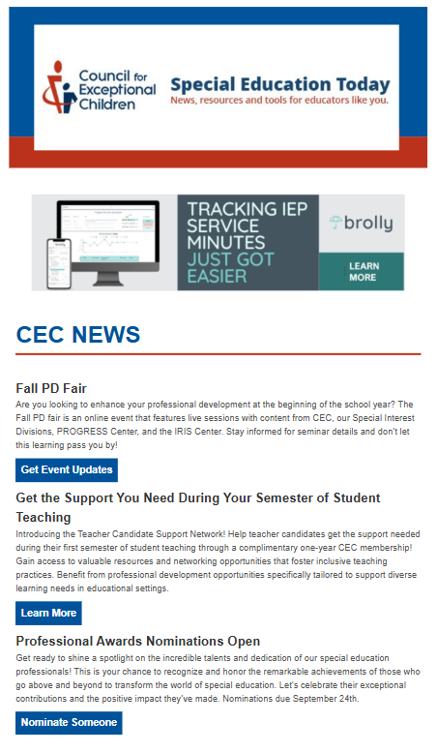
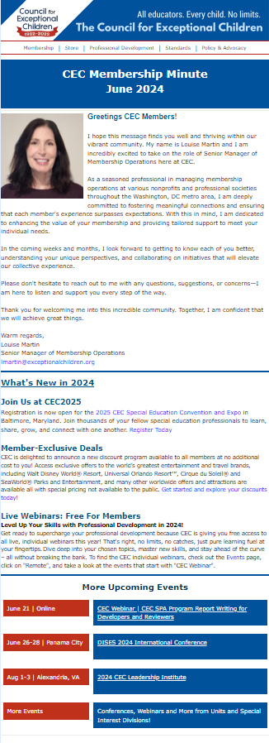
Newsletters
Condensed and easy way to keep members informed
Great for re-promoting older resources
Can be “themed” certain holidays
Notes:
1. Newsletters
Purpose: Serve as a comprehensive monthly update, providing members with the latest news, events, and highlights from the organization.
Content Ideas: Include upcoming events, recent achievements, member spotlights, educational resources, and relevant industry news.
Best Practices: Keep the content concise and visually appealing. Use clear headings and subheadings, and include calls-to-action (CTAs) to encourage further engagement.

Slide 8
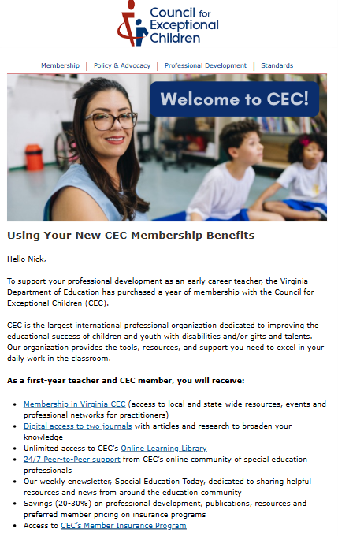
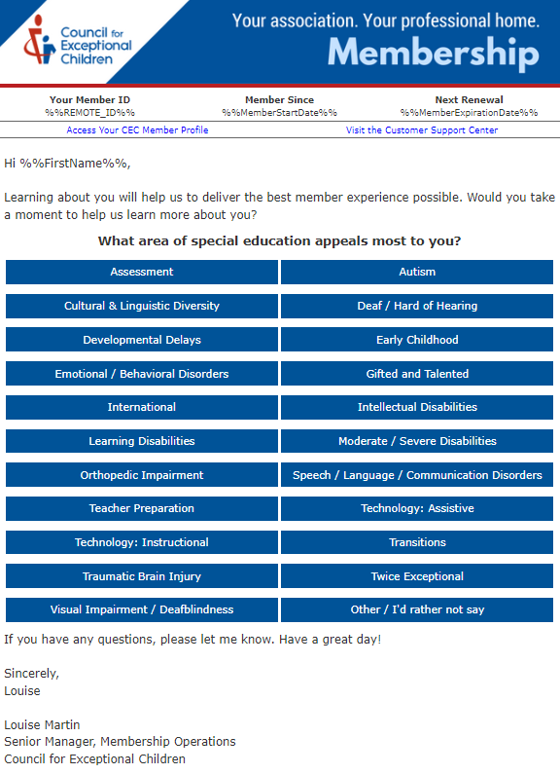
Welcome Emails
Introduce your organization and put your best foot forward
Include a survey to learn about them
Notes:
2. Welcome Emails
Purpose: Make a positive first impression on new members by introducing them to the organization, its mission, and the benefits of membership.
Content Ideas: Include a warm welcome message, an overview of key benefits and resources, links to important areas of the website, and a call-to-action to engage with the community (e.g., joining a forum, attending a webinar).
Best Practices: Personalize the message by addressing the recipient by name. Keep the tone friendly and informative, and make it easy for new members to get started.

Slide 9
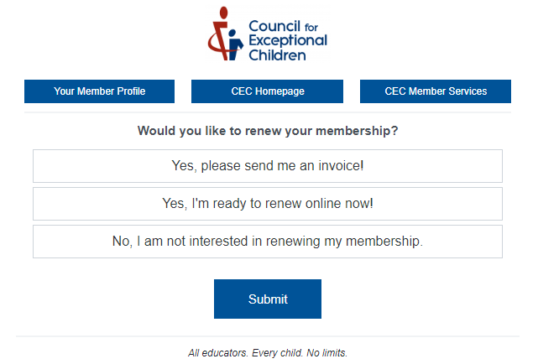
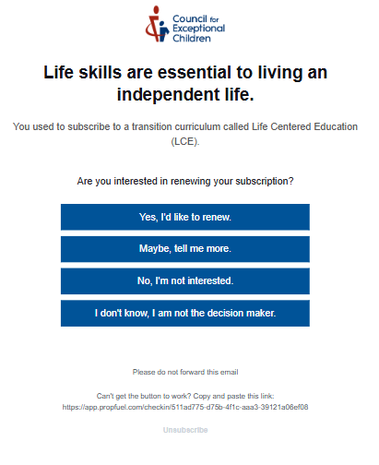
Renewal Emails
Remind people when their membership is going to expire
If possible, set up automated campaign so the work is done for you!
Notes:
Renewal Emails
Purpose: Remind members about their upcoming membership renewal and encourage them to continue their involvement with the organization.
Content Ideas: Highlight the value and benefits of membership, showcase recent accomplishments or new resources, and provide clear instructions for renewing. Consider offering an incentive, such as a discount for early renewal.
Best Practices: Send multiple reminders, starting well before the renewal date. Use a sense of urgency in the final reminder, and make the renewal process as simple as possible.

Slide 10
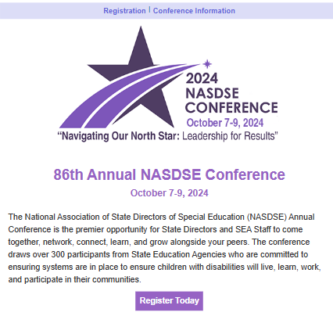
Promotional Emails
The standard “marketing email”
Promoting an event, webinar, resource, etc.
Incredibly effective but should not be abused
Notes:
Promoting Upcoming Events or Offerings
Purpose: Inform members about upcoming events, webinars, workshops, or new products and services.
Content Ideas: Include event details (date, time, location, speakers), benefits of attending, and registration information. Use engaging visuals and CTAs to drive attendance or participation.
Best Practices: Segment your audience to tailor messages to those most likely to be interested. Use compelling subject lines and teaser content to create excitement and anticipation.

Slide 11
What We Mean by “Abuse”
Not every member is going to care about everything you do, and that’s OK!
If you keep sending content they don’t care about, they’ll unsubscribe or just stop interacting!
Notes:
Not everything we email is relevant to everyone. That’s okay! Membership organizations offer a ton of different services and resources to serve a wide range of membership types. You cannot capture all of these in a single email. That being said, be careful about over-sending or spamming your audiences. With the average professional receiving approximately 120 emails every day, you need to ensure that you are going overboard or bothering them with too much information. Information overload is often cited as a reason for people to stop opening emails or unsubscribing.

Slide 12
Segmentation + Targeting
Email allows you to segment your audience more than any other medium
Instead of sending an email to everyone, ask yourself “Why do I think this person will want to know about this event?”
The more you know about your members, the better you can identify what they may want to get messages about!
Notes:
Email allows for more detailed audience segmentation compared to other communication channels.
By segmenting your audience based on specific criteria, you can tailor your messages to resonate with different groups, leading to more personalized and relevant communications.
Asking the Right Questions
Guiding Question: "Why do I think this person will want to know about this event?"
This question helps you focus on the interests and needs of your audience, ensuring that your emails are relevant and valuable to the recipients.
Example: If you're promoting a professional development event, consider which members have previously shown interest in similar events, or who have expressed a desire for further training.
The more information you have about your members—such as their interests, past behaviors, and engagement levels—the better you can tailor your communications.
Use member data to create targeted segments, such as new members, long-term members, those who frequently attend events, or those who have expressed interest in specific topics.
Targeted messaging can lead to higher engagement rates, improved member satisfaction, and increased attendance at events or participation in programs.
Consider creating segments based on demographics (age, location), professional interests, engagement history, or membership tenure.

Slide 13
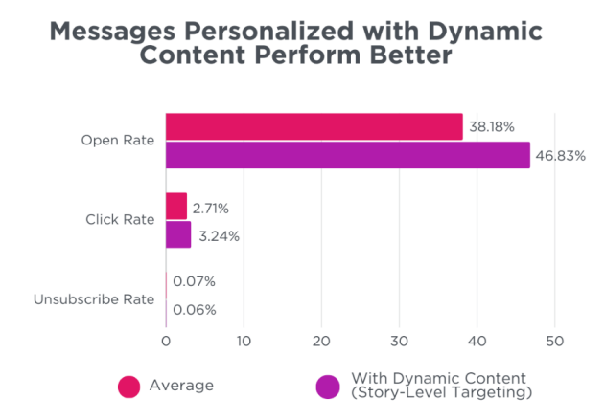
Notes:
This graph demonstrates the impact of personalizing your email content. When you are sending generic emails to your entire email list, it’s like throwing everything at the wall and seeing what sticks. Implementing personalization allows you send the best possible emails and get better outcomes.

Slide 14
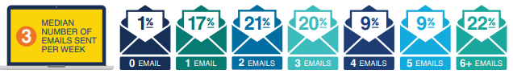
Frequency
Associations with renewal rates of 80% or higher send only two emails to members per week.
Sending emails is not a “no-cost” solution to everything! It is a short-term Band-Aid with long-term impacts!
6+ emails is a sign you aren’t segmenting enough
Notes:
1. Optimal Email Frequency for High Renewal Rates
Key Statistic: Associations with renewal rates of 80% or higher typically send only two emails to members per week.
Insight: This suggests that a moderate frequency of communication can be effective in maintaining member engagement and satisfaction without overwhelming them.
Action Point: Focus on quality over quantity in your email communications. Make each email valuable and relevant to your members.
2. The Cost of Over-Sending Emails
Important Consideration: Sending too many emails is not a “no-cost” solution to all communication needs.
Explanation: While it may seem easy to send frequent emails, it can lead to negative consequences such as email fatigue, increased unsubscribe rates, and decreased member engagement.
Long-Term Impact: Over-relying on frequent emails as a solution can harm your relationship with members over time, potentially reducing their likelihood of renewing memberships.
3. Signs of Insufficient Segmentation
Indicator: Sending 6+ emails per week is a sign that you may not be segmenting your audience effectively.
Implication: High email frequency often results from trying to communicate different messages to all members at once, rather than tailoring content to specific segments.
Solution: Reevaluate your segmentation strategy. Ensure you are dividing your audience into meaningful groups based on interests, engagement, and other relevant criteria. This allows you to send more targeted and relevant emails, reducing the need for high-frequency communication.
4. Recommendations for Effective Email Frequency
Balanced Approach: Aim for a frequency that keeps your members informed and engaged without overwhelming them. Two emails per week is a good benchmark for many associations.
Monitor and Adjust: Regularly review engagement metrics like open rates, click-through rates, and unsubscribe rates to gauge how your frequency is impacting your members. Be prepared to adjust based on these insights.
Focus on Relevance: Prioritize sending emails that offer clear value to each segment of your audience. Relevant content is more likely to be welcomed and acted upon.

Slide 15
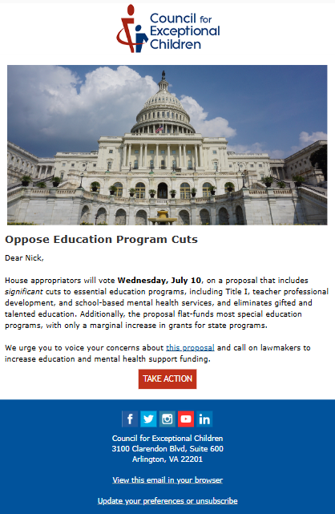
Elements of a Good Email
Succinct subject line (don’t forget preview text)
Compelling image
Personalized greeting
A clear call to action
Consistent with branding
Works across all platforms and devices
Notes:
1. Succinct Subject Line (and Preview Text)
Key Point: The subject line is the first thing recipients see and should grab their attention quickly.
Best Practices: Keep it concise, relevant, and intriguing. Use action-oriented language or create a sense of urgency. Don’t forget the preview text, which offers a brief preview of the email content and can further entice recipients to open the email.
2. Compelling Image
Purpose: Images help make emails more engaging and visually appealing.
Best Practices: Use high-quality, relevant images that support the message of your email. Ensure images are properly optimized for fast loading and are accompanied by alt text for accessibility.
3. Personalized Greeting
Key Point: Personalization helps build a connection with the recipient.
Best Practices: Address the recipient by their first name if possible. Personalization can also include tailoring the content based on past interactions or preferences, making the email more relevant to the reader.
4. A Clear Call to Action (CTA)
Purpose: The CTA directs the recipient on what to do next.
Best Practices: Make your CTA clear, concise, and actionable. Use strong verbs and make it stand out visually (e.g., with a button or distinct color). The CTA should be easy to find and encourage immediate action, such as “Register Now,” “Learn More,” or “Join Us.”
5. Consistent with Branding
Key Point: Consistency in branding builds trust and recognition.
Best Practices: Ensure the email design, tone, and language align with your organization's brand identity. Use consistent colors, fonts, logos, and other brand elements. This helps reinforce your brand’s presence and credibility.
6. Works Across All Platforms and Devices
Importance: With a diverse range of devices and email clients, ensuring your email is accessible and functional for everyone is crucial.
Best Practices: Use responsive design to ensure your email looks good on both desktop and mobile devices. Test emails on various platforms and email clients to check for compatibility. Keep the layout simple and avoid elements that may not display correctly, such as certain fonts or large images.

Slide 16
Must-Haves for CAN-SPAM Compliance
A way to unsubscribe
A physical address for your organization
An accurate subject (no bait-and-switch)
Indication if something is an advertisement or sponsored content
Notes:
There are legal implications for sending emails. The CAN-SPAM Act is a law that sets the rules for commercial email and establishes requirements for commercial messages, gives recipients the right to have you stop emailing them, and spells out tough penalties for violations. The FTC enforces the CAN-SPAM Act and the accompanying CAN-SPAM Rule.
Despite its name, the CAN-SPAM Act doesn’t apply just to bulk email. It covers all commercial messages, which the law defines as “any electronic mail message the primary purpose of which is the commercial advertisement or promotion of a commercial product or service,” including email that promotes content on commercial websites. The law makes no exception for business-to-business email. That means all email – for example, a message to former customers announcing a new product line – must comply with the law.
Your emails must include:
A way to unsubscribe
A physical address for your organization
An accurate header – nothing misleading
Indication if the content is sponsored

Slide 17
Accessibility Considerations
Alt-text for images
Clear and simple language
Color-contrast
Mobile responsiveness
Notes:
Given CEC’s mission, it is especially vital to ensure that we are integrating accessibility into all of our communication. Accessibility features help everyone.
Alternative Text, or alt text, describes a digital image. Alt text helps those with visual disabilities understand what is pictured and appears on the webpage when an image fails to load. Alt text ensures that those utilizing screen readers and other assistive devices can experience what you are communicating.
In the special education field, it can feel like we speak our own language. With many affiliated with academics, and the various legal acts involved, we can end up speaking in acroymns. But remember that our membership comes from a variety of backgrounds and experience levels. When you writing your emails, keep the language straightforward and simple. Fully spell out the acryonms at least once and remember that emails are meant to catch attention and direct people to the right place, not deliver everything in a single place. (Think of movie trailers – keep it simple, give a taste, but don’t spoil the entire thing)
Utilizing color in your communications can be visually pleasing but can create barriers for those who cannot distinguish between certain colors and those with visual disabilities. It’s important to ensure that you are using an accessible color palette to ensure that your content is seen and understood by your audience.
You can utilize tools like ColorSafe to create an accessible color palette and tools like Accessible Web’s Color Checker to check the accessibility of your website’s color palette.
Nearly everyone has a smartphone nowadays and tend to read their emails on their devices. Smartphones tend to have more accessibility features baked in. Make sure when you are creating emails, it appears correctly on phones.

Slide 18
Metrics and Success
Deliverability Rate
Open Rate*
Clickthrough Rate
Unsubscribe Rate
Time spent in email*
Goal completions
Notes:
There are a lot of metrics available. Consider what your goals are for your emails when measuring success. For example, if you want people to sign-up for an event, check out how many link clicks you have and at your registration numbers. If you are sharing important information, consider looking at the open rate and time spent.

Slide 19
Metrics and success
Deliverability Rate
Open Rate*
Clickthrough Rate
Unsubscribe Rate
Time spent in email*
Goal completions
Deliverability
Anything under 90% is a sign of a problem
A low deliverability rate can lead to email platforms thinking you are spam
Notes:
. Deliverability Rate
Definition: The percentage of emails that successfully reach the recipients' inboxes.
Importance: A high deliverability rate indicates that your emails are not being blocked or filtered out as spam, ensuring your messages reach your audience.

Slide 20
Metrics and success
Deliverability Rate
Open Rate
Clickthrough Rate
Unsubscribe Rate
Time spent in email*
Goal completions
Open Rate
No longer the go-to metric for email
Because of Apple Privacy changes from 2001, open rates are inflated and unreliable
Can be used to compare 2 emails going to same audience
Notes:
Open Rate
Definition: The percentage of recipients who open your email.
Importance: Open rate measures the effectiveness of your subject lines and preview text in grabbing attention. It gives insight into how engaged your audience is with your emails.

Slide 21
Metrics and success
Deliverability Rate
Open Rate
Clickthrough Rate
Unsubscribe Rate
Time spent in email*
Goal completions
Clickthrough Rate
Market average is around 1.5%-2%
Different types of emails get different types of engagement, so keep that in mind
Pay attention to what in your emails are getting clicks!
Notes:
. Clickthrough Rate (CTR)
Definition: The percentage of recipients who clicked on one or more links within your email.
Importance: CTR indicates the effectiveness of your email content and CTAs. It shows how compelling and relevant your message was to encourage further action.

Slide 22
Metrics and success
Deliverability Rate
Open Rate
Clickthrough Rate
Unsubscribe Rate
Time spent in email*
Goal completions
Unsubscribe Rate
Association average unsubscribe rate is .07%
That can add up to a lot if you send too many emails!
Not necessarily a bad thing, especially if you have message categories
Notes:
Definition: The percentage of recipients who choose to unsubscribe from your email list.
Importance: A rising unsubscribe rate can indicate issues with email content, frequency, or relevance. It's crucial to monitor and address this to maintain a healthy subscriber base.

Slide 23
Metrics and success
Deliverability Rate
Open Rate
Clickthrough Rate
Unsubscribe Rate
Time spent in email*
Goal completions
Time spent in email
Not a metric all email marketing platforms offer
Very useful for gauging success of something like a newsletter
Notes:
Time Spent in Email
Definition: The average amount of time recipients spend reading your email.
Importance: This metric provides insights into how engaging your content is. Longer time spent in email can suggest that the content is engaging and informative, while a short time may indicate that the email is not capturing attention.

Slide 24
Metrics and success
Deliverability Rate
Open Rate
Clickthrough Rate
Unsubscribe Rate
Time spent in email*
Goal completions
Goal completions
What was the purpose of the email?
Even if you don’t have GA to track conversions, you can still look for correlations!
Notes:
Goal Completions
Definition: The number of recipients who complete a specific action you want them to take, such as registering for an event or making a purchase.
Importance: This metric is crucial for measuring the success of your email campaigns in achieving your desired outcomes. It helps you assess the effectiveness of your emails in driving conversions or other key actions.

Slide 25
Experimenting
Not all best practices work for everyone. Your audience is unique to you!
Things to consider A/B testing:
  Subject lines
  Personalization
  Images
  CTAs
Notes:
A/B testing, also known as split testing, is a method of comparing two versions of an email to determine which one performs better.
It helps identify what resonates most with your audience, enabling you to optimize your emails for higher engagement and conversions.
Subject Lines: Test different subject lines to see which one generates a higher open rate. Variations can include different wording, lengths, or the inclusion of emojis.
Content: Compare different email content, such as the body text, headlines, or the tone of the message, to find what appeals most to your audience.
Calls to Action (CTAs): Experiment with different CTA wording, button colors, and placements to determine what drives the most clicks and conversions.
Images and Visuals: Test different images or the use of visuals versus text-heavy emails to see which one better captures attention.
Send Times: Compare different send times or days of the week to identify when your audience is most likely to engage with your emails.
Best Practices for A/B Testing
Test One Variable at a Time: To accurately determine what caused the difference in performance, only change one element between the two versions.
Ensure a Large Enough Sample Size: A small sample size can lead to inconclusive or misleading results. Aim for a sample that provides statistically significant data.
Run Tests Simultaneously: Send both versions at the same time to control for external factors like time of day or day of the week that could affect results.
Iterate and Learn: A/B testing is an ongoing process. Use each test as a learning opportunity to continually improve your email marketing strategy.

Slide 26
THANK YOU
Nick Cafferky, Email Marketing Manager
  ncafferky@exceptionalchildren.org
Hannah Hickman, Marketing Manager
  hhickman@exceptionalchildren.org

