Slide 2
Your Website + Your Goals = A Success Story
Mason Shelby, Director, Digital Content
Lara Fahey, Specialist, Digital Content

Slide 3
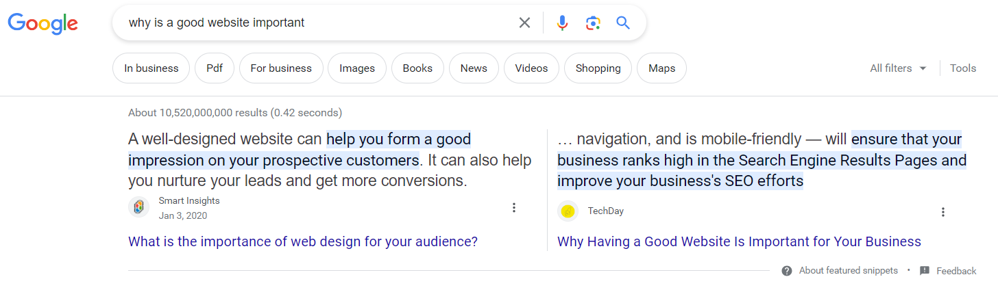
Why is a good website important?

Slide 4
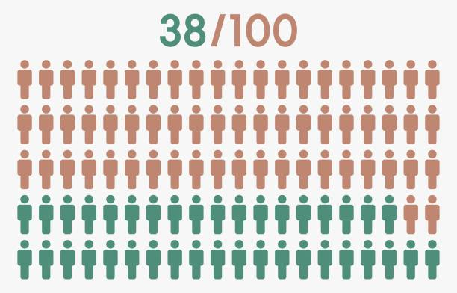
First Impressions
Notes:
According to a recent study conducted by Stanford University….
38% will stop engaging if the content or layout is unattractive
First impressions are 94% design related
75% of website credibility comes from design
https://www.paradigmmarketinganddesign.com/get-it-together-people-why-website-first-impression-statistics-matter/

Slide 5
Where do we start? Take a step back…
Clear call to action
Reorganize your content for easy navigation
Assess your branding
Check for broken links and outdated/irrelevant information
Identify text-heavy areas (and where you need images)
  Use direct language & titles
Identify areas for member testimonials

Slide 6
Standard Section Enhancements
About Us
Mission/purpose statement
Founding
Board
Bylaws
Events
CEC Events
Virtual
Conferences
Networking Opportunities
Non-CEC Events
Membership
Link to CEC
Member-only benefits
New Member Onboarding Webinars
Get Involved
Communications & Blog feature
Affiliated groups

Slide 7
Content Area Recommendations
Link back to CEC’s membership page
Include an up-to-date contact in the footer
No blank/dead end pages/links
Updated board information
Old conference/event pages are hidden or are only accessible through a past events page

Slide 8
Optimizing Your Webpage in 2 Steps
Define Your Goals
Design Your Webpage
Assess and Re-design (as Needed)

Slide 9
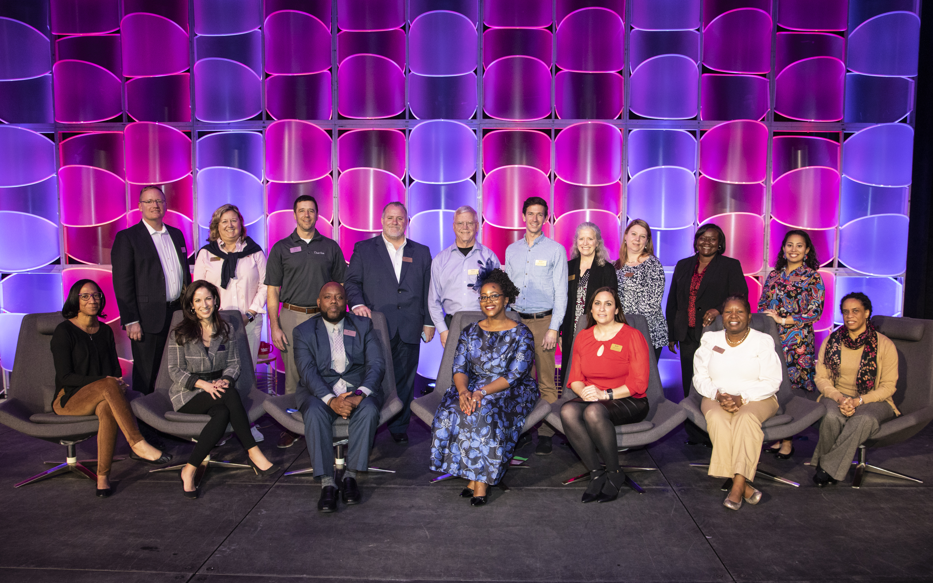
Defining Your Goals
What are the goals of your component?
Who is your audience?
Sample Goals:
  Increase awareness of, and attendance at, an event
  Increase member (and non-member) engagement
  Increase the number of website views/sessions
  New member registrations/renewals

Slide 10
Designing Your Webpage
Does the layout/hierarchy of your website reflect your goals?
Is the purpose/goal explicitly stated? Why not?
Who is your audience?
How easy is it for users to convert (register, sign up, purchase, etc)?
Which design choices increase engagement/conversion, and which introduce clutter
Identify keywords, hero image, “elevator pitch”

Slide 11

Assess: Webpage Report Card
Clearly defined goal?
Descriptive title?
Overview description/instruction?
Strong hero image?
Using alt tags on images?
Using good/relevant keywords appropriately?
Related content or “next page”?

Slide 12

1. Clearly defined goal?
What is the goal(s) of your page?
Your goal(s) should be obvious
Your goals should be prioritized
Achieving your goal(s) should be easy/painless for the user
What’s your “elevator pitch” for the purpose of this webpage?

Slide 13

2. Descriptive Title?
Are you using a descriptive title on your page?
Is your title concise?
Is your title direct and un-mysterious?
Does it reflect what a user would enter into a search engine?

Slide 14

3. Overview description/instruction?
Does your page have an overview description or instructions for the user?
In the overview, you can explicitly state:
  Who this webpage is for? Call out your audience,
  they will feel “seen”!
  Remind or tell them: what is the goal?
  Other background information / context?
  “Am I in the right place?”

Slide 15

4. Strong hero image?
What is a hero image?
  A hero image is a large, attention-grabbing picture shown in the above-the-fold area of the webpage or email.
1 Great Picture > 10 Okay Pictures
Pictures with People > Pictures without People
Repeated, consistent use of hero image across channels (website, email, social media)

Slide 16

5. Using alt tags on images?
Are you using alt tags?
Accessibility is an inseparable goal of CEC
Also helps with SEO!

Slide 17

6. Using good/relevant keywords?
Are you including keywords in the content of your webpage?
Does it reflect what a user would enter into a search engine?
When to use thesaurus? Finding the right balance between repeating the same words or phrases enough to positively influence search engines without being too redundant

Slide 18
7. Related content or “next page”?
What should a user do after they’ve finished engaging with your webpage? Encourage them to stay by including links to other related pages on your website!
A general goal of any webpage should be to keep user on your website (rather than leaving your website). The more time a user spends on your website, the more engaged they will be with the content and more likely they are to convert.
Adding 1 or 2 embedded hyperlinks provides pathways to other relevant content on your website, is good for SEO, and keeps users engaged
Adding 1 or 2 explicit, separate promotional callouts via buttons, graphics, and other design choices

Slide 19
Webpage Report Card: Grading Time!
How did we do?
Wins to celebrate?
Areas to work on / improve?

Slide 20

Thank You!
Mason Shelby, Director, Digital Content
Lara Fahey, Specialist, Digital Content
Email us: websubmit@exceptionalchildren.org
Submit a request: exceptionalchildren.org/webrequest

